Slide 1

Requisition Approvers
Training for SAP Requisition Approvals

Slide 2
Responsibilities of an Approver
  By approving SAP Requisitions, the Approver is responsible for affirming the following:
  The purchase is in compliance with all policies and procedures of the University.
  The purchasing method selected by the Requisitioner is correct based on the nature of the transaction.
  The funding type selected is valid for the purchase based on the nature of the transaction.
  Funds are available for the purchase
  The documentation has been reviewed and all relevant information within the transaction is valid and correct.

Slide 3
Approver Levels
Multiple approvals may be required depending on the amount of SAP Requisition.
Total value of document | Approval(s) Required
Less than $10,000 | Level 1 only
$10,000 or greater | Level 1 & Level 2
Note: Special additional approvals are required for purchases of vehicles and computer equipment.

Slide 4
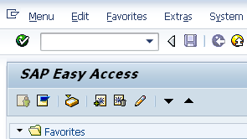
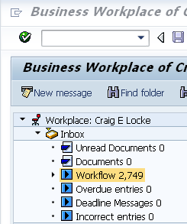
SAP Requisition – Access Business Workplace
Within SAP, the Easy Access screen will open in a new window. Click the Inbox icon to access Business Workplace.
From Business Workplace, click Workflow within the Inbox to access documents awaiting approval.

Slide 5
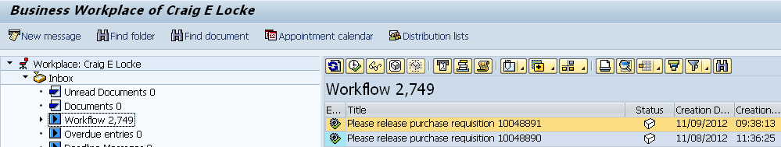
Requisition – Access Documents
Requisitions awaiting approval will appear on the right side of Business Workplace
Double-click into the workflow item to access the document

Slide 6
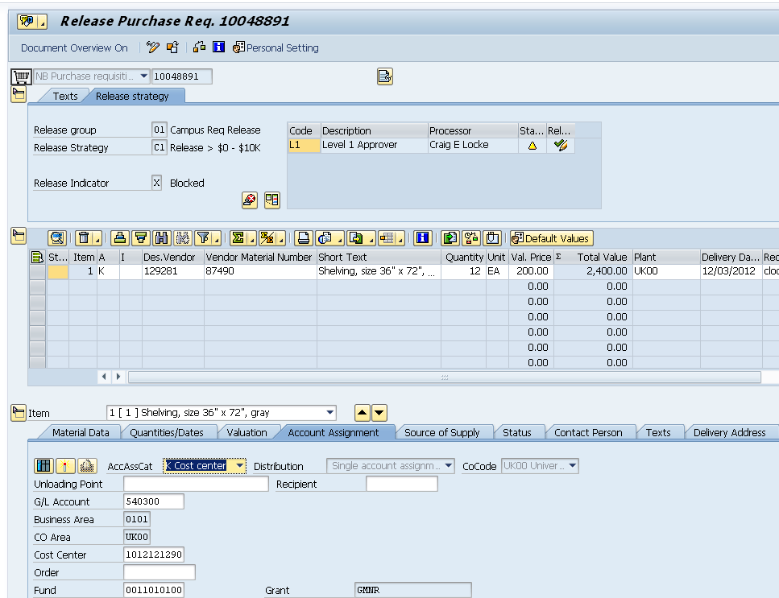
SAP Requisition – Major Components
Header Section contains Text notes and Release Strategy tabs
Item Overview section contains items requested for purchase with supplier, description, quantity and price.
Details Section contains Account Assignment, Delivery information, etc.

Slide 7
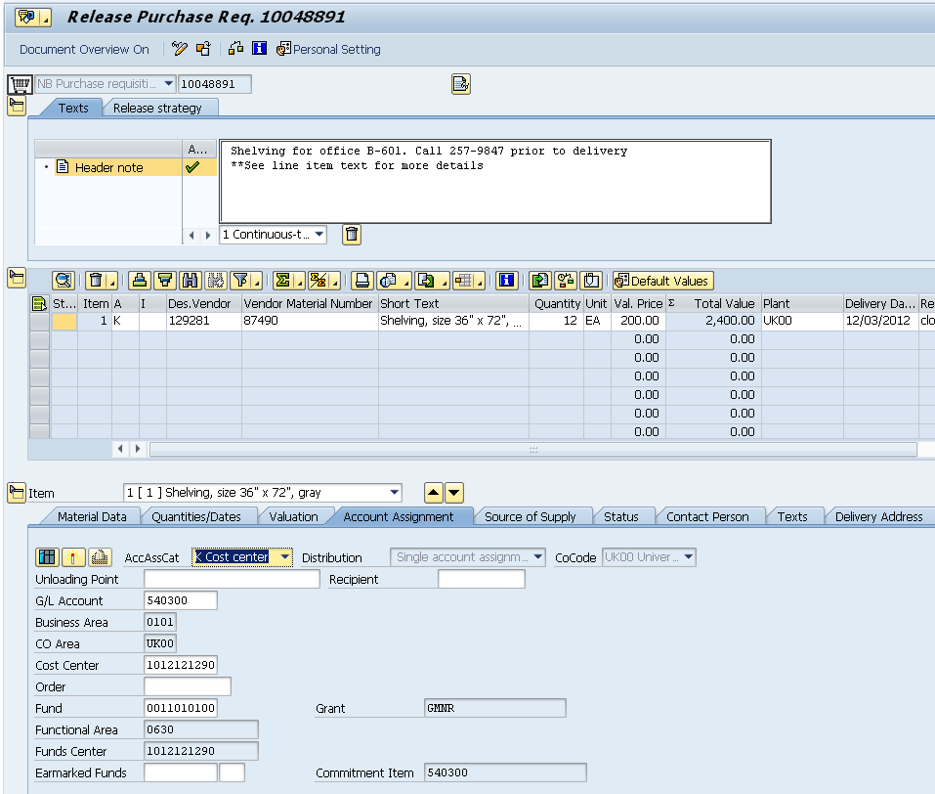
SAP Requisition – Approval Steps
1. Click Header text tab to review notes
2. Confirm description, quantity, price, delivery date, etc. are correct.
3. Confirm Account Assignment information is correct, in particular that the correct G/L Account and cost object or WBS element are entered.

Slide 8
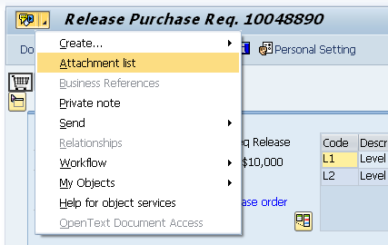
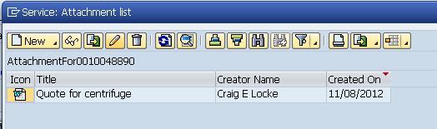
SAP Requisition – Where to Find Attachments
Attachments (e.g., supplier quote) commonly accompany a requisition. Approvers can access and view attachments if needed.
1. Click black triangle on right side of Services for Object icon
2. Click Attachment List
3. Double click on Attachment to download and view

Slide 9
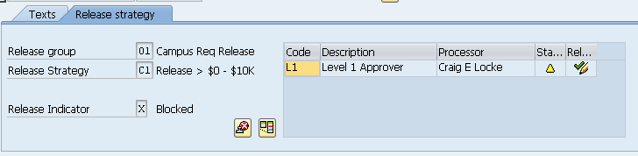
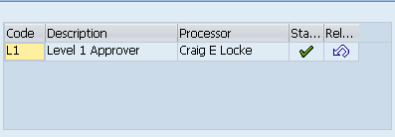

SAP Requisition – Complete Approval
4. To Approve, click the green check-mark icon on Release Strategy tab
Status will turn from yellow to green
5. Click the Save icon at the top of the requisition to finish

Slide 10
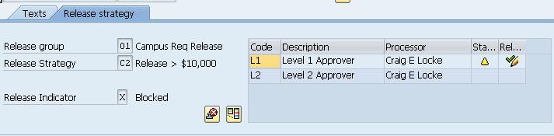
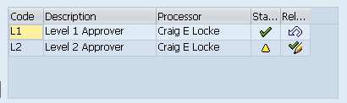
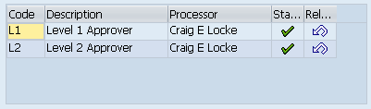
SAP Requisition – Complete Level 2 Approval
Requisitions that exceed $10K require second level approval. In some cases the same person holds both levels of authority and can process both approvals from the same screen.
1. Click check for Level 1
2. Click check for Level 2
Status for both levels complete
3. Click Save to finish

Slide 11
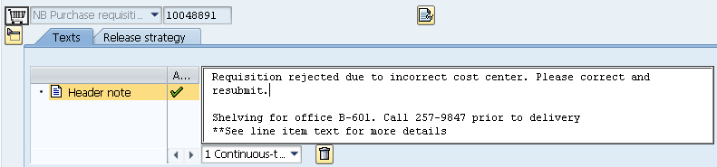
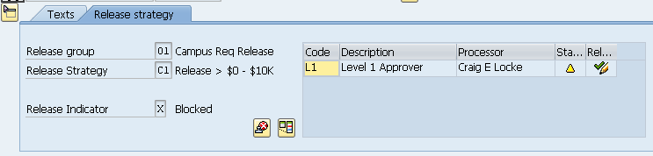
SAP Requisition – Reject Requisition
The Approver for an SAP Requisition can choose to reject the document if needed.
1. Select Text tab and enter reason for rejection
2. Click the Reject icon on the Release Strategy tab
3. Click Save to finish. The Requisitioner must make changes if needed and re-order.

Slide 12
SAP Requisition – Edit
If an SAP Requisition needs revisions, at the Approver’s discretion, s/he can perform the edit and approve rather than rejecting the document.
Examples of possible edits:
  Add or delete line items
  Change cost assignment
  Change delivery address
  Add attachments
Edits must be completed prior to approving and can be completed while the document is in approval mode.

Slide 13
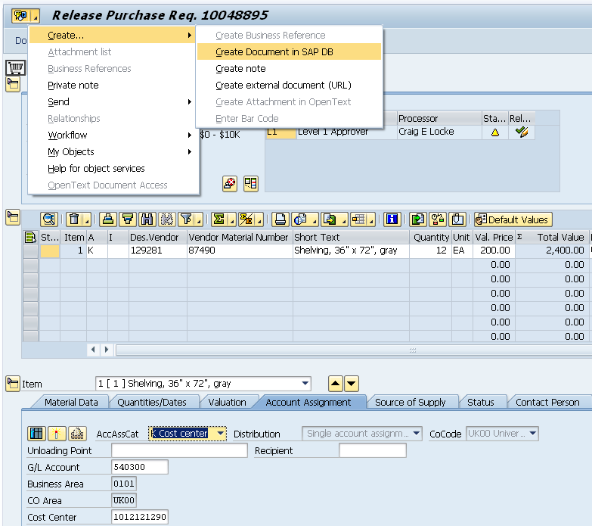
SAP Requisition – Edit
Approver can add their own notes or attachments
Modify or delete line item data
Modify/overwrite account assignment information, etc.

Slide 14
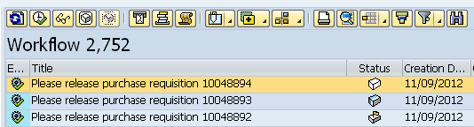
SAP Requisition – Understanding Status Icons
The manner in which an Approver handles requisitions within Business Workplace affects the document’s status as well as other Approvers’ access to the document.
White icon means the requisition has not been accessed and is available to all applicable approvers.
Blue and white icon means requisition is In-Process. An Approver has accessed the document, but not yet approved it. Important: This action removes it from other Approvers’ inboxes.
Flag icon means an Approver has intentionally Reserved the document for their approval only. As with an In-Process requisition, this removes it from all other Approvers’ inboxes.

Slide 15
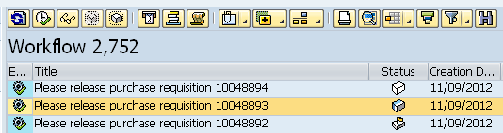
SAP Requisition – Understanding Status
The toolbox at the top of the Workflow section has icons for managing status
of requisitions.
To reserve a requisition for your approval only, highlight the document and click Reserve icon.
If an In-Process or Reserved requisition needs to be re-delivered to other Approvers’ inboxes, highlight the document and click the Replace icon.

