Slide 1



Strategic Sourcing
Business Case
Title: XXXX
﻿An Equal Opportunity University

Slide 2

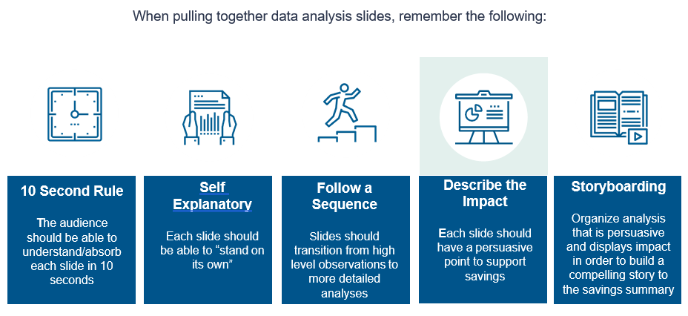
How To Prepare PowerPoint (Delete this slide when case is complete)
Category Specialists may opt to use a PowerPoint file to develop and present their business case rather than the Word template.
This template is mirrored on those provided and suggested by Huron
PowerPoint Tips:
Ensure to use the same font on all slides for the same type elements
  Headings will have one font size, general body text will have all same size, charts and tables should have consistent font size
  Body font size should be at least 20, preferably 22-24
Label all axes on charts
Bar charts are generally preferred over pie charts
Use the $ symbol when discussing spend
Make graphs/charts sized so they are easy to read
Place some sort of summary on each slide to demonstrate why the info provided is important to guide the reader through the document.
Does all content add value to the presentation?
Do chart(s) pass the 5-second rule? (The reader should be able to digest the intent of a chart within 5 seconds of viewing).
Important: Delete this slide when finished with your Business Case. If you have a Table of Contents developed, you will need to update the TOC page numbers after slide deletion.
﻿An Equal Opportunity University

Slide 3
Purpose: Outline the Business Case and direct readers to the pertinent sections
Indexes and Tables of Content serve to outline the topics included in the business case
Index bullets/numbers should correlate with the main heading of each slide and/or section
Keep brief and to the point
Delete this box when done.
Index/Table of Contents
XXXX
﻿An Equal Opportunity University

Slide 4
Purpose: Internal and external perspectives are used to set the context for the business case.
Utilize industry observations to:
Introduce the business case
Support the main leverage points of the business case.
Cover research specific to the area industry, suppliers, and specific commodity items
Typical observations provide insight on:
Industry competition
Industry mechanisms
Trends in the commodity
Pricing trends.
Use internal observations to:
Provide specific data facts
Emphasize internal facts that parallel main business case findings
Present facts specific to the commodity and current University situation learned through contract reviews, data gathering, interviews with key stakeholders, etc.
Internal observations typically include:
Commodities purchased / sources
Purchasing trends
Forecasted purchasing
Organizational observations
Best practices
Delete this box when done.
Observations
XXXX
﻿An Equal Opportunity University

Slide 5
Purpose: Understand main area suppliers, historical spend, and key cost drivers. Typically, there are a couple of slides here with charts/tables/dashboards. Use the Excel templates in the 20-Huron folder as needed to complete and paste into the slide(s).
Accounts payable (A/P) and purchasing card (P-Card) data can be used to perform a high-level analysis of spend
Spend analysis can take many forms, but is usually a combination of:
A/P and P-Card Category Analysis:
  Presents spend of all suppliers in a particular area, highlighting suppliers reviewed
  Multiple suppliers analyzed
  Shows total area size spend
Historical Analysis:
  Supplier spend over several years
  Emphasizes significant account growth
Delete this box when done.
Spend Analysis
XXXX
﻿An Equal Opportunity University

Slide 6
Purpose: Understand main area suppliers, historical spend, and key cost drivers. Typically, there are a couple of slides here with charts/tables/dashboards. Use the Excel templates in the 20-Huron folder as needed to complete and paste into the slide(s).
Purchasing (PO), Accounts payable (A/P), and purchasing card (P-Card) data can be used to perform a high-level analysis of spend
Spend analysis can take many forms, but is usually a combination of:
PO, A/P and P-Card Category Analysis:
  Presents spend of all suppliers in a particular area, highlighting suppliers reviewed
  Multiple suppliers analyzed
  Shows total area size spend
Historical Analysis:
  Supplier spend over several years
  Emphasizes significant account growth
Delete this box when done.
Spend Analysis
XXXX
﻿An Equal Opportunity University

Slide 7
Purpose: Give the audience a synopsis of the current agreement, terms and conditions, and key cost drivers.
Provide a brief overview of key contract terms and value-add observations for important area suppliers
Key areas include:
Effective date
Termination date
Termination clause
Pricing
Financial Incentives
Delete this box when done.
Contract Overview
XXXX
﻿An Equal Opportunity University

Slide 8
Purpose: Present accurate and detailed findings that support savings opportunities. Typically, this consist of a couple of slides. Use the Excel templates in the 20-Huron folder as needed to complete and paste into the slide(s).
Present accurate and detailed findings that support savings opportunities using any number of slides and analyses necessary
Make a new, sequential point on each slide and tie to the savings summary
Analysis slides may include, but are not limited to:
Demand management
Pricing analysis
Discount analysis
Comparative pricing
Market analysis
Delete this box when done.
Data Analysis
XXXX
﻿An Equal Opportunity University

Slide 9
Purpose: Present accurate and detailed findings that support savings opportunities. Typically, this consist of a couple of slides. Use the Excel templates in the 20-Huron folder as needed to complete and paste into the slide(s).
Present accurate and detailed findings that support savings opportunities using any number of slides and analyses necessary
Make a new, sequential point on each slide and tie to the savings summary
Analysis slides may include, but are not limited to:
Demand management
Pricing analysis
Discount analysis
Comparative pricing
Market analysis
Delete this box when done.
Data Analysis
XXXX
﻿An Equal Opportunity University

Slide 10
Purpose: Conclusion to the business case which highlights the key savings levers, reiterates observations, and estimates opportunity.
The savings summary is the key output reflecting the sourcing process savings potential
Quantify the opportunity and clearly define the impact of implementation decisions on achieving savings
Use comment fields in order to connect points made by analysis slides; new thoughts should not be introduced
Several methods exist to both measure and present savings; the method used should be determined by the organization’s standards and culture
Delete this box when done.
Savings Summary
XXXX
﻿An Equal Opportunity University

Slide 11
Purpose: Assist with savings implementation and determining next steps and roles and responsibilities.
Utilize action plans to assist with savings implementation
All plans will vary, but generally should include a schedule of activities, primary tasks, responsibility, and status
Action plans that are placed in business cases are preliminary and primarily serve to facilitate discussion among key stakeholders
Delete this box when done.
Action Plan
XXXX
﻿An Equal Opportunity University

Slide 12
Purpose: Highlight the potential impacts on and considerations for implementation of savings opportunities.
Follow savings summary assumptions and detail potential impacts to the achievable savings opportunities
Address business case findings and take into account the commodity area current state at the organization
Detail potential implementation paths and associated benefits and challenges that may occur
Utilize color-coding or numbered measurements as a simple way to demonstrate strategy pros and cons
Delete this box when done.
Strategy Considerations
XXXX
﻿An Equal Opportunity University

Slide 13
Purpose: Exhibit slide(s) that are not critical to the Business Case but contain relevant analytical support. These may consist of completed Excel templates or dashboards from the 20-Huron Templates folder on the network drive.
Exhibits are pieces of analysis that are not key to the business case storyboarding, but are relevant information about the supplier, organization, and/or commodity
May not be presented, but are in the document in case additional support is needed
Can provide more detailed explanations of calculations or term definitions
Delete this box when done.
If no additional exhibits, delete this slide entirely
Exhibit
XXXX
﻿An Equal Opportunity University

Slide 14
Purpose: Exhibit slide(s) that are not critical to the Business Case but contain relevant analytical support. These may consist of completed Excel templates or dashboards from the 20-Huron Templates folder on the network drive.
Exhibits are pieces of analysis that are not key to the business case storyboarding, but are relevant information about the supplier, organization, and/or commodity
May not be presented, but are in the document in case additional support is needed
Can provide more detailed explanations of calculations or term definitions
Delete this box when done.
If no additional exhibits, delete this slide entirely
Exhibit
XXXX
﻿An Equal Opportunity University

Slide 15

Questions?
﻿An Equal Opportunity University

