Slide 1
Enterprise Amazon Business Account amazon Shoppers

Slide 2
Table of contents
What is Enterprise Amazon Business Account?
Enterprise Amazon Business Account Benefits
Amazon Purchases in Higher Education
Access To Platform
Amazon Business Shopping Experience Key Points
Restricted Soft- and Hard-Blocked Items
Departmental Approvals
Procurement Services Approvals
Step-by-Step Sample Order and Checkout
Resources and Support
2
Notes:
Table of Contents:
What is Enterprise Amazon Business Account?
Enterprise Amazon Business Account Benefits
Amazon Purchases in Higher Education
Access To Platform
Amazon Business Shopping Experience Key Points
Restricted Soft- and Hard-Blocked Items
Departmental Approvals
Procurement Services Approvals
Step-by-Step Sample Order and Checkout
Resources and Support

Slide 3
1-What is enterprise amazon business Account?
Amazon Business Account (BA) is an enterprise-wide platform for purchase of Amazon products at an institutional level.
Originally planned as an SRM Ariba e-catalog, the Amazon Business Account instead is an independent platform accessible through myUK Enterprise Services tab.
Utilizes a University employee’s LinkBlue ID and password for Single Sign-On (SSO) for convenience and ease.
Eliminates the need for staff and departments to purchase with their personal Amazon.com accounts or for colleges/units to establish and pay for their own Amazon Business Accounts or Prime Memberships.
3
Notes:
Amazon Business Account (BA) is an enterprise-wide platform for purchase of Amazon products at an institutional level.
Originally planned as an SRM Ariba e-catalog, the Amazon Business Account instead is an independent platform accessible through myUK Enterprise Services tab.
Utilizes a University employee’s LinkBlue ID and password for Single Sign-On (SSO) for convenience and ease.
Eliminates the need for staff and departments to purchase with their personal Amazon.com accounts or for colleges/units to establish and pay for their own Amazon Business Accounts or Prime Memberships.

Slide 4
1-What is enterprise amazon business Account?
In response to input/feedback from departments for a single dedicated, centralized connection to buy needed items from Amazon.
Provides departmental/college/unit Business Officers and Procurement Services needed tools for proper visibility, management, and oversight of Amazon products purchased
Improves compliance for Amazon purchases at the institutional level by ensuring appropriate items are purchased and overall supplier engagement is properly managed
Improves management of sales tax and exemptions as they apply to Amazon purchases
4
Notes:
Deployment of the enterprise account is in response to input/feedback from departments for a dedicated, centralized connection to buy needed items from Amazon.
It provides departmental/college/unit Business Officers and Procurement Services needed tools for proper visibility, management, and oversight of Amazon products purchased
It improves compliance for Amazon purchases at the institutional level by ensuring appropriate items are purchased and overall supplier engagement is properly managed
Improves management of sales tax and exemptions as they apply to Amazon purchases

Slide 5
2-Enterprise Amazon Business Account Benefits
Access to millions of additional products available only to Amazon Business customers
Business pricing is frequently better value and available only for registered Amazon Business customers. It also includes quantity discounts on eligible items.
Automatic tax-exempt purchasing on items sold by Amazon LLC & participating 3rd party sellers
Access to the University account on mobile devices through the Amazon Business Mobile App (iOS App or Android App) (Post Go-Live)
Access to a specialized Amazon Business Customer Service team
5
Notes:
What are some of the benefits?
It provides access to millions of additional products, available only to Amazon Business customers
Business pricing is frequently better value and available only for registered Amazon Business customers. It also includes quantity discounts on eligible items.
Automatic tax-exempt purchasing on items sold by Amazon LLC & participating 3rd party sellers
Access to the University account on mobile devices through the Amazon Business Mobile App (iOS App or Android App) (Post Go-Live)
Access to a specialized Amazon Business Customer Service team

Slide 6
2-Amazon Prime Shipping Benefits
All users on the centralized account will receive Free Two-Day Shipping on eligible items.
Prime-eligible items are fulfilled by Amazon. Shoppers can specifically search for Prime-eligible items.
Business Prime does not include additional Prime benefits such as Amazon Fresh, Pantry, Video, or Music.
An easy way to ensure that your products arrive on time and as expected is to order products fulfilled directly from Amazon. All products clearly indicate who the seller is on the product detail page.
6
Notes:
All users on the centralized account will receive Free Two-Day Shipping on eligible items.
Prime-eligible items are fulfilled by Amazon. Shoppers can specifically search for Prime-eligible items.
Business Prime does not include additional Prime benefits such as Amazon Fresh, Pantry, Video, or Music.
An easy way to ensure that your products arrive on time and as expected is to order products fulfilled directly from Amazon. All products clearly indicate who the seller is on the product detail page.

Slide 7
3-Amazon purchases in higher education
The “Amazon Challenge” in Higher Education:
Amazon’s unique role as the largest global online retailer; assumption that it can be the de facto, single provider for most goods needed by an entity
Particularly problematic in public institutions where procurement guidelines are more restricted with greater accountability required for compliance with state procurement laws
Influence of the personal consumer mindset into the institutional workplace and business processes
Potential quality risks from marketplace sellers
Little visibility into shipping/delivery points
Fallacy that Amazon is always the lowest price supplier for every item
7
Notes:
Let’s talk about the “Amazon Challenge” in Higher Education. This includes:
Amazon’s unique role as the largest global online retailer and general assumption (arguably) that it can be the de facto, single provider for most goods needed by a person or entity
It can be particularly problematic in public institutions where procurement guidelines are generally more restricted with greater accountability required for compliance purchases in line with state procurement laws
Influence of the personal consumer mindset into the institutional workplace and business processes
Potential quality risks from marketplace sellers
Little visibility into shipping/delivery points
Fallacy that Amazon is always the lowest price supplier for every item – An analysis performed against Ariba e-catalog offerings found 50 items in a relatively short time where Amazon was not lower on price than products within a sampling from Office Depot, Dell, CDW, and VWR contract items.

Slide 8
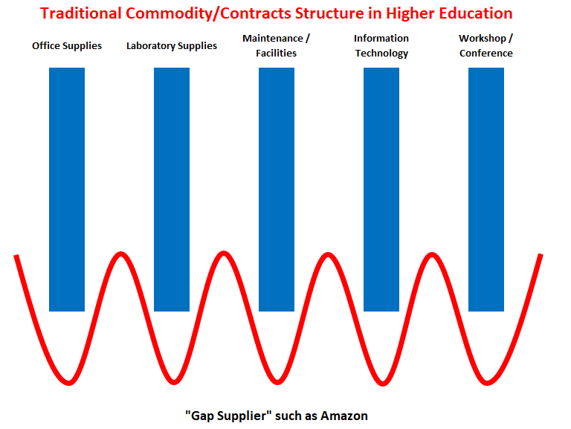
3-Amazon purchases in higher education
What is the right view?
Key institutional contracts are awarded based on suppliers providing for large commodity groups
Some of these contain exclusivity clauses binding supplier and the University.
Amazon can be a key and important “gap supplier” providing many items needed by departments that do not fit into larger institutional contracts.
Successful Amazon purchasing is based on proper balance, decision-making, and oversight
8
Notes:
What is the right view?
Key institutional contracts are awarded based on suppliers providing for large commodity groups
Some of these contain exclusivity clauses binding supplier and the University.
Amazon can be a key and important “gap supplier” providing many items needed by departments that do not fit into larger institutional contracts.
Successful Amazon purchasing is based on proper balance, decision-making, and oversight

Slide 9
4-Access to platform
When accessing Enterprise Amazon Business Account through myUK, University staff and faculty should consider two factors:
Whether they been added to their respective departmental/group workflow, and
Whether the employee has any type of Amazon personal or other account type that utilizes the linkblue version of their University email address as their login ID. Amazon uses this as the Shopper’s unique identifier, e.g., jsmith4@uky.edu
Both are one-time considerations and only relevant to first-time access.
9
Notes:
When accessing Enterprise Amazon Business Account through myUK, University staff and faculty should consider two factors:
Whether they been added to their respective departmental/group workflow, and
Whether the employee has any type of Amazon personal or other account type that utilizes the linkblue version of their University email address as their login ID. Amazon uses this as the Shopper’s unique identifier, e.g., jsmith@uky.edu
Both are one-time considerations and only relevant to first-time access.

Slide 10
4-Access to Platform
Employees holding the Procurement Card holder role, with exception of those in Athletics and UK Healthcare (Hospital), will be automatically onboarded into the Enterprise Amazon Business Account in myUK in conjunction with the Go-Live date.
Cardholder staff/faculty also will be loaded into their respective departmental groups at Go-Live.
After onboarding, these initial Amazon Shoppers should access the platform directly through myUK / Enterprise Services tab.
10
Notes:
Employees holding the Procurement Card holder role, with exception of those in Athletics and UK Healthcare (Hospital), will be automatically onboarded into the Enterprise Amazon Business Account in myUK in conjunction with the Go-Live date.
Cardholder staff/faculty also will be loaded into their respective departmental groups at Go-Live.
After onboarding, these initial Amazon Shoppers should access the platform directly through myUK / Enterprise Services tab.

Slide 11
4-Access to platform
Upon their first visit to the Enterprise Amazon Business Account, employees who have personal or other Amazon accounts using the linkblue version of their UK email address may encounter account conversion/migration tasks requiring attention.
Information is available on the Procurement Services website to manage account conversions/migrations.
University employees who have not used the linkblue version of their email address with Amazon previously should transition easily onto the platform through the Amazon tab within myUK / Enterprise Services.
Staff and faculty who are not procurement card users have opportunity to browse products on the platform and create/download Shopping Lists.
11
Notes:
Upon their first visit to the Enterprise Amazon Business Account, employees who have personal or other Amazon accounts using the linkblue version of their UK email address may encounter account conversion/migration tasks requiring attention.
Information is available on the Procurement Services website to manage account conversions/migrations.
University employees who have not used the linkblue version of their email address with Amazon previously should transition easily onto the platform through the Amazon tab within myUK / Enterprise Services.
Staff and faculty who are not procurement card users have opportunity to browse products on the platform and create/download Shopping Lists.

Slide 12
4-Access to platform
Other staff and faculty, along with any future procurement card holders who plan to perform Amazon Shopping and order creation, must first be assigned to their departmental group / workflow within the platform.
These employees may work with their local Business Officer (Amazon Approver) to be added to their group or they can request access by completing the Onboarding Web Form on the Procurement Services website.
Completion of the form helps facilitate placement into the applicable departmental group and the employee can receive support in the event they encounter login/migration issues during their first visit.
Procurement Services will provide support to Amazon Approvers as well in onboarding tasks.
12
Notes:
Other staff and faculty, along with any future procurement card holders who plan to perform Amazon Shopping and order creation, must first be assigned to their departmental group / workflow within the platform.
These employees may work with their local Business Officer (Amazon Approver) to be added to their group or they can request access by completing the Onboarding Web Form on the Procurement Services website.
Completion of the form helps facilitate placement into the applicable departmental group and the employee can receive support in the event they encounter login/migration issues during their first visit.
Procurement Services will provide support to Amazon Approvers as well in onboarding tasks.

Slide 13
4-Access to platform
Note: If an employee accesses the Amazon tab within myUK / Enterprise Services without first being added to their departmental group by either their departmental Amazon Approver or Procurement Services, they:
Will be able to browse products and create/download Amazon Shopping Lists
Will not be able to check out with an order
May encounter unexpected account migration issues if they have previously used the linkblue version of their UK email address with Amazon.
13
Notes:
Note: If an employee accesses the Amazon tab within myUK / Enterprise Services without first being added to their departmental group by either their departmental Approver or Procurement Services, they:
Will be able to browse products and create/download Amazon Shopping Lists
Will not be able to check out with an order
May encounter unexpected account migration issues if they have previously used the linkblue version of their UK email address with Amazon.

Slide 14
4-Access to platform - Summary
13
Notes:
Shown here is a summary of the first-time access factors.

Slide 15
5-Amazon Business Shopping Experience – key points
Product browsing and shopping is identical to that of Amazon.com
Checkout process is similar with a streamlined format
Amazon Business Shoppers enter their delivery address and select shipping options, etc. as typically done with Amazon.com orders.
Delivery information should be official business addresses only
Procurement card is payment method
Tax exemptions managed at institutional level
Employs “Guided Buying” tools for restricted (soft- and hard-blocked) items
14
Notes:
Product browsing and shopping is identical to that of Amazon.com
Checkout process is similar with a streamlined format
Amazon Business Shoppers enter their delivery address and select shipping options, etc. as typically done with Amazon.com orders.
Delivery information should be official business addresses only
Procurement card is payment method
Tax exemptions managed at institutional level
Employs “Guided Buying” tools for restricted (soft- and hard-blocked) items

Slide 16
6-Restricted soft- and hard-blocked items
While many items are available unrestricted on the platform, some items may also be available from other University contracts. These are notated by a yellow icon.
Shoppers may still place soft-blocked item(s) into their cart for consideration for purchase.
Please place a text next note on your cart during checkout with information for Approvers when ordering soft-blocked items.
When performing comparison shopping and providing notes for soft-blocked items, please keep mind the value of your time vs potential product savings.
15
Notes:
While many items are available unrestricted on the platform, some items may also be available from other University contracts. These are notated by a yellow icon.
Shoppers may still place soft-blocked item(s) into their cart for consideration for purchase.
Please place a text next note on your cart during checkout with information for Approvers when ordering soft-blocked items.
When performing comparison shopping and providing notes for soft-blocked items, please keep mind the value of your time vs potential product savings.

Slide 17
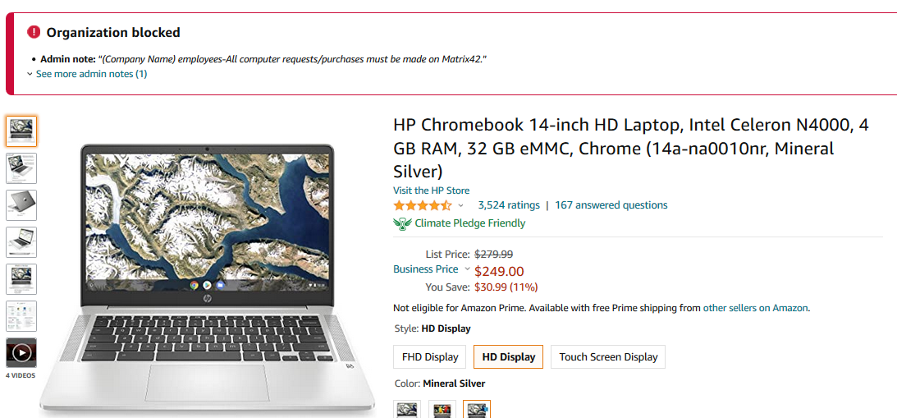
6-Restricted soft- and hard-blocked items
A minor portion of items are restricted from placement into a cart for purchase. These are notated with a red icon.
These include obvious items such as weapons and security products as well as items that conflict with University exclusive contracts, etc.
A Procurement Services Buyer can assist you with sourcing items as appropriate, if needed.
16
Notes:
A minor portion of items are restricted from placement into a cart for purchase. These are notated with a red icon.
These include obvious items such as weapons and security products as well as items that conflict with University exclusive contracts, etc.
A Procurement Services Buyer can assist you with sourcing items as appropriate, if needed.

Slide 18
7-Departmental Approvers
Receive separate Amazon-direct training for their role to approve/reject orders
Approver workflow occurs on the Amazon Business platform and mirrors that of SRM Shopping Carts/PRD/Concur transactions.
Only one departmental approval required. A departmental group could have multiple Approvers who receive the email notification identical to SRM Shopping Carts, etc.
Approvers can add additional employees to their groups as well as remove them.
Can manage additional settings at the departmental level as well as review orders from their area and conduct their own analytics.
17
Notes:
Receive separate Amazon-direct training for their role to approve/reject orders
Approver workflow occurs on the Amazon Business platform and mirrors that of SRM Shopping Carts/PRD/Concur transactions.
Only one departmental approval required. A departmental group could have multiple Approvers who receive the email notification identical to SRM Shopping Carts, etc.
Approvers can add additional employees to their groups as well as remove them.
Can manage additional settings at the departmental level as well as review orders from their area and conduct their own analytics.

Slide 19
7-Departmental Approvers
Once submitted, each cart moves to the departmental Approver. This is the same Approver(s) who would normally approve an SRM Shopping Cart or most purchase transactions for an area.
They receive an automatic email with your items and instructions to approve or reject. Approvers can also approve/reject specific line items only. For any rejected items, Amazon automatically adjusts shipping costs.
Employees can request their local Amazon Approver to add them to departmental group workflow.
Employees who shop without being previously added to their departmental workflow will be able to browse and place items into a cart, but not able to check out from Amazon. Contact Procurement Services if assistance is needed.
18
Notes:
Once submitted, each cart moves to the departmental Approver. This is the same Approver(s) who would normally approve an SRM Shopping Cart or most purchase transactions for an area.
They receive an automatic email with your items and instructions to approve or reject. Approvers can also approve/reject specific line items only. For any rejected items, Amazon automatically adjusts shipping costs.
Employees can request their local Amazon Approver to add them to departmental group workflow.
Employees who shop without being previously added to their departmental workflow will be able to browse and place items into a cart, but not able to check out from Amazon. Contact Procurement Services if assistance is needed.

Slide 20
8-Procurement Services approval and Order placement
Each order, once approved by the department, will move through Procurement Services for review and approval
Ensures institutional oversight/compliance and no conflicts with existing contracts, etc.
Once approved in Procurement Services, order immediately places with Amazon for fulfillment and Shopper is notified by email.
Amazon holds the price on Shopping Cart items for 7 calendar days from the time of checkout until order placement. Approvers are encouraged to review/ approve their carts expediently.
Procurement Services plans to review carts within one to two business days of receipt. Amazon will notify the Shopper if an order placement falls outside the 7-day window.
19
Notes:
Each order, once approved by the department, will move through Procurement Services for review and approval
Ensures institutional oversight/compliance and no conflicts with existing contracts, etc.
Once approved in Procurement Services, order immediately places with Amazon for fulfillment and Shopper is notified by email.
Amazon holds the price on Shopping Cart items for 7 calendar days from the time of checkout until order placement. Approvers are encouraged to review/approve their carts expediently.
Procurement Services plans to review carts within one to two business days of receipt. Amazon will notify the Shopper if an order placement falls outside the 7-day window.

Slide 21
Summary Amazon Business Shopping Experience
Workflow for an Amazon Business Order:
Amazon Shopper
Dept Approver(s)
Procurement Services
Amazon
1
2
Access via myUK
Dept approver(s)
Procurement Services
Buyer(s)
Enterprise Services
receive(s) email
Order placed with
tab.
notification.
receive email
Amazon and fulfilled.
First-time access may
Accesses via "Details"
notification.
If order placement
require account
link within email or log
Accesses via "Details"
date > 7 calendar
conversion/migration
in to account. One
link within email or log
days, pricing may
tasks.
level departmental
in to account.
expire.
approval required.
20
Notes:
The graphic shows the Amazon Shopping workflow process.
Once the Amazon Shopper is placed into their respective departmental group and accesses Amazon Business successfully through myUK Enterprise Services tab, they will be able to shop and create orders.
As shown in the graphic, the cart first moves through the departmental Approver and then onto Procurement Services for review.
Once workflow is complete, the order places immediately with Amazon and the Shopper is notified via email of order placement.

Slide 22
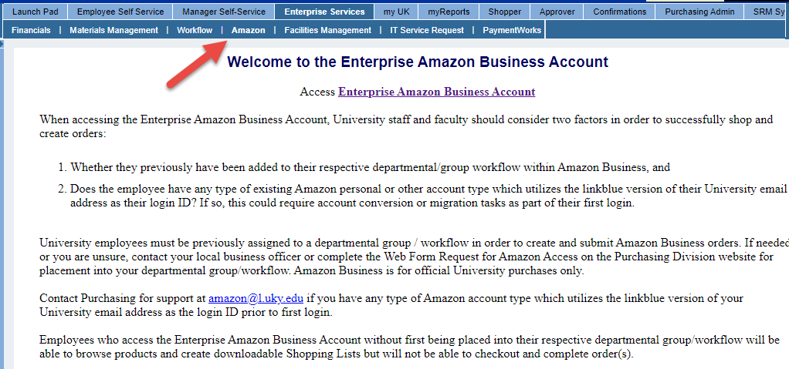
9-Step-by-Step Sample Order and checkout
Access Enterprise Amazon Business Account via myUK Enterprise Services tab.
Keep in mind earlier points regarding departmental group placement and potential conversion/migration on the first visit if you previously used the linkblue version of your UK email address with an Amazon account.
Important: Be sure to sign out of any other Amazon accounts that may have been used on your computer when accessing Amazon Business.
21
Notes:
Access Enterprise Amazon Business Account via myUK Enterprise Services tab.
Keep in mind earlier points regarding departmental group placement and potential conversion/migration on the first visit if you previously used the linkblue version of your UK email address with an Amazon account.
Important: Be sure to sign out of any other Amazon accounts that may have been used on your computer when accessing Amazon Business.

Slide 23
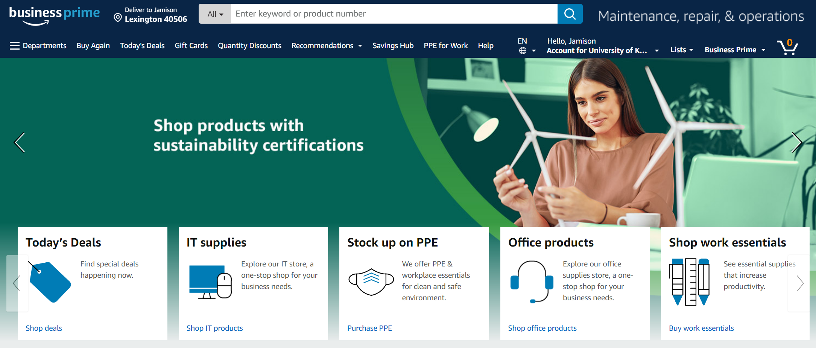
9-Step-by-Step Sample Order and checkout
2. Arrival at the Enterprise Amazon Business Account
22
Notes:
The Amazon Shopper arrives at the Enterprise Business Account as normal and can perform product searches and shop as one normally would on Amazon.com. The look, feel, and functionality of Amazon Business are very similar to that of Amazon.com.

Slide 24
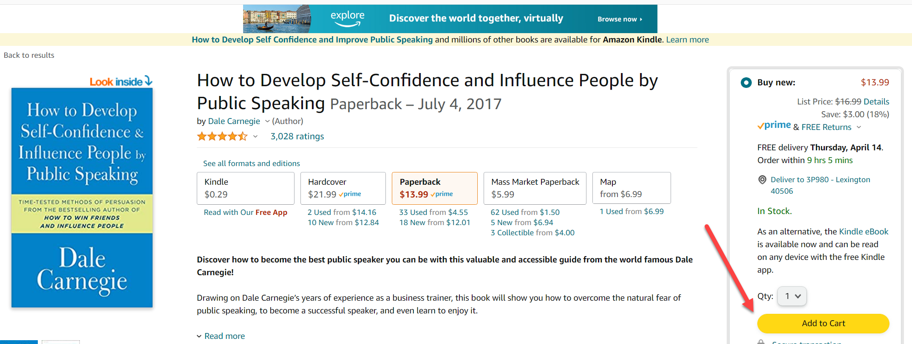
9-Step-by-Step Sample Order and checkout
3. Search, locate, and place items into your cart as you normally would with Amazon.com.
Keep in mind that soft-blocked items can be placed into your cart for consideration; please put a text note on comments during checkout, e.g., did you compare items to a contracted item, is pricing lower, etc. Hard-blocked items cannot be placed into a cart.
23
Notes:
3. Search, locate, and place items into your cart as you normally would with Amazon.com.
Keep in mind that soft-blocked items can be placed into your cart for consideration; please put a text note on comments during checkout, e.g., did you compare items to a contracted item, is pricing lower, etc. Hard-blocked items cannot be placed into a cart.

Slide 25
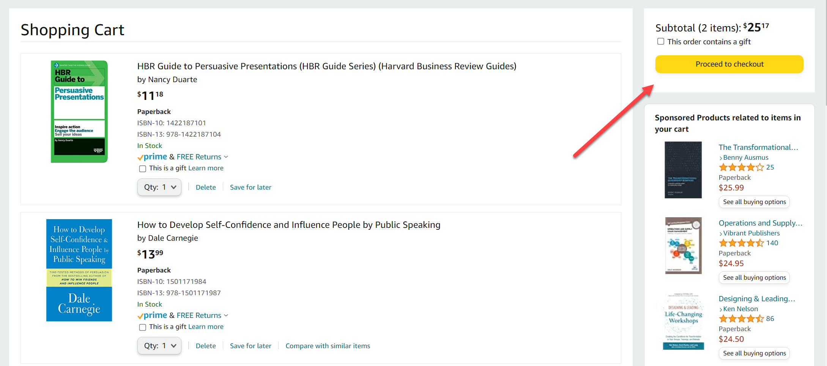
9-Step-by-Step Sample Order and checkout
4. Click Proceed to Checkout when finished Shopping:
24
Notes:
4. When all needed items are placed into your cart, click Proceed to Checkout:

Slide 26
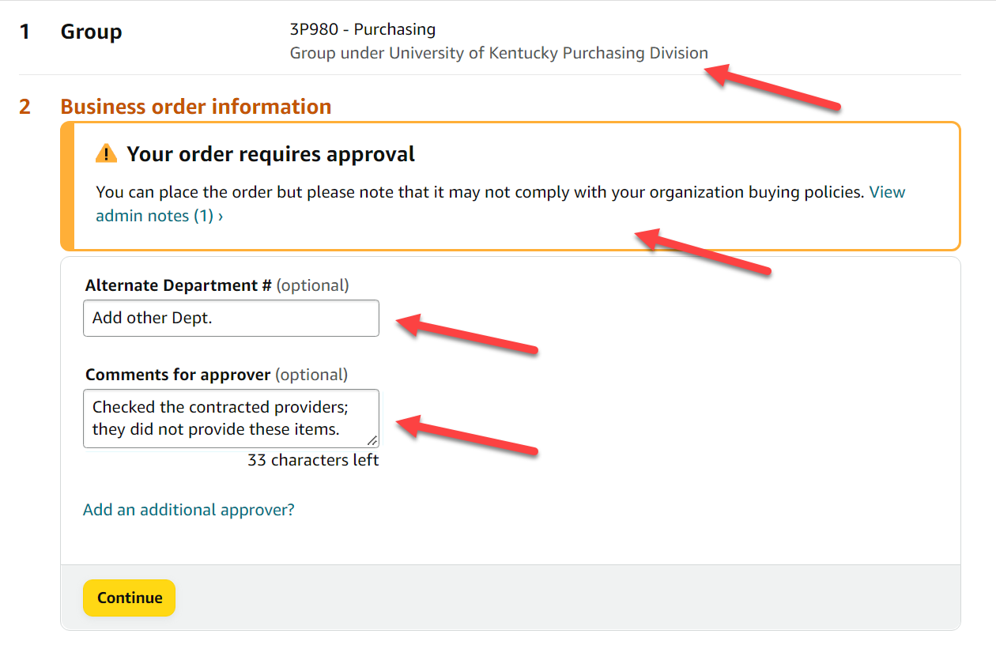
9-Step-by-Step Sample Order and checkout
5. Complete initial checkout steps:
Your departmental group will show automatically in the upper section
Business Order Information – place a note under Comments for Approver if you have any soft-blocked items.
You can also use the Alternate Department box for text notes if you are buying on behalf of another area (optional).
25
Notes:
5. Complete initial checkout steps:
Your departmental group will show automatically in the upper section
Business Order Information – place a note under Comments for Approver if you have any soft-blocked items.
You can also use the Alternate Department box for text notes if you are buying on behalf of another area (optional).

Slide 27
9-Step-by-Step Sample Order and checkout
6. Complete shipping address information:
You can setup/manage multiple delivery locations if desired. Must be official University-sponsored location, no personal residences or non-business addresses permitted unless exception has been approved.
26
Notes:
6. Complete shipping address information:
You can setup/manage multiple delivery locations, if desired. Must be official University-sponsored location, no personal residences or non-business addresses permitted unless exception has been approved.

Slide 28
9-Step-by-Step Sample Order and checkout
7. Enter payment information:
Use only a University-issued procurement card for Amazon Business purchases.
27
Notes:
7. Enter payment information:
Use only a University-issued procurement card for Amazon Business purchases.

Slide 29
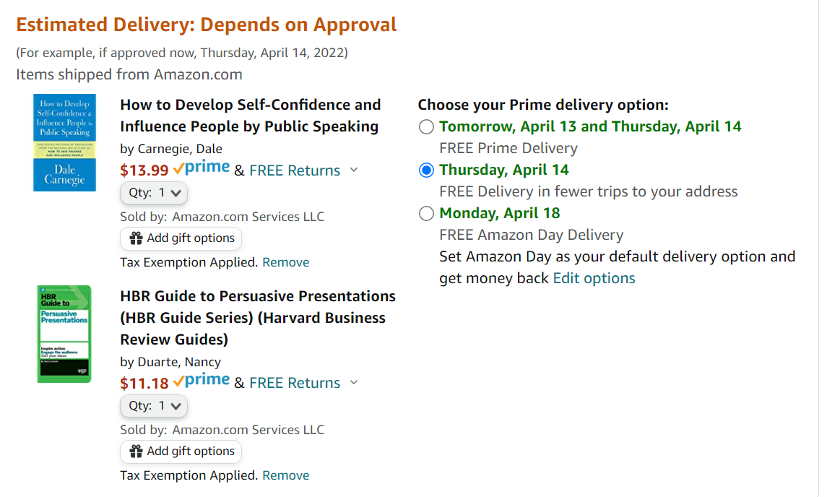
9-Step-by-Step Sample Order and checkout
8. Review item(s) and select desired shipping option:
Remember you will automatically receive Business Prime shipping benefits, when applicable.
28
Notes:
8. Review item(s) and select desired shipping option:
Remember you will automatically receive Business Prime shipping benefits, when applicable.

Slide 30
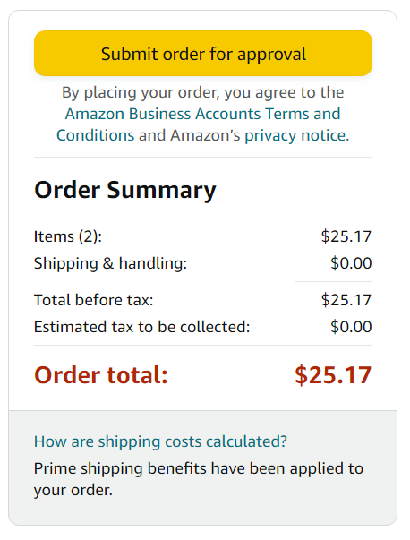
9-Step-by-Step Sample Order and checkout
9. Click Submit Order for Approval button. Once the order passes through workflow, you will receive an Amazon email notifying of order placement.
29
Notes:
9. Click Submit Order for Approval button. Once the order passes through workflow, you will receive an Amazon email notifying of order placement.

Slide 31
10-Resources and support
Resources for departments related to the Enterprise Amazon Business Account:
Amazon Business Information Page on the Procurement Services website
Dedicated section on the Procurement Services Learning and Training Resources page, including Help Guides and Quick Reference Cards
Amazon Business Frequently Asked Questions (FAQs)
Amazon web forms on the Procurement Services website – use for inquiries or assistance including requests for placement into a departmental group
Assistance/support email: amazon@l.uky.edu
Procurement Services provides support for general inquiries related to an order until placement with Amazon Business. This could include Business Account access, group assignments and workflow, restricted (soft- and hard-blocked) items, cart approval status, etc.
30
Notes:
Resources for departments related to the Enterprise Amazon Business Account include:
Amazon Business Information Page on the Procurement Services website
Dedicated section on the Procurement Services Learning and Training Resources page, including Help Guides and Quick Reference Cards
Amazon Business Frequently Asked Questions (FAQs)
Amazon web forms on the Procurement Services website – use for inquiries or assistance including requests for placement into a departmental group
Assistance/support email: amazon@l.uky.edu
Procurement Services provides support for general inquiries related to an order until placement with Amazon Business. This could include Business Account access, group assignments and workflow, restricted (soft- and hard-blocked) items, cart approval status, etc.

Slide 32
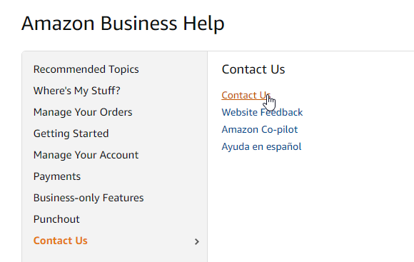
10-Resources and support
Departments should contact Amazon Business Customer Support order placement for assistance related to delivery, shipping status, returns, pricing discrepancy, etc.
Dedicated U.S. based Business Customer Support can be reached via email, chat, and phone.
Provides end users the option to call, email, or live chat. Use this method for anything relating to an order, transaction, charge, or shipment.
Help is available through the top menu of Shopper’s home page.
Phone: (888) 281-3847
31
Notes:
Departments should contact Amazon Business Customer Support order placement for assistance related to delivery, shipping status, returns, pricing discrepancy, etc.
Dedicated U.S. based Business Customer Support can be reached via email, chat, and phone.
Provides end users the option to call, email, or live chat. Use this method for anything relating to an order, transaction, charge, or shipment.
Help is available through the top menu of Shopper’s home page.
Phone: (888) 281-3847

Slide 33
10-Resources and support
Amazon offers dedicated resources related specifically to delivery issues:
Package Escalation: Email amzl-address-info@amazon.com or
Phone (844) 370-7615
Provide at least one TBA tracking number if available and estimated number of packages that may have been involved, if known. If needed, you could also reference your original Amazon Business order number.
32
Notes:
Amazon offers dedicated resources related specifically to delivery issues:
Package Escalation: Email amzl-address-info@amazon.com or
Phone (844) 370-7615
Provide at least one TBA tracking number if available and estimated number of packages that may have been involved, if known. If needed, you could also reference your original Amazon Business order number.

Slide 34
Questions and answers

