Slide 1
Administrator Training
Marcus Lopez
Sr. Customer Success Manager
8/9 & 8/10

Slide 2
Table of Contents
Shopping on Amazon Business
Business Account Navigation
Members
Buying Policies
Approvals
Amazon Business Analytics
Your Orders
Business Customer Support

Slide 3
Shopping on Amazon Business

Slide 4
Amazon Business Benefits
Business Pricing & Quantity Discounts
As a registered business on Amazon Business, you will receive business pricing and quantity discounts. Click to learn more.
Business Prime
Once Business Prime has been purchased, all users on the centralized account will receive Free Two-Day Shipping on eligible items. There are multiple pricing tiers to meet the needs of businesses of all sizes. Click to learn more.
Buying Policies
Customize Amazon Business to your organization’s buying standards and procedures. Features include approval workflows, negotiated pricing, and preferred suppliers and preferred products.
Business-Only Selection
Business-only selection refers to items and offers that are only available for purchase by Amazon Business customers.
Amazon Business Analytics
Use Amazon Business Analytics to view data about your orders, create and filter reports based on your business needs, and view both charts and tables. Click to learn more.

Slide 5
Amazon Business Discounts
There are a variety of discounts available on Amazon Business that your organization can take advantage of to unlock savings.
Business Pricing
Business pricing is cheaper pricing available only for registered Amazon Business customers. No action is needed to turn on business pricing and is available on select items.
Quantity Discounts
Quantity Discounts are volume-tiered discounts, only available for registered Amazon Business customers. Quantity discounts appear on the product detail page and users can review the tiered discounts available.
Subscribe & Save
Subscribe & Save is part of the Amazon Recurring Delivery program. Customers can subscribe to eligible Subscribe & Save items and get a 5% discount for their new subscriptions.

Slide 6
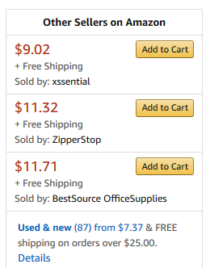
Search Optimization
Optimizing search functions in Amazon Business allows you to find the best products to meet your needs and compare prices to find the best value
Maximize Savings! Search All Departments & try using generic descriptors instead of brand names
Consider refining search results with filters available of left side of your screen, such as Prime or Business Seller or Climate Pledge Friendly
Sort results by options listed on the top left of your screen, such as Price: Low to High
In many cases, you can also Select Quantity Discounts to review quantity discounts and purchasing options
To compare offers, scroll down & select Used & new to pull up the Offer Listing page

Slide 7
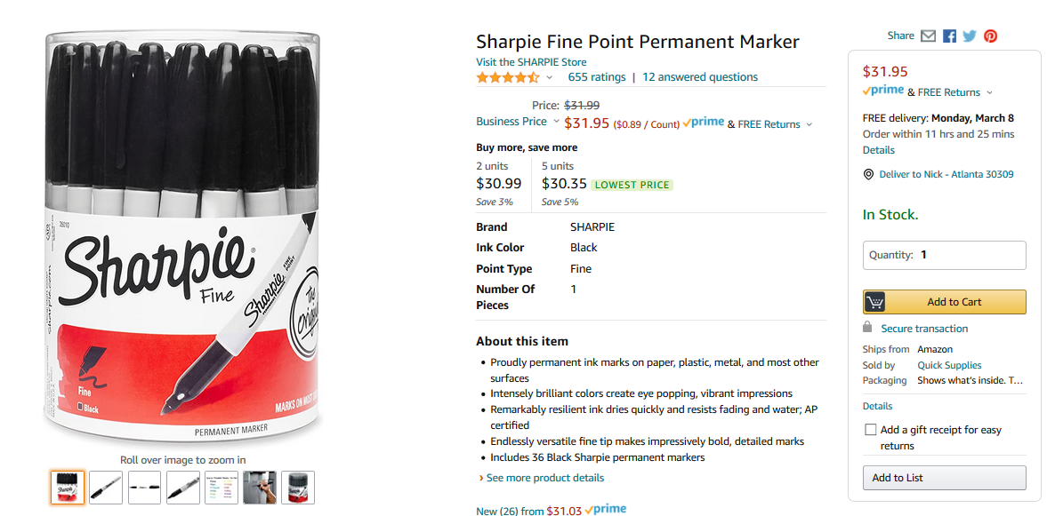
Take Advantage of Amazon Prime Shipping Benefits
An easy way to ensure that your products arrive on time and as expected, is to order products fulfilled directly from Amazon. All products clearly mark who the seller is on the product detail page.
Prime Eligibility – Fulfilled by Amazon
Prime eligible items are fulfilled by Amazon. We recommend searching for Prime eligible items.
What’s not Included?
Business Prime does not include additional Prime benefits such as Amazon Fresh, Pantry, Video, or Music.

Slide 8
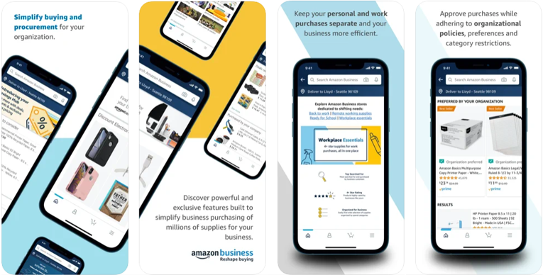
Amazon Business Mobile App
The Amazon Business app is your one-stop shop for finding and buying work supplies on the go. Amazon Business customers can now sign in to the dedicated Amazon Business mobile app, which is exclusive for business users.
Discover business-relevant options on the navigation menu
Deep-link into the app directly from your emails
Get push notifications for order shipments and approvals
Enjoy a seamless purchasing experience while adhering to organizational policies and preferences all from your mobile device

Slide 9
Business Account Navigation

Slide 10
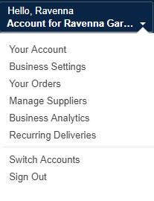
Business Account Navigation
Page | Functionality
Your Account | Standard Amazon account information
Business Settings | Business Management pages. Add users, set up groups, configure buying policies, etc.
Approve Orders | If workflow approvals are enabled, approvers can view and take action on pending orders
Your Orders | View and track your orders. Administrations can view orders others have placed on behalf of the organization
Manage Suppliers | Easily find suppliers on Amazon Business and add them to your list of Saved Suppliers. Learn more.
Business Analytics | Create and filter custom reports based on your business needs to view your organization’s orders
Recurring Deliveries | Have essential items delivered automatically, based on a schedule you choose. Learn More.

Slide 11
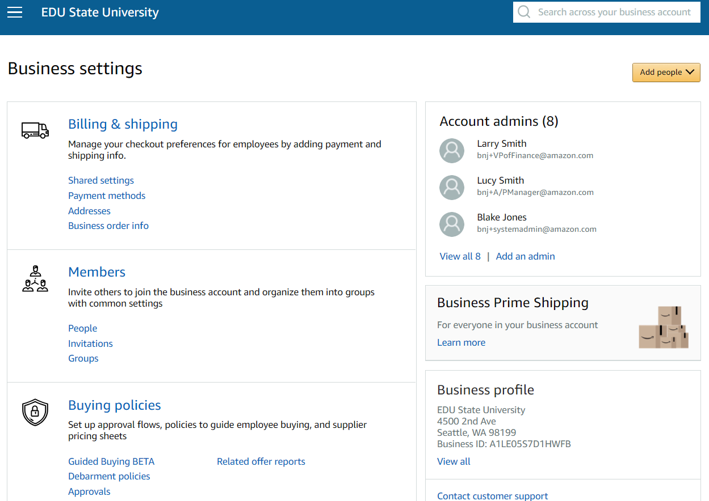
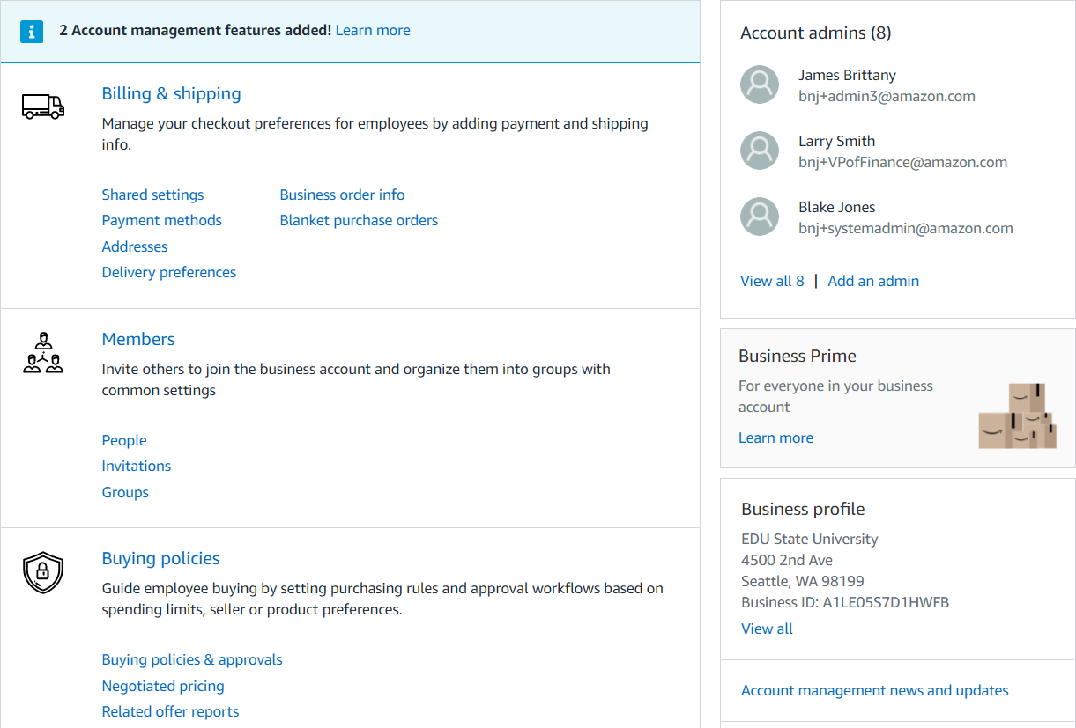
Business Settings
Amazon Business Administrators have the ability to add and remove users, update payment methods, create or edit order & buying policies, and more within the “Business Settings” page.

Slide 12
Members

Slide 13
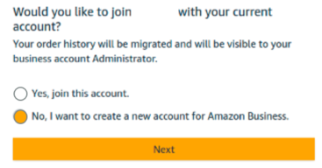
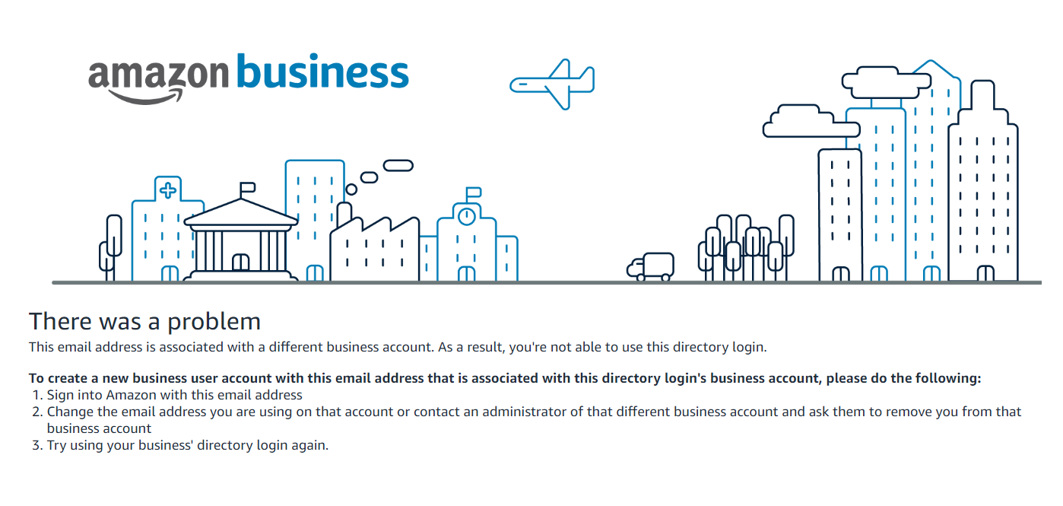
Registration Workflow
Admin sends email to end users announcing AB program and SSO link and action required by each status type
User begins shopping.
No password needed
New to Amazon (NTA)
Click SSO Link
User chooses create a new account for Amazon Business
Existing .com
Rogue account requisitioners will have to change the email address on existing business account or reach out to your administrator of previous business account to be removed. Admin should deregister rogue account.
Existing MUA Business*

Slide 14
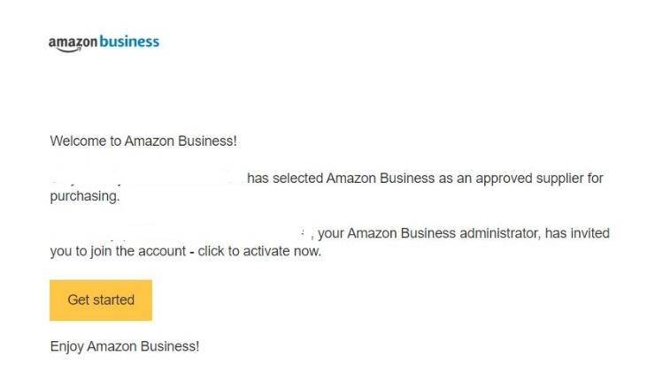
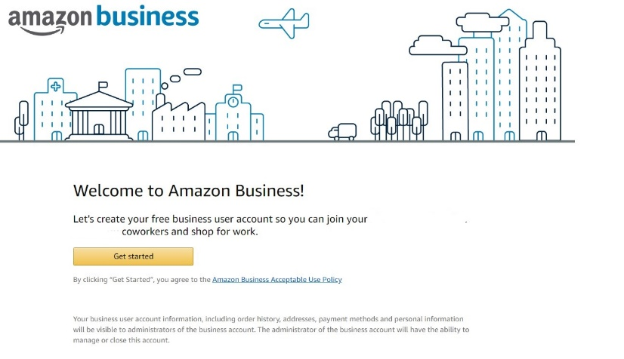
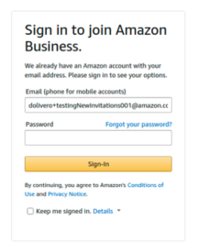
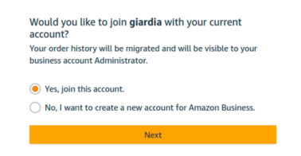
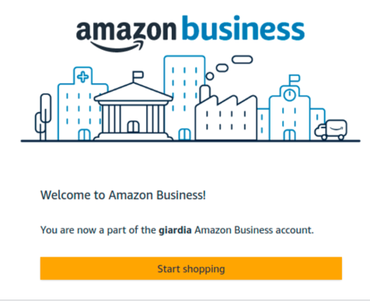
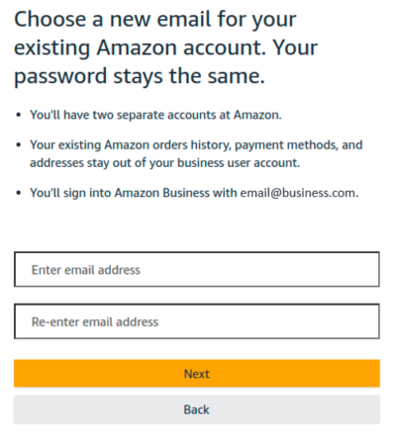
Existing Amazon.com User Registration Flow
User email
pre-populates
name@business.com

Slide 15
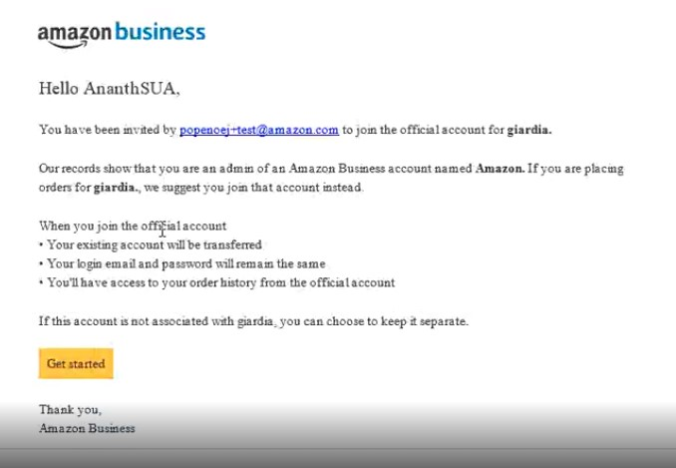
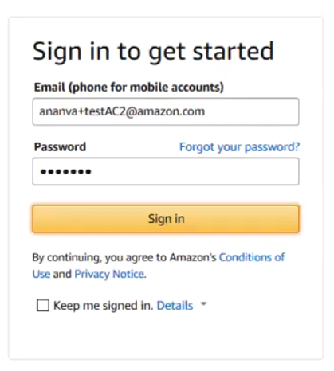
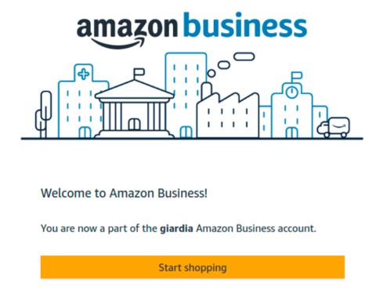
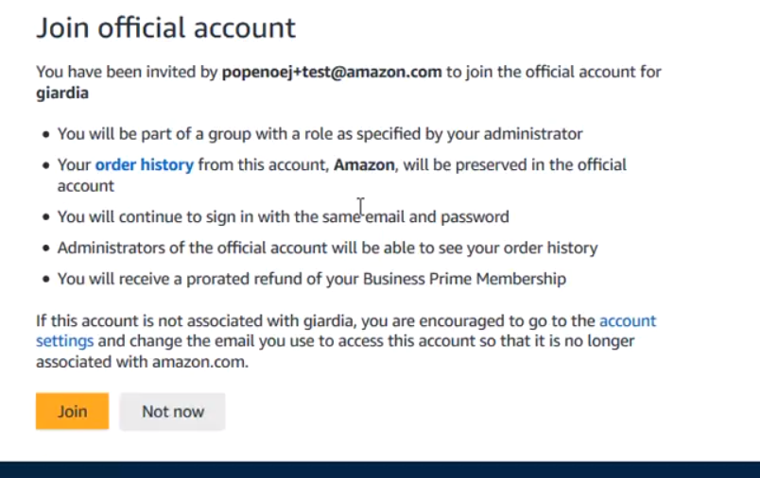
Existing Amazon Business User Registration Flow
Email address will not auto populate. User must enter email (must use same email address that was sent the invitation).
,
administrator@business.com
Existing Amazon Business User
Clicks “Get Started”
Prompted to sign in to existing account
Information Message on screen
Clicks “Join” (or “Not now”)
Clicks “Start Shopping”
administrator@business.com
Notes:
AA LAB C: https://w.amazon.com/bin/view/AB_Learning_and_Development/Playbooks/Account_Authority
AUC NTA Demo: https://drive.corp.amazon.com/view/ananva@/AB%20Account%20Authority/Auto%20User%20Creation%20Demo.mp4
SUA demo: https://drive.corp.amazon.com/view/ananva@/AB%20Account%20Authority/SUA%20Consolidation%20Demo.mp4 (video broken)
MUA screenshots: https://amazon.awsapps.com/workdocs/index.html#/document/cd04116eb066daa6fb811bdd82c8b0c9d072340274e5b2798c27a8d7a32bc636

Slide 16
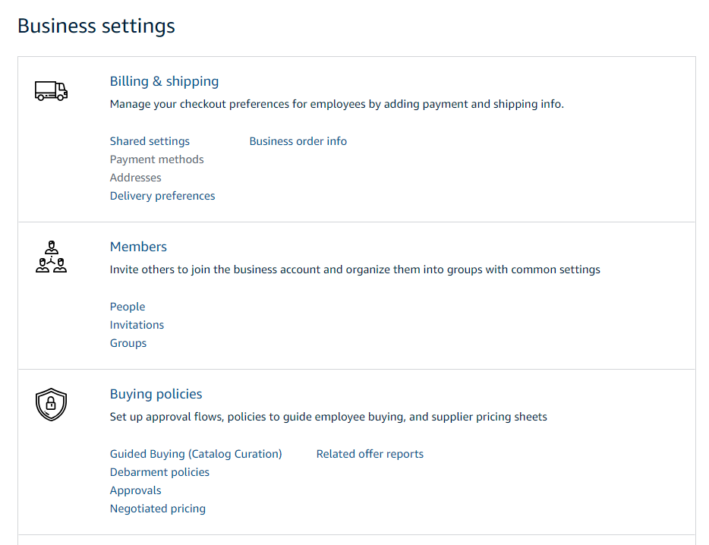
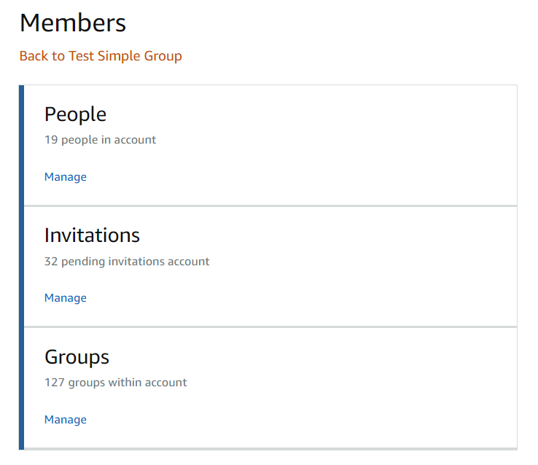
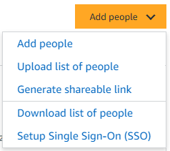
Members
Invite others to join the business account and organize them into groups with common settings
The People section of your account enables you to manage all active users on the business account. You can add and remove users, edit user roles, and download a complete list of account users from this section of your account.
The Invitations section tracks all pending and expired invitations to users. Once a user has accepted their invitation, that person will move to the People section.
To help keep your users organized, people can be added to specific Groups. Many settings such as approvals, shared payment methods, and catalog curation messages can be configured at the group level

Slide 17
User Roles & Permissions
Each user can have multiple roles -- administrator or requisitioner, or both. Permissions can be assigned when an administrator invites a user to the business. Administrators can change user permissions at any time.
Assign administrator permissions on a per-group basis. One administrator can manage multiple groups. Group level administrators only have admin authority over the group(s) they are assigned.
Role | Permissions & Functionality | Visibility
Admin | Manage business settings & business features Invite people to join the business account Remove users from the business account Assign a role to a user Set up approval workflows and spending limits Configure shared payment methods and shipping addresses Add certifications such as tax exemptions to the business account | Administrators can view orders and order history for all purchases in their group(s) on behalf of the business. Last 4 digits of any payment methods used by Requisitioners Billing & Ship to addresses All Amazon Business Analytics fields for orders placed by users in their group(s)
Buyer (requisitioner) | Place orders on behalf of the organization Add payment methods and shipping addresses at checkout *if individual pay is configured Utilize Business Analytics for their own purchases Can be configured as an Approver | Order history for all orders that they placed for their organization with their business user account Shipping addresses & payment methods (last 4 digits visible), as established by the administrator

Slide 18
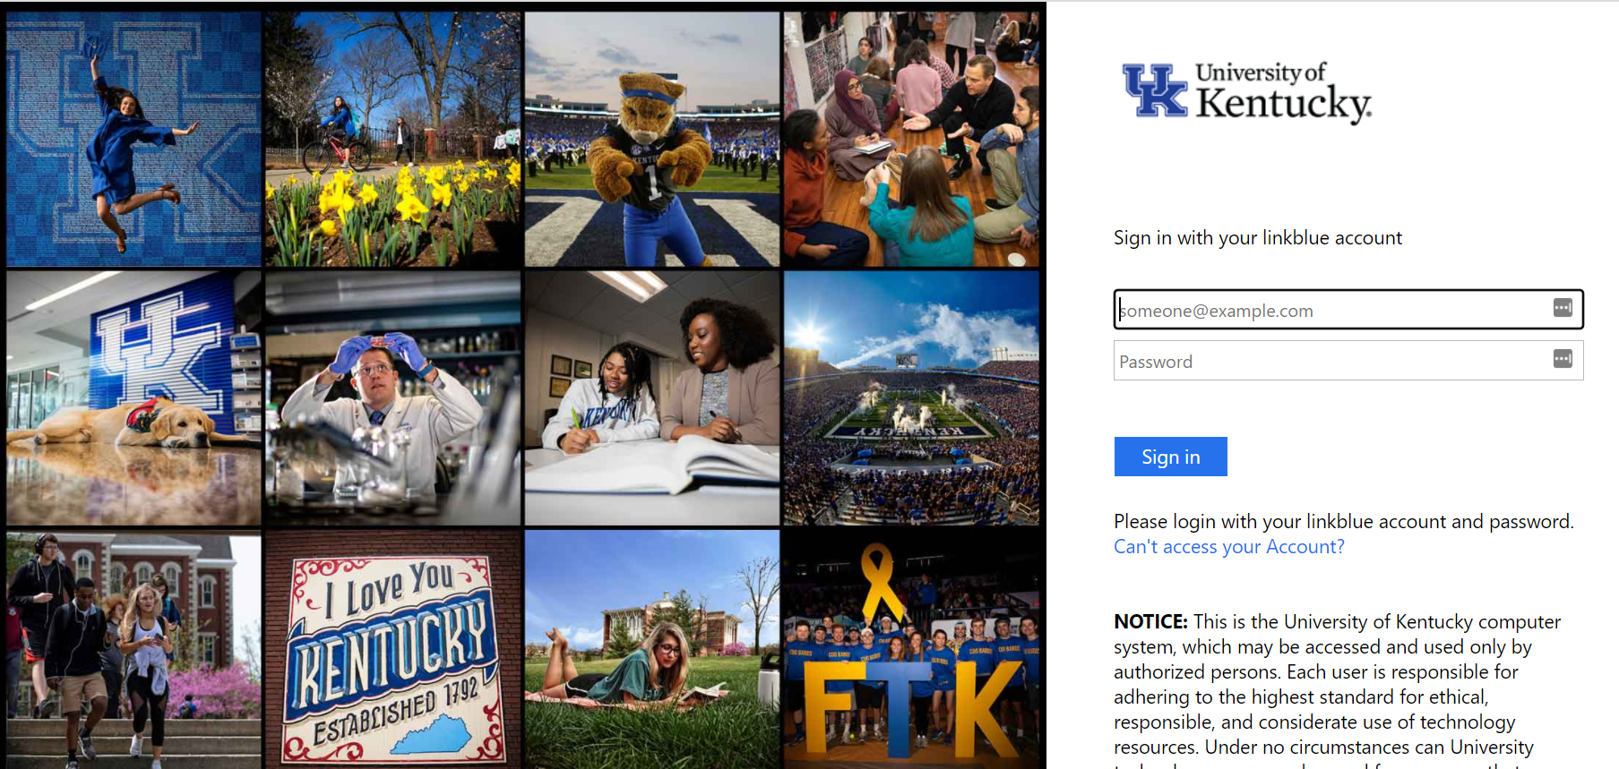
Accessing the Account through Single Sign On
Accessing the Amazon Business account is simple for end users when Amazon is integrated with your organization’s IDP
How do end users sign in?
Access via the SP Initiated URL (Provided to you in your Launch Email)
Once your account is active, you can log in to Amazon.com with your Link Blue Email Address. You will be routed to UKY’s Single Sign On

Slide 19
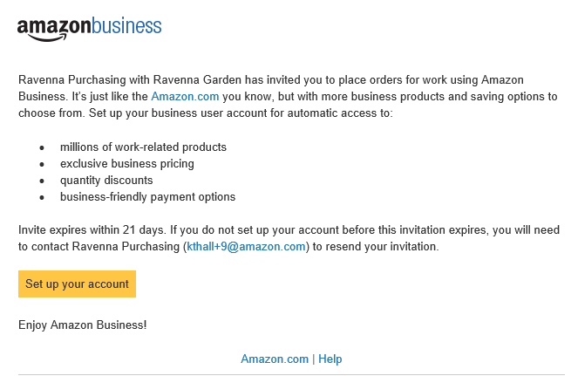
Inviting Users to Amazon Business
Administrators can add users to the account one by one or all at once by uploading a spreadsheet
How do Invitations Work?
When a user is added to the business account, an invitation to join is immediately emailed.
Invitations are tied to an end users email address. The recipient cannot change the email address they use to register for the account.
End users must take action after being invited to an account in order to become an active user.
User permissions are assigned when a user is invited.
Account invitations are valid for 90 days from send date. After 90 days, they will expire and need to be resent
your account admin email@company.com)

Slide 20
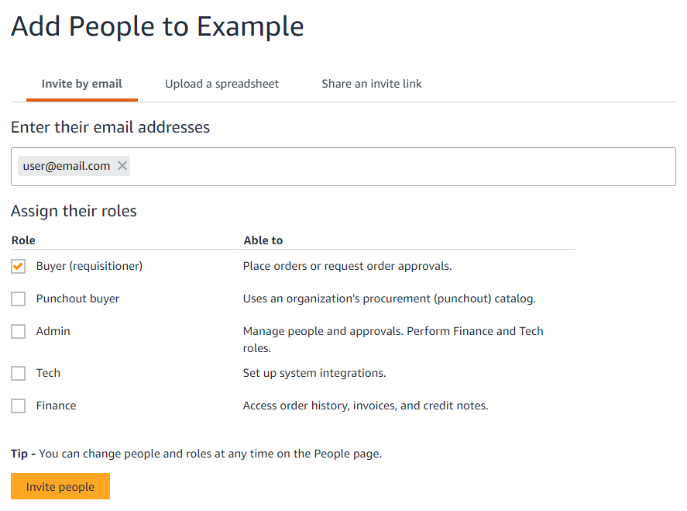
Add a New User
Administrators can add users to the account one by one or in bulk using a spreadsheet
Add Users from Business Settings
Under the “Add people” button at the account or group level, select “Add people” again. Enter the user’s email address and select the appropriate user permissions. You can select one role or both. Up to 12 people can be invited in this window at once.

Slide 21
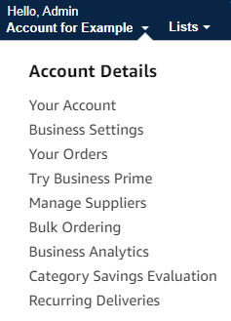
Determine Who is in Your Group(s)
Download a user list
Navigate to “Business Settings”
Select “Add people”
Select “Download list of people”. This action will trigger an email from no-reply@amazon.com sent to your inbox titled “YOUR NAME, your customer list is ready to download”
Select the hyperlink in the email to download an excel file

Slide 22
Buying Policies

Slide 23
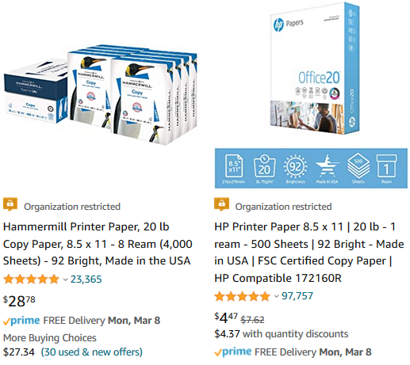
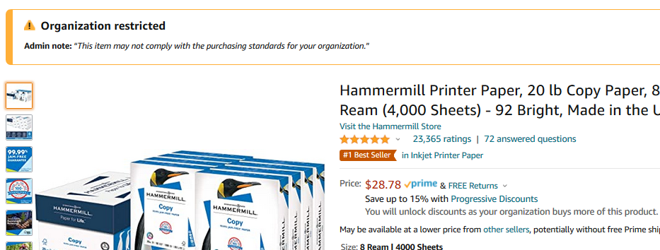
Organization Restricted
Administrators can customize messaging to let end users know IF and WHEN they can purchase certain UNSPSC based categories on Amazon Business
Restriction Best Practice:
If you are unsure of the specific UNSPSC you want to restrict, use the tool to search the product name for suggested codes and sample product images.
Be aware, restricting a category does not prevent a purchase but adds a warning.

Slide 24
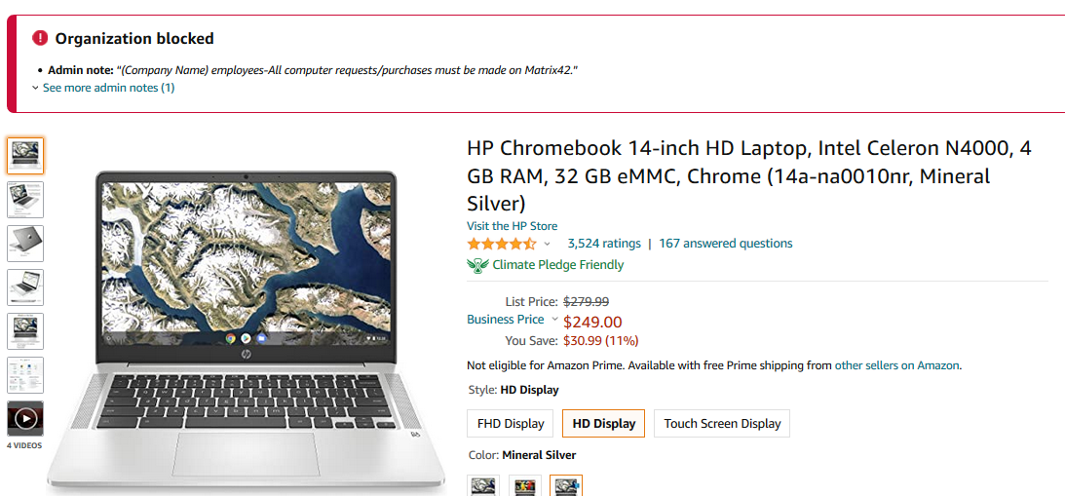
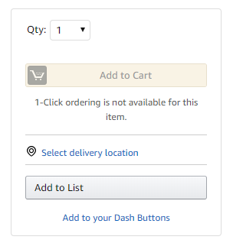
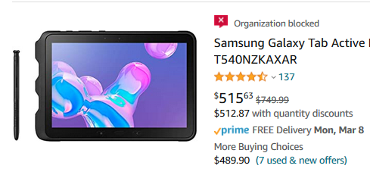
Organization Blocked
Hard blocking product categories prevents an end user from adding these product to their cart. The add to cart option will appear greyed out for any product categories that are blocked
Please contact IT for laptop acquisition.

Slide 25
Approvals

Slide 26
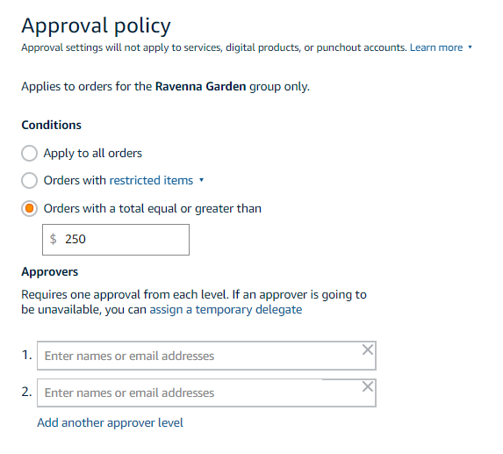
Approval Policies
Approval workflows provide visibility and control over purchasing
Each level of approval can have more than one approver. Only one approval is needed at each level.
Approvers are notified of pending orders through email as well as when they log into their Amazon Business account.
Only active account users can be configured as approvers.

Slide 27
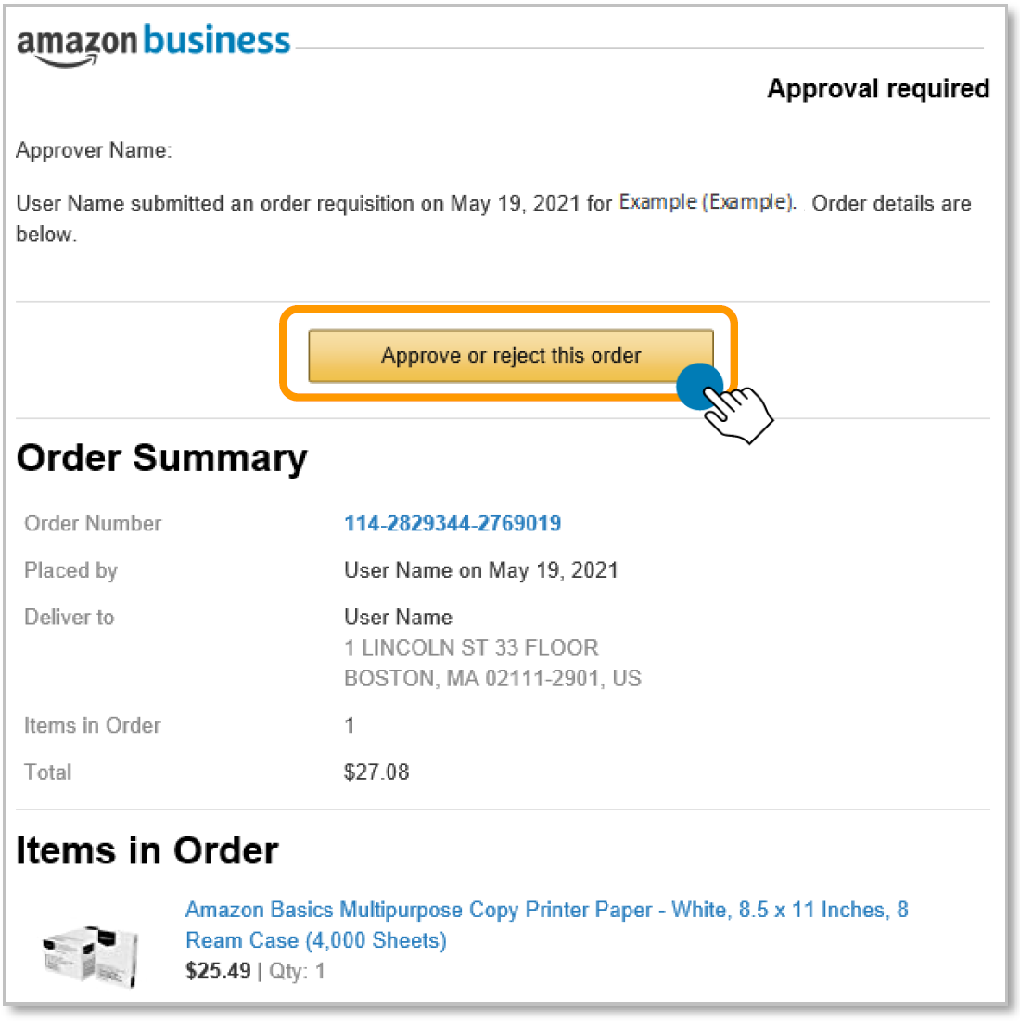
Approving Orders
When a user places an order with an approval policy required, the approver will get an email notifying them of the request.
Once a purchase is submitted for approval, the order is held for 7 days. Approval requests that take longer than 7 days will be rejected
Purchase requests can be approved directly from the email or by navigating to Approve Orders in the top right drop down of your account.

Slide 28
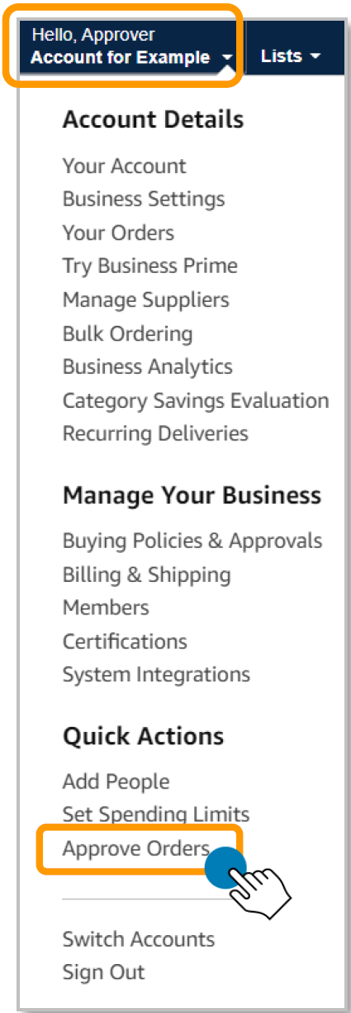
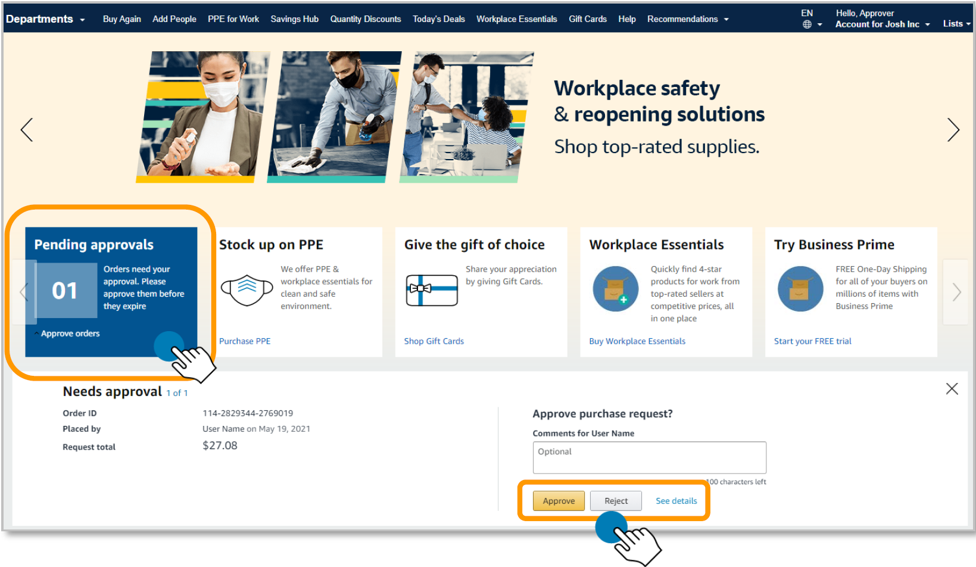
Approving Orders
Since UKY has enabled SSO, you will need to go to Amazon via Okta and navigate to Approve Orders in the top right drop down of your account.

Slide 29
Purchase requests page
The Purchase requests page allows you to review orders that have been submitted for approval.
You can select the check box on the left hand side of the order and Approve selected or Reject selected order(s) from this page.
If you wish to review the order in further detail, you can select Needs Review.
If you have multiple orders awaiting approval, you have the option to approve or reject them in bulk

Slide 30
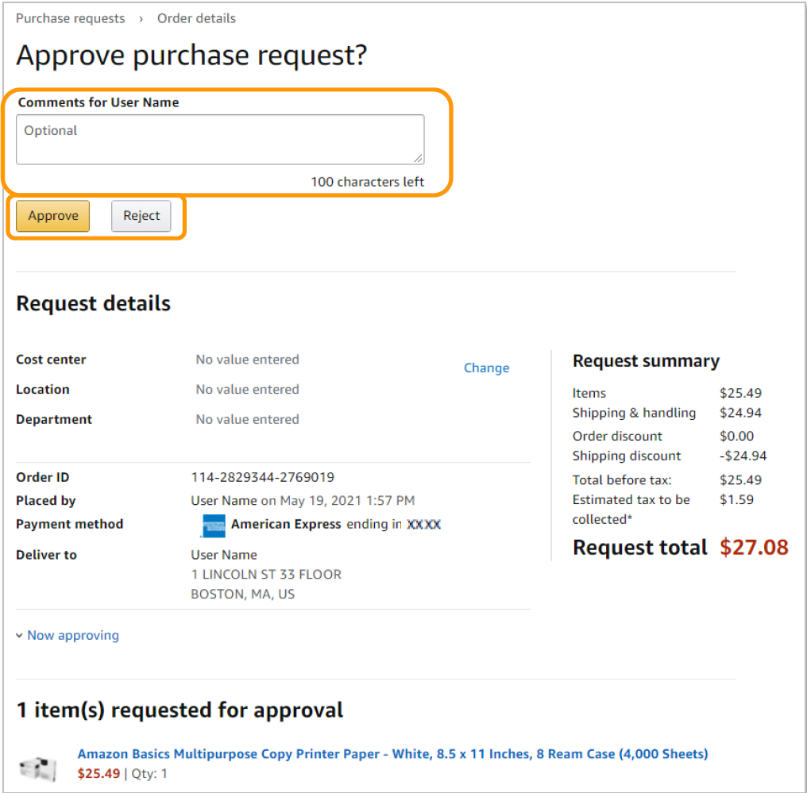
Approve/Reject
Review order details and Approve or Reject the order. You are also able to include comments on the reasoning for order approval or rejection for the user to review.

Slide 31
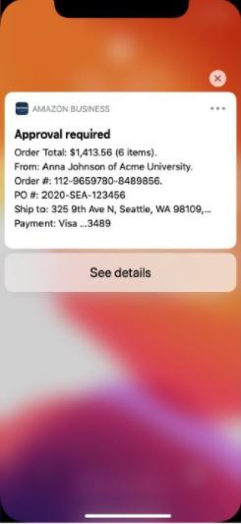
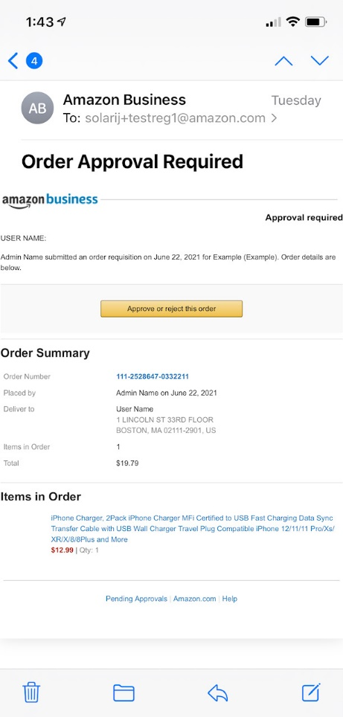
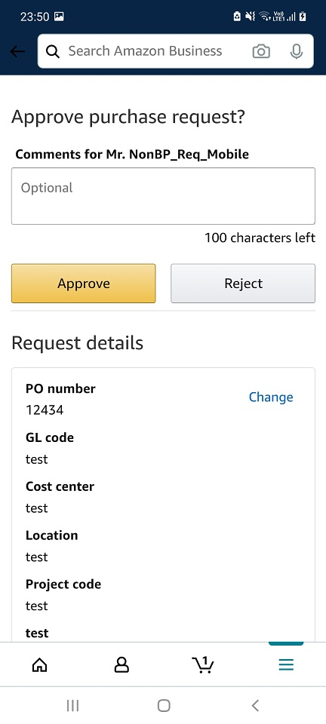
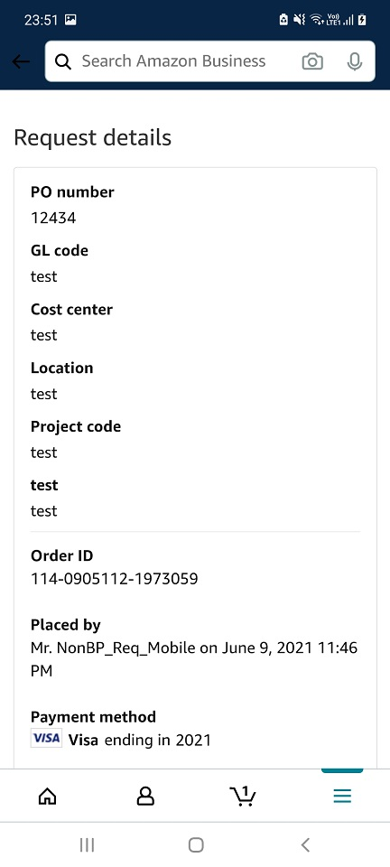
Approving Orders On the Go
Purchase requests can be approved directly from your mobile device with the Amazon Business Mobile App.
When an approver has the Amazon Business Mobile App installed on their mobile device and a user places an order with an approval policy required, the approver will get an email notifying them of the request as well as a push notification on their device.
The approval can be actioned from the push notification or the email.

Slide 32
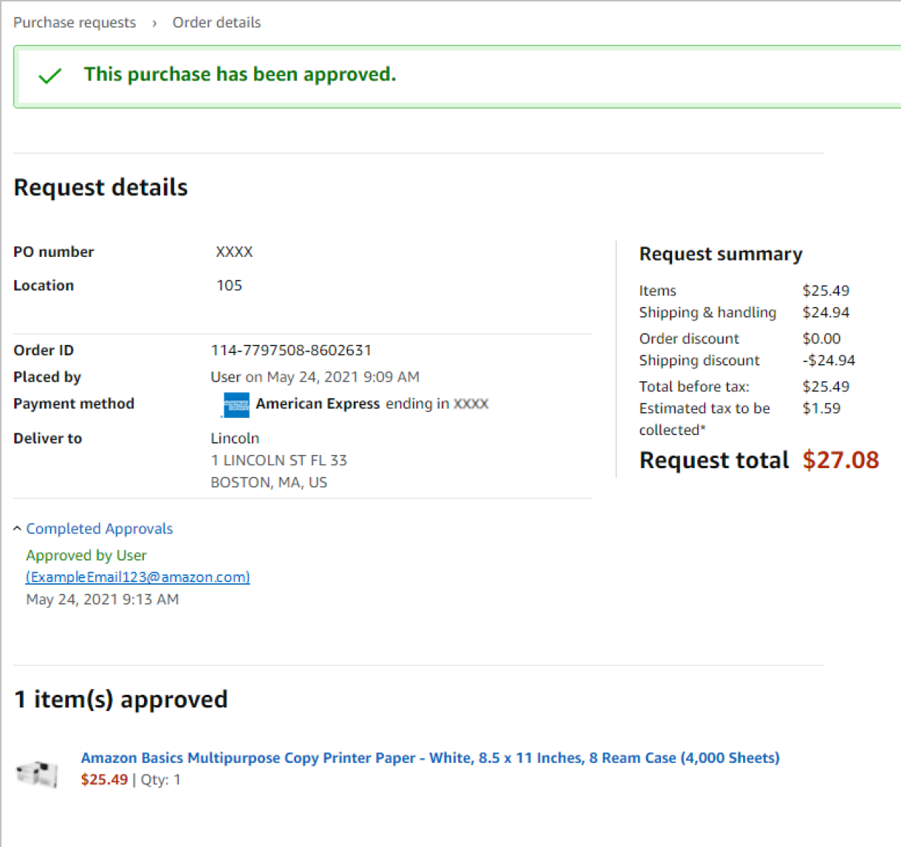
Email Confirmation
Once an order is approved or rejected, you will receive a confirmation and the order requestor will also be notified via email.

Slide 33
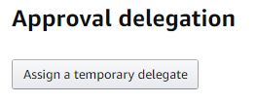
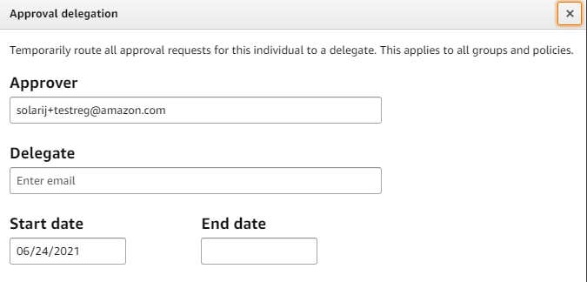
Assign an Approval Delegate
An approver can assign an approval delegate for time periods where that primary approver will be out of the office or unable to approve orders.
Navigate to your approval queue by selecting Approve Orders from the drop down menu in the top right hand corner of your homepage.
Click Assign a temporary delegate.
Enter approval delegate’s email address and the start and end date for the approval delegation to be applied and save.

Slide 34
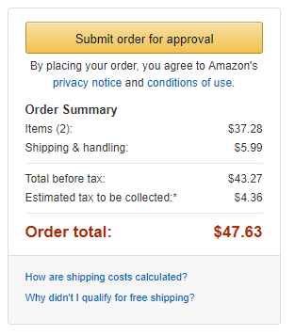
Approval Workflow – User Experience
All orders placed on the account are subject to approval before being fulfilled
How do I order with Approvals configured?
There are no additional steps to take to submit your order for approval. Check out as you normally would and you will see the option at checkout. As an approver, you will not have to approve your own orders despite selecting Submit order for approval at checkout.
Your order will not be processed until it is approved by the appropriate approver. Keep this in mind for shipping timelines. You will be notified over email once your order is submitted and then again once your order has been approved and processed. Just as with a normal order on Amazon, you will also receive relevant shipping updates.
If your order is not approved within 7 days, the order will automatically be canceled; however, the items in your order will not be deleted. If your order is canceled, you will need to submit the order again for approval.

Slide 35
Business Analytics

Slide 36
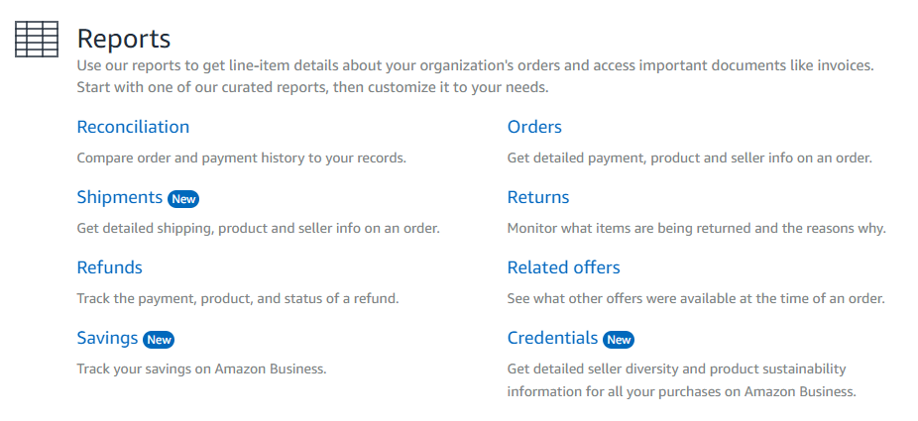
Amazon Business Analytics
Amazon Business Analytics provides the ability to:
Aggregate purchases to compare and track spend over time
Monitor and track 60+ data fields including customer info, shipment info, payment info, and seller info
Customize and save report templates to meet business needs
Download CSV files to analyze your data in excel

Slide 37
Your Orders

Slide 38
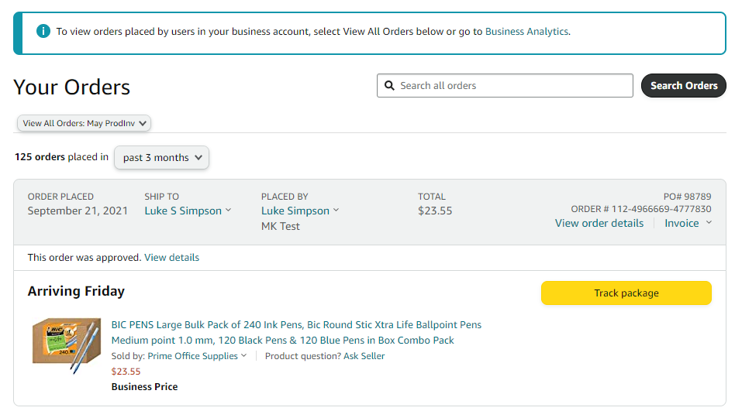
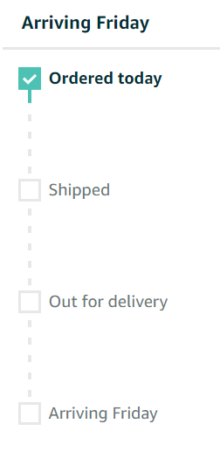
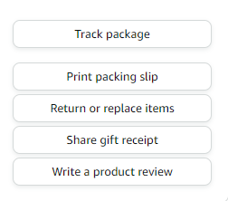
Your Orders
This section of the account provides additional detail regarding the status of all orders that have been placed within the Business Account.
Direct users to the Your Orders page to take actions such as initiating returns or tracking the delivery of a package.

Slide 39
Return an Item
When an item needs to be returned, have the user who placed the order navigate to Your Orders and select Return or replace items. For additional assistance, they contact Amazon Business Customer Service.
Use Contact Us or our Chat feature for assistance with Returns

Slide 40
Business Customer Support

Slide 41
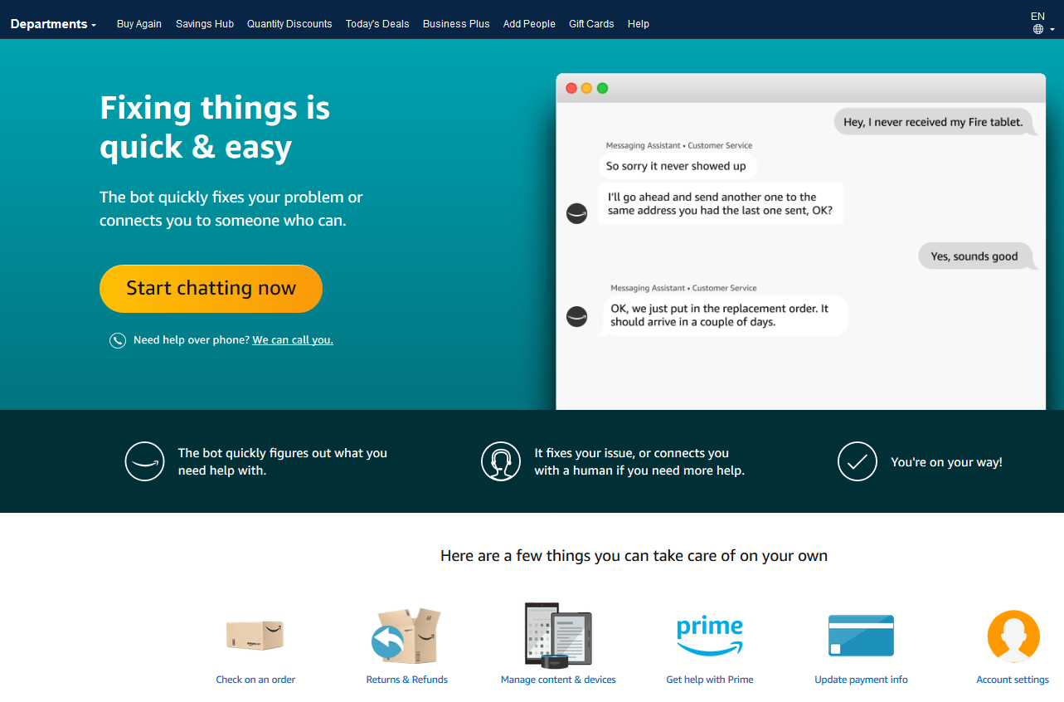
Business Customer Support
Dedicated U.S. based Business Customer Support can be reached a number of ways including email, chat and phone. Not sure what you’re looking for? Learn more about the features and benefits on Amazon Business HERE.

Slide 42
Common Customer Support Questions
jehillm@amazon.com
jehillm@amazon.com
See below for quick resolutions to frequently asked questions from your end users as well as contact information for a variety of support resources
Contact Business Customer Support: CLICK HERE
Provides end users the option to call, email, or live chat. Please use this method of contact for anything relating to an order, transaction, charge, or shipment
Call Business Customer Support:
888. 281. 3847
Your Customer Advisor – Jennifer Hill (jehillm@amazon.com)
This person is your point of contact for anything related to the Amazon Business account structure, new features and functionality, and questions that do not fall into the above categories

