Slide 1
Using the SRM VWR Punch-out Catalog for Laboratory Equipment and Supplies

Slide 2
Introduction
These reference materials show specifically how to use the VWR, International punch-out catalog to purchase Laboratory Equipment and Supplies within the Supplier Relationship Management (SRM) system.
Departmental staff placing orders must first hold the SRM Shopper role and have the related tab within myUK. If needed, additional SRM information is available on the Purchasing website at: http://www.uky.edu/Purchasing/SRM.htm
How-To Guide for Establishing Roles, including information on booking and taking the online curriculum to receive the Shopper tab in myUK.
Full SRM Shopper Training Guide
This Quick Reference Guide assumes the Shopper has already set their Personal Settings. If assistance is needed with Personal Settings or other features beyond what is reflected here, you may find the larger Shopper training documents to be useful.

Slide 3
Who Uses the VWR Punch-Out Catalog
The VWR punch-out catalog is used solely with the Supplier Relationship Management (SRM) system. All areas of campus use SRM as their procurement system with the exception of Hospital areas.
All areas of the academic campus should utilize the punch-out catalog through SRM for purchases of VWR Laboratory Equipment and Supplies products regardless of order amount. This includes items previously purchased utilizing procurement card.

Slide 4
Partnership Overview
VWR, International is the University’s strategic partner for provision of Laboratory Equipment and Supplies.
As contract recipient, VWR is the primary provider of laboratory equipment and supplies for departments. In addition to best value pricing, the University receives the following benefits from the partnership:
Access to the widest array of laboratory equipment and supplies provided by a single supplier to the University (> 1 million products available)
Provision of punch-out e-catalog with contract pricing and advanced features for the University research community
Electronic invoicing
Departmental promotional credits for purchase of VWR core items from the punch-out catalog
Based on the nature of the contract award, VWR is the first source for the University for purchase of laboratory equipment and supplies.

Slide 5
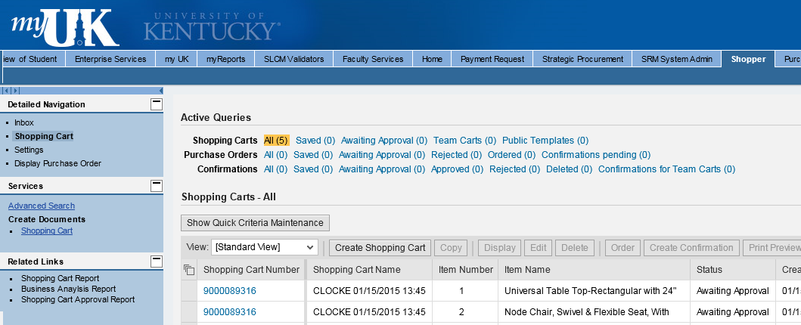
Begin Shopping Cart from POWL
1. Start from the Shopper tab within myUK
2. Select Shopping Cart from Site Navigation to display the POWL
3. Click Create Shopping Cart

Slide 6
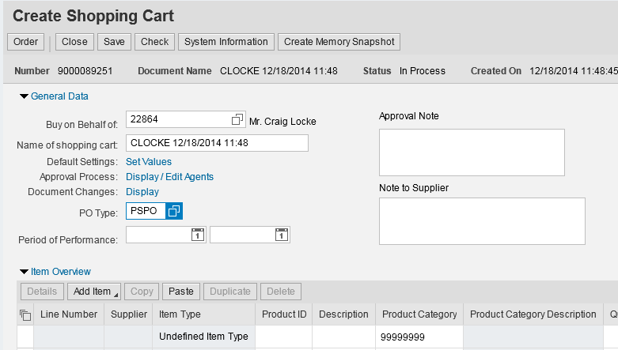
Set Header Values
Two Header values – Account Assignment and Delivery Address – can be set at the beginning of the ordering process. This will copy the data to all line items as they are placed into the Shopping Cart.
4. Click Set Values within Default Settings

Slide 7
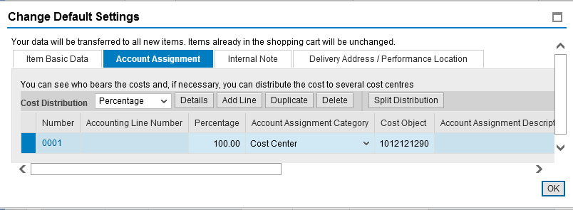
Set Account Assignment (Header Level)
Enter Cost Center or WBS Element information if the entire order will be charged to the same cost object structure. Alternatively, if you need to charge various line items to different cost objects, this can be entered later within Line Item Details.
5. Default Account Assignment Category is Cost Center. You can also select WBS Element from the dropdown if needed.
6. Enter the Cost Center or WBS Element number as applicable
TIP: A WBS Element relates to grants.

Slide 8
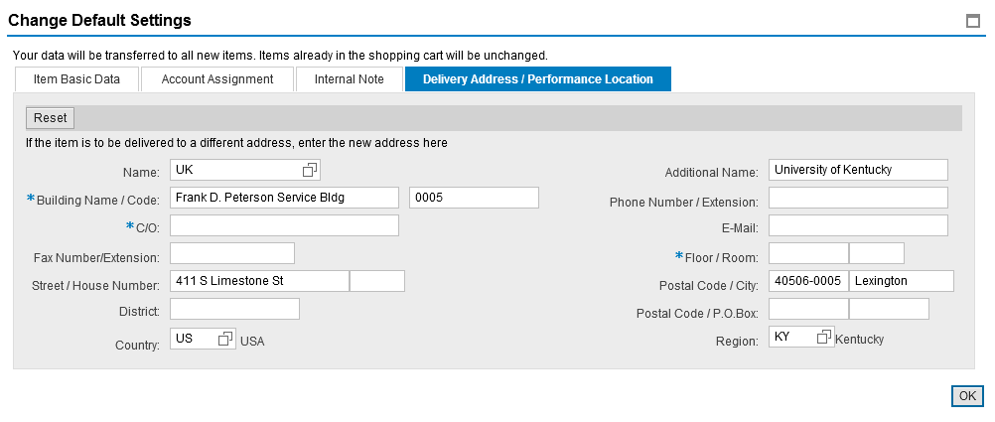
Set Delivery Room/Floor
7. Select the Delivery Address / Performance Location tab

Slide 9
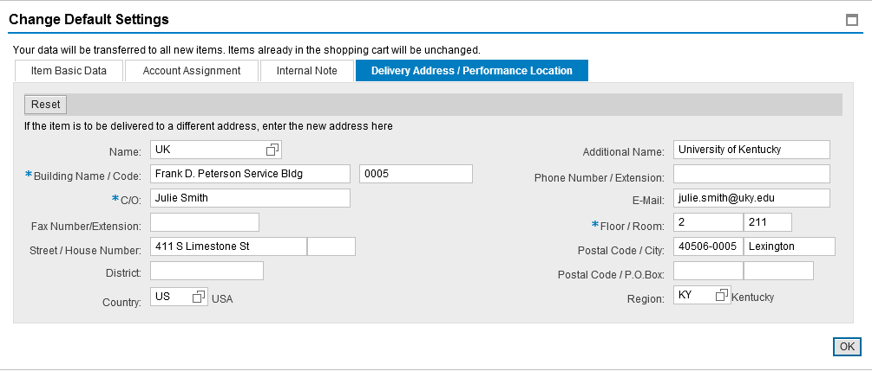
Set Delivery Room/Floor
Delivery information flows in from Personal Settings and reflects your building address only. The Shopper must add the contact person, floor, and room number, etc. This must be completed for each cart and will populate to all line items placed in the cart.
Important: Be sure to enter this delivery information at the header level. Bypassing entry of the contact person, floor, and room number within Set Values will require the information to be entered for each line item in the bottom Details section.
8. Complete contact person, floor, room, etc.

Slide 10
Setting an Alternate Delivery Building
At the Shopper’s choosing, you can enter an alternate building for delivery on a cart-by-cart basis. See Appendix at the end of this reference guide for step-by-step instructions.
If needed, follow instructions within Appendix section of this reference guide. Important: Do not freeform building delivery information into the fields.

Slide 11
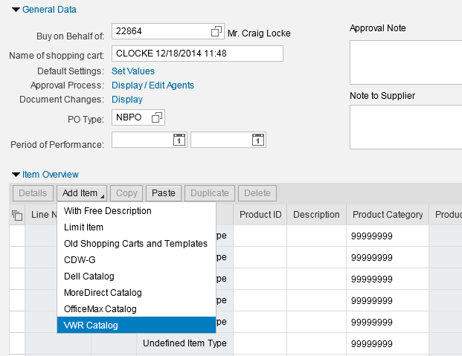
Select VWR Catalog from Add Item Menu
Punch-out catalog items are ordered through the Add Item dropdown menu.
9. Click Add Item and select VWR Catalog. Shopper will be transferred from SRM to the VWR punch-out site.

Slide 12
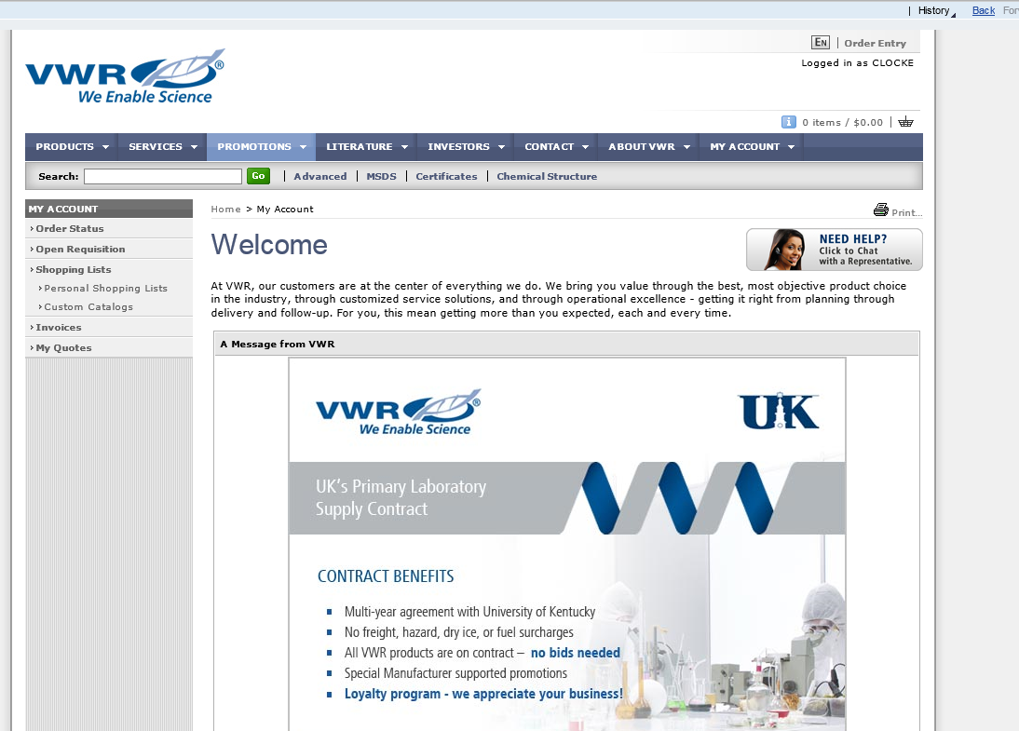
VWR Punch-out Landing Page
Upon arrival at the VWR punch-out landing page, utilize the Search feature to locate equipment or supplies you would like to order.
TIP: If you decide not to order products, you can click the Back button to return to SRM at any time.
Searches - Find products using text or part numbers with the Quick Search feature.
Note: Punch-out orders will time out after several minutes of inactivity. It is a good idea to move through the shopping process expeditiously and in one sitting.

Slide 13
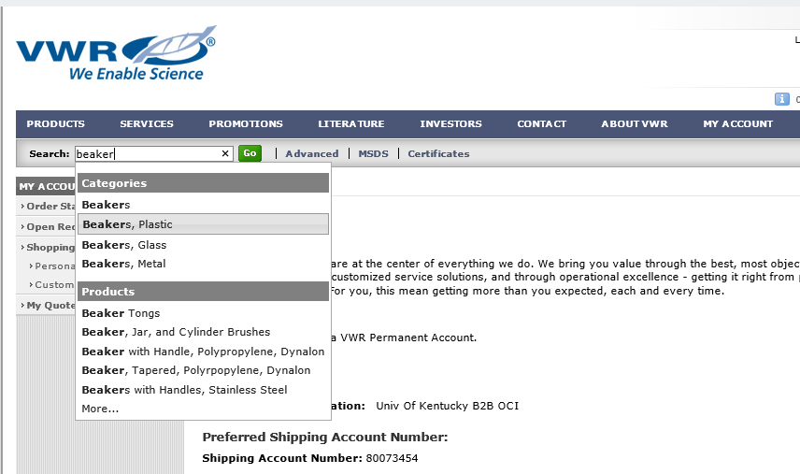
Quick Search Options
10. Enter keyword(s) or product number to find matches against product information, MSDS, Certificates, or website content. As you type, the search feature will auto-suggest possible items. You can also cross reference competitor or manufacturer part numbers.

Slide 14
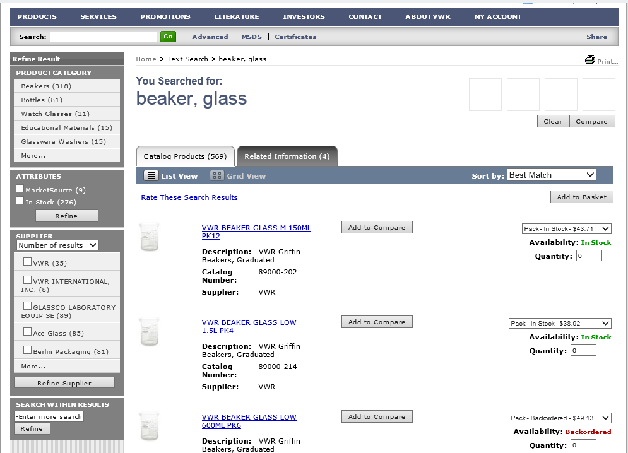
Search Results and Options
Different views and refinement tools make searches faster and more successful. Results are weighted on how well the data matches your search word (relevancy).
If desired you can refine your results by product category, product attributes, supplier, or search within current results using additional keywords.

Slide 15
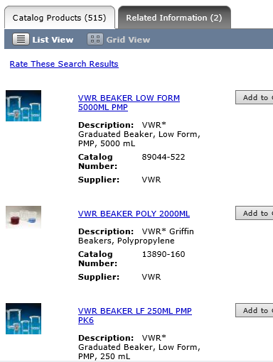
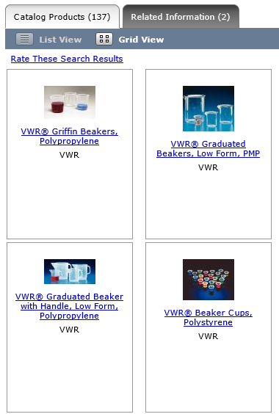
Search View Options
You can use different views to navigate search results. “List View” shows all product/size combinations and enables you to add directly to your VWR basket or compare products. “Grid View” shows a rolled-up view of products.
List View
Grid View

Slide 16
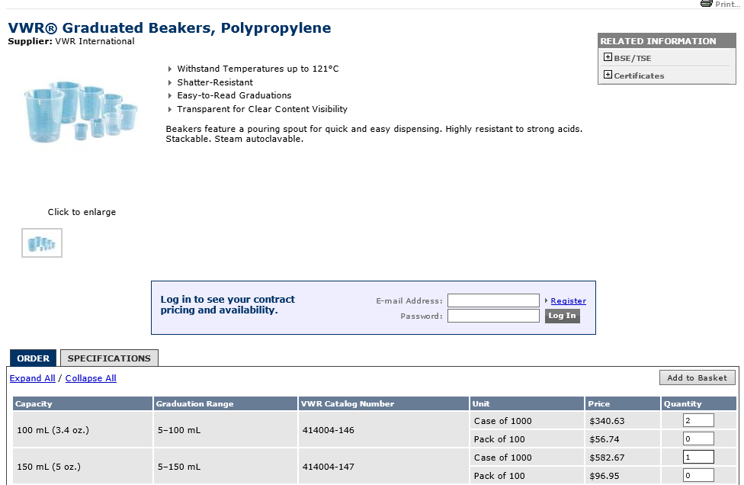
Selecting Items For The VWR Shopping Basket
11. As you locate needed items, enter the order quantity for each.
12. Click Add to Basket

Slide 17
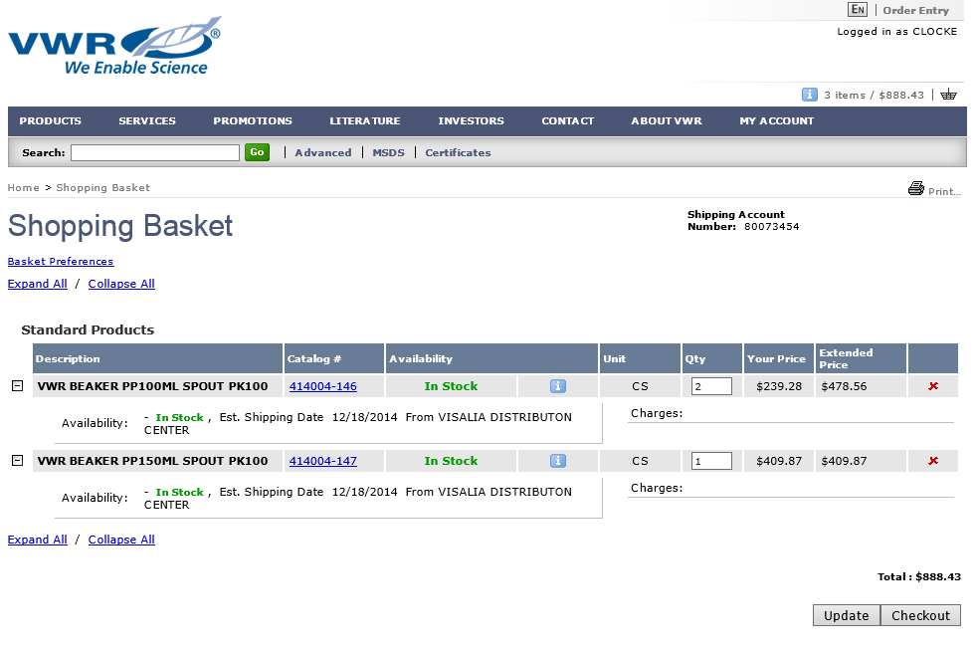
Manage VWR Shopping Basket
If you want to add more items to the VWR basket, continue to locate items through the Quick Search feature.
From the VWR Shopping Basket, you can see availability of items and estimated shipping date.

Slide 18
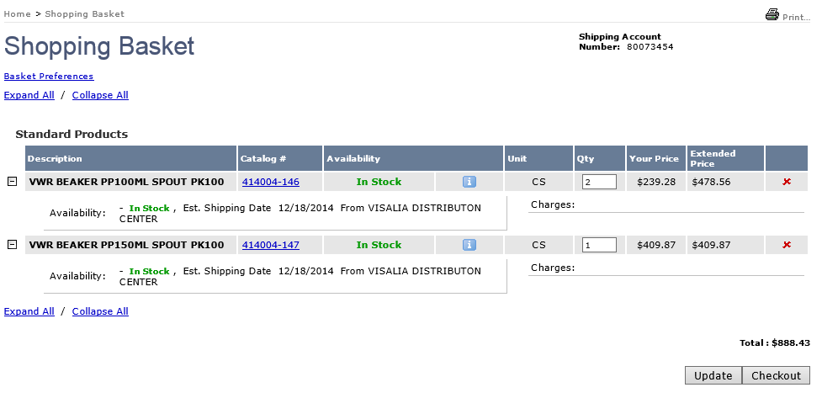
VWR Shopping Basket Update or Checkout
You can update quantities, delete items, or proceed to Checkout.
To delete items from the basket, click X
13. When you are finished Shopping, click Checkout to return VWR basket items to SRM.
If you change quantities, click Update to reflect the changes.

Slide 19
Learn Advanced Features On VWR Punch-out
Slides 20 through 34 provide information on additional tools available on the VWR punch-out catalog:
Advanced Search Features
MSDS and Certificates Searches
Obtaining Supporting Documents
Build Shopping Baskets Quickly Using the Order Entry Feature
Create and Manage Shopping Lists for Future Orders
VWR Building Blocks Portal/Compounds
Utilizing Online Quotes
Restricted Items
To bypass these features and return your VWR basket to SRM, proceed to Slide 35.

Slide 20
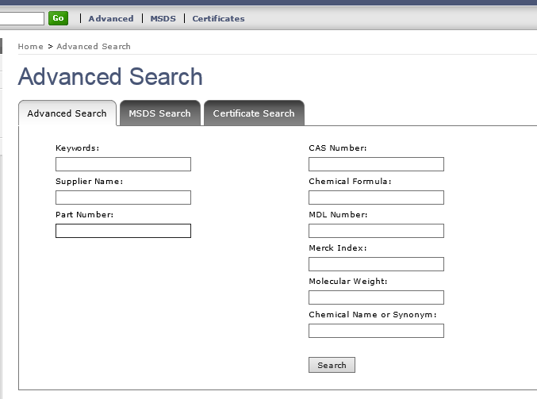
Using Advanced Search
Advanced Search: If needed you can search for matches against specific product information, such as CAS number, chemical formula, chemical name / synonym, or molecular weight.

Slide 21
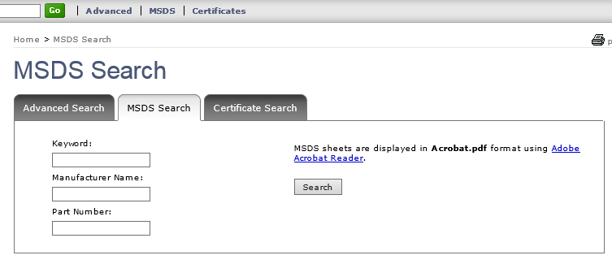
MSDS Search
MSDS Search: Search for MSDS sheets by part number or text to locate a .pdf version of an MSDS to download or print.

Slide 22
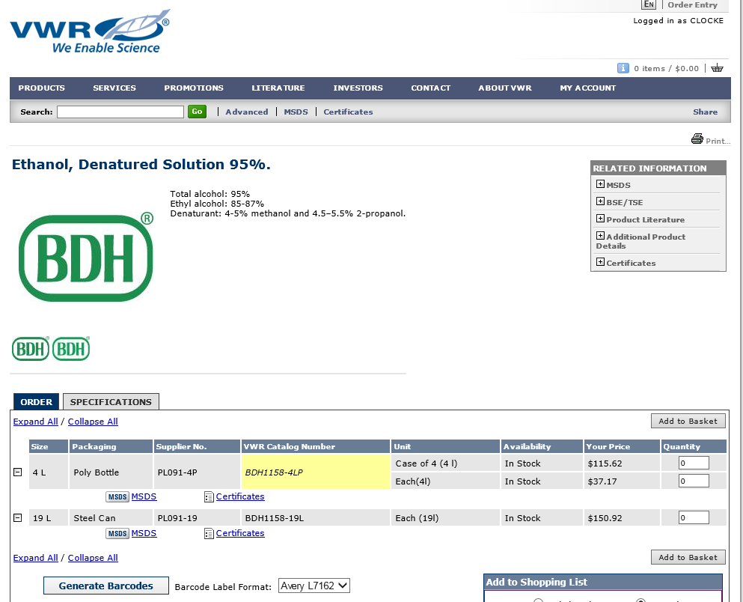
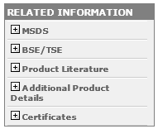
Related Information On Product Pages
Product Pages: As you order items from the product pages, you can also find resources related to a product from Sales Literature and Manuals to MSDS sheets and Certificates.

Slide 23
Related Information On Product Pages
Product Pages: Specifications and accessories (if applicable) can be found in the product details section. This also contains links to MSDS and Certificates, if applicable.

Slide 24
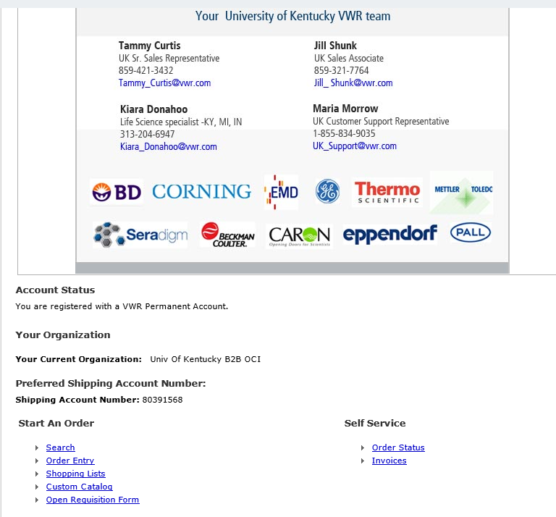
Building a Shopping Basket Using Order Entry
There are multiple ways to locate and place items into your VWR Shopping Basket. The Order Entry feature is a way to quickly add a list of catalog numbers to your cart.
You can access Order Entry from the bottom of the VWR punch-out landing page.

Slide 25
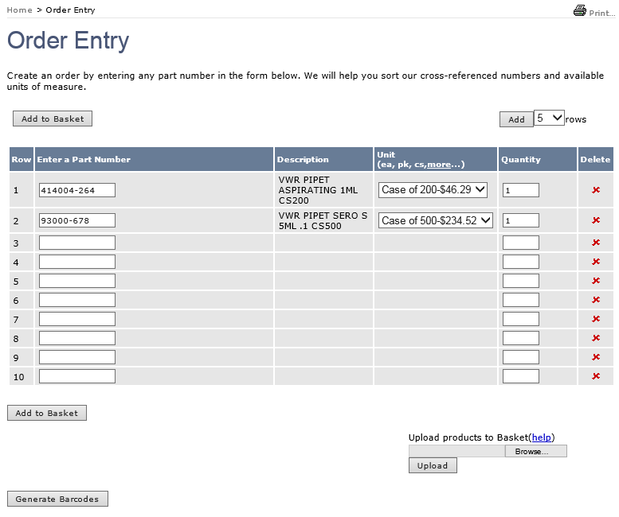
Building a Shopping Basket Using Order Entry
Use VWR, Manufacturer, or Competitors’ Catalog Numbers along with Unit of Measure and Quantity. For non-VWR numbers, you will be given cross reference alternatives from which to select. You can enter up to 35 items at a time.
Once entered you can add all items to the VWR Basket at once.
Alternatively, you can upload a CSV or text file of part numbers.

Slide 26
Build and Manage Shopping Lists
Frequently used or hard-to-find items may be saved in “Shopping Lists”. These lists allow the Shopper to quickly load items to a future VWR basket.
Shopping Lists can be accessed through the landing page or anytime through the My Account selection.

Slide 27
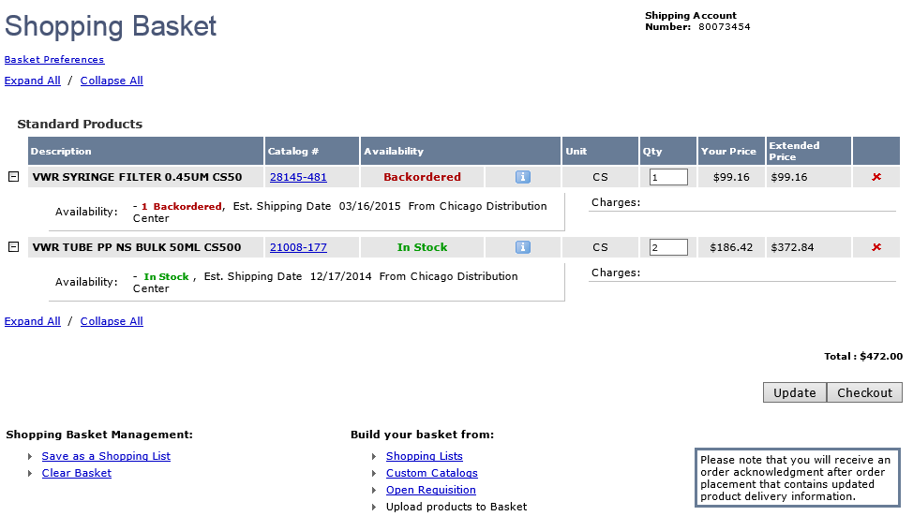
Build and Manage Shopping Lists
To build a Shopping List, place products in your basket and click Save as Shopping List.

Slide 28
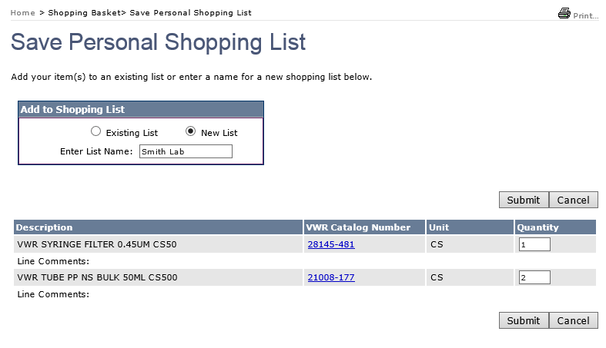
Build and Manage Shopping Lists
Name the list and click Submit

Slide 29
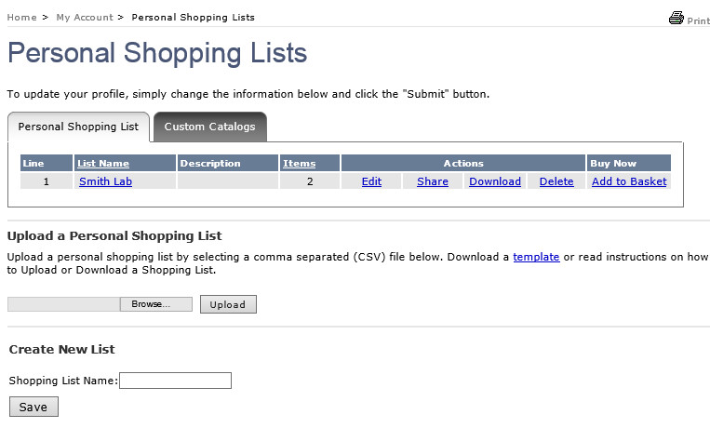
Build and Manage Shopping Lists
You can then manage or order the list from your “Personal Shopping List” page at a later time.

Slide 30
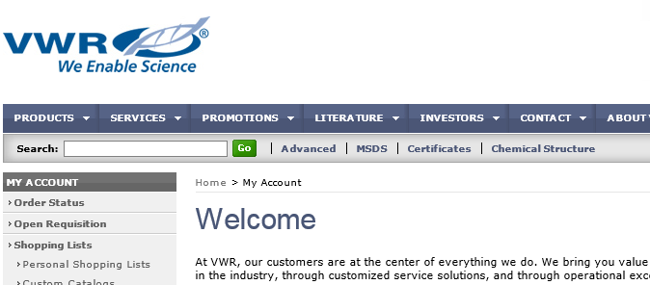
VWR Building Blocks Portal / Compounds
Shoppers can access up to 650,000 compounds through the Building Blocks Portal
Sub-structure, similarity or exact search, or use an SD file, SMILES, chemical name, CAS number, MCFD number, etc.
Real time price and availability
Shopper can add items into their basket and return them through the punch-out environment back to SRM

Slide 31
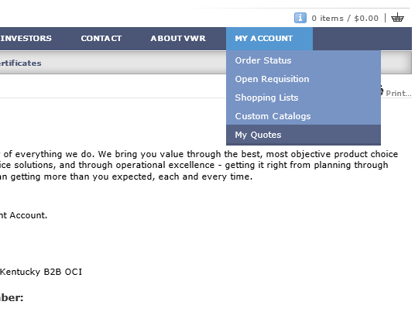
Ordering Customized Quotes through the Punch-out
VWR Customer Service Representative(s) can write customized quotes for departments on an as-needed basis. Typically, customized quotes are for larger, more complex laboratory equipment purchases.
1. Once a customized quote is prepared by the sales rep, it can be found within the My Quotes selection of My Account

Slide 32
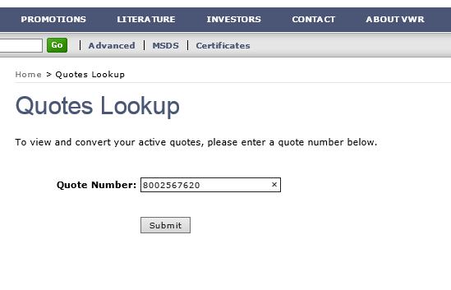
Ordering Customized Quotes through the Punch-out
2. Enter the quote number provided by the sales rep

Slide 33
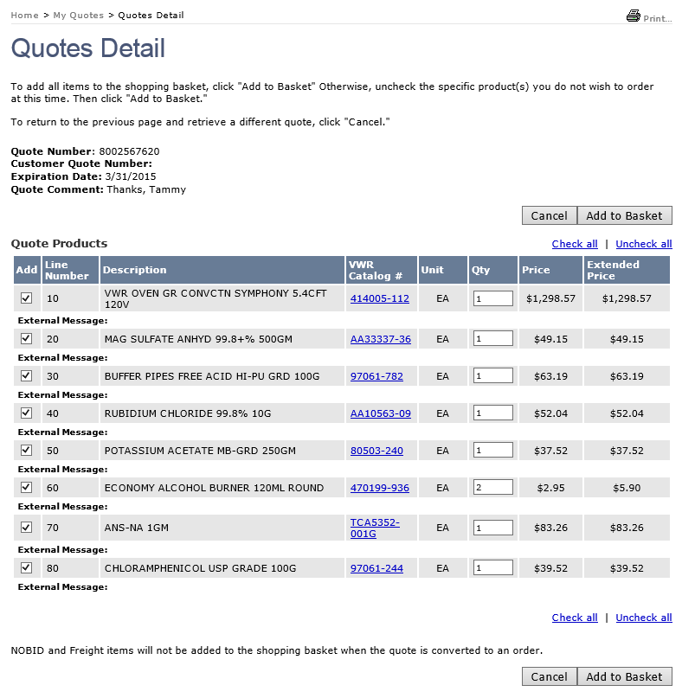
Complete Customized Quotes through the Punch-out
Shopper can add all or select items from the customized quote for the VWR basket

Slide 34
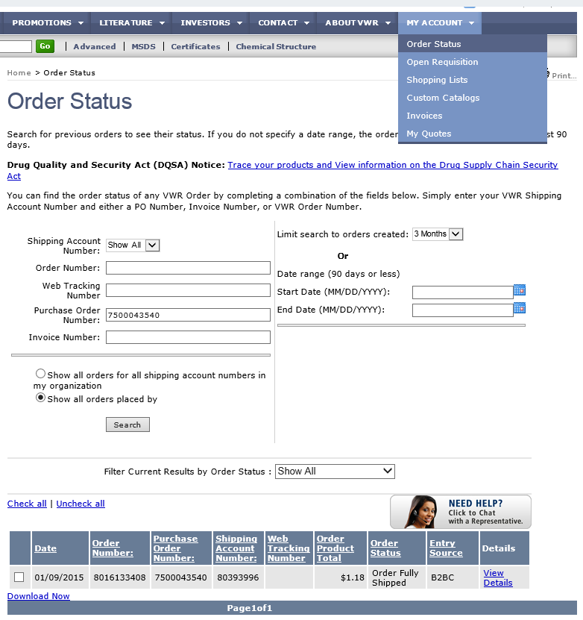
Order Status
Order Status Information can be found under the My Account section of the menu bar.
1. Select Order Status from within My Account
2. Complete entries as required and click Search to retrieve status information on placed orders

Slide 35
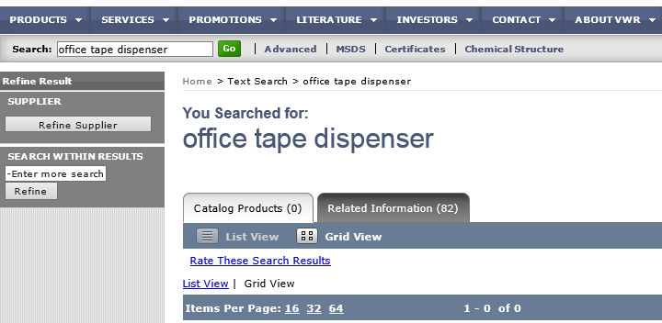
Restricted Items
VWR offers items which are not scientific or laboratory-related in nature. Some of these conflict with other University contracts. In the event, searches or product selections are performed on restricted items, the results will be 0 or “Item not found”.
Example 1: General office supplies are required for purchase from OfficeMax
Example 2: General office furniture is restricted to the University’s office furniture contracts

Slide 36
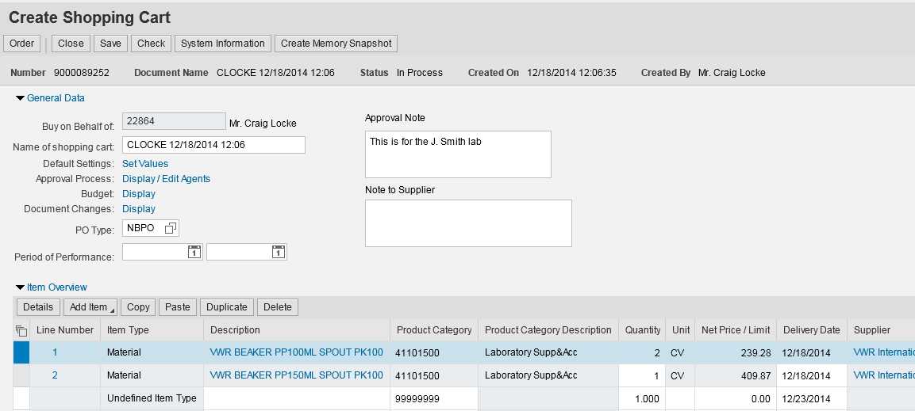
Punch-out Items Return to SRM Shopping Cart
Optional: Shopper can add an Approval note (internal only; does not print on purchase order) or Note to Supplier (prints on purchase order).
The punch-out order populates back to the SRM Shopping Cart.
14. Click to open Details (bottom) section of Shopping Cart

Slide 37
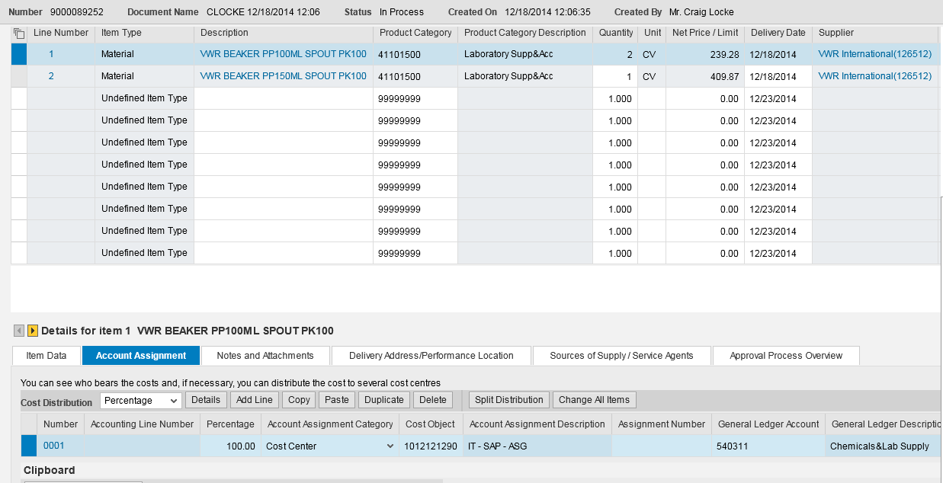
Review/Complete Account Assignment
If you need to assign cost object information to different line items, complete Account Assignment tasks here. If you completed this at the header level, you do not need to make changes to the cost object structure.
15. Select Cost Center or WBS Element from the dropdown menu
16. Enter the cost center or WBS Element number
Note: If you apply account assignment information at the line item level, it will need entered manually, or copied and pasted, for each line.

Slide 38
Complete Account Assignment – GL Account
17. GL Account 540311 will load by default. You can overwrite with a different GL Account if desired.
Note: If ordering a single item that is over $5000, a capital GL Account must be entered. 550030 is the most common capital GL used with scientific equipment.

Slide 39
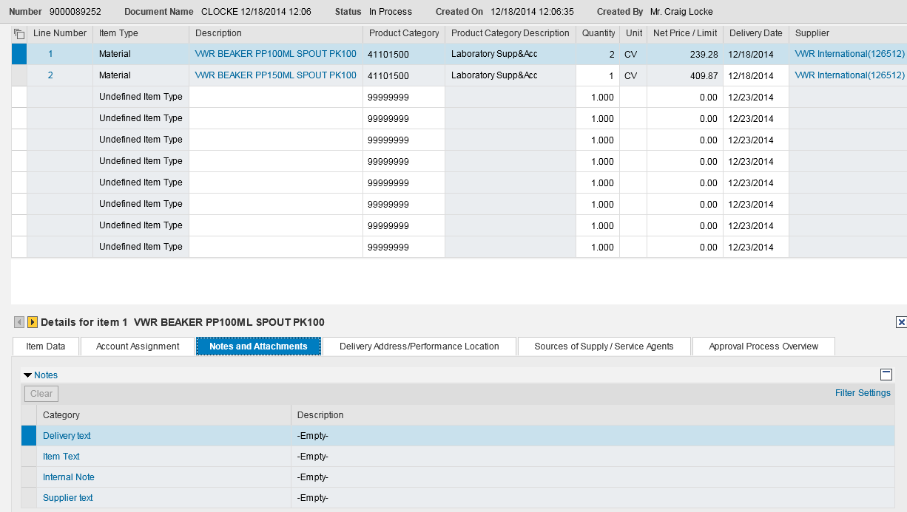
Punch-out Catalog Order – Details Section
TIP: Delivery Address information was already set at header level under Default Settings/Set Values. Thus, nothing needs entered or modified in Details section.
18. Optional: Notes and file attachments can be added at the line item level. (Note: There is no quote attachment involved for a VWR punch-out order.)

Slide 40
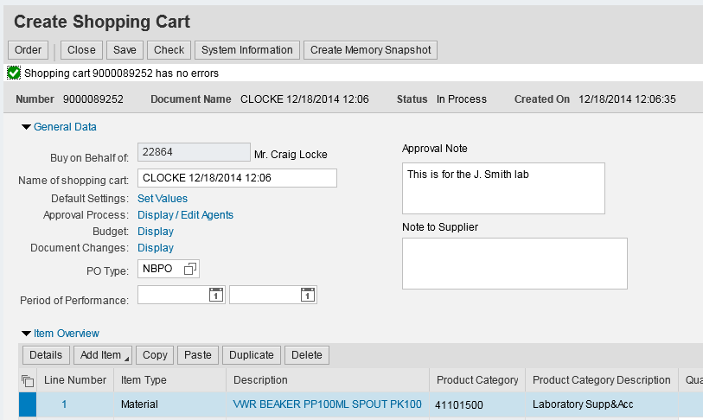
Check and Complete Order
19. Click Check to confirm whether errors exist
Remember: Only click the SAVE button if the order is to be placed on HOLD.
A Saved Shopping Cart is incomplete; it resides in the Shopper’s POWL and does not move forward.
20. Click Order to finish

Slide 41
Order Successful and Close Window
21. Click Close button
Order was successful

Slide 42
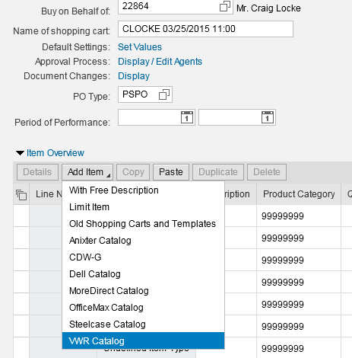
TIP: Accessing VWR Punch-out Without Shopping
If you need to visit the VWR punch-out site for information purposes only, without creating an order, (e.g., check item availability, get pricing, etc.) you do not have to visit Set Values or set the PO type. Simply select VWR Catalog from Add Item menu to visit the site. Exit from VWR and close the empty cart when finished.
To simply browse the VWR punch-out, select the catalog to visit the site.

Slide 43
Special Notes on VWR Punch-out Shopping Carts
Special features are added to SRM for VWR punch-out catalog orders:
Orders totaling less than $5000 from the VWR punch-out catalog do not require approval. SRM automatically transmits a purchase order once a cart is created and ordered.
For orders over $5000, SRM automatically transmits the purchase order after the appropriate approvals have taken place.
Goods Confirmations are required for all VWR punch-out catalog orders.
VWR generates an electronic invoice and transmits to Accounts Payable for payment.
The Shopper receives an email message confirming when the invoice posts. To maintain a system of checks and balances, the Shopper’s supervisor is copied on the email notification.

Slide 44
What Happens Next at VWR
Once the purchase order is received by VWR, an email acknowledgement is sent to the Shopper.
The order is shipped to the Delivery Address indicated on the Shopping Cart. Once received, remember to create a Goods Confirmation in SRM to confirm on the items.
VWR transmits the electronic invoice to Accounts Payable.

Slide 45
VWR Product Support
Questions regarding VWR laboratory equipment and supplies, MSDS, supporting documents, order inquiries, customized quotes, etc. should be directed to:
Phone: 855-834-9035
Email: UK_Support@vwr.com
Tammy Curtis, Central Kentucky Sales Representative, is the dedicated representative for the University account.
If you need expedited (overnight or 2-day shipment) freight for an order, call 855-834-9035 to request. Cut-off to expedite next day orders is 12:00 noon. Reference the 75XXXXXXXX purchase order number when placing the request.

Slide 46
Post-Order Changes and Purchasing Support
If changes are needed after a purchase order is placed, contact Purchasing with questions or for guidance.
The Contracting Officer for the VWR, International agreement and scientific / laboratory purchases for the University is:
Debbie Konichek
Phone: 257-5792
Email: dkonichek@uky.edu
Alternatively, you can email SRMHelp@uky.edu at any time for system or ordering assistance.

Slide 47
SRM Help Resources
SRM Resource Page on Purchasing web site: http://www.uky.edu/Purchasing/srm.htm
myHelp – MM & Purchasing Help web site: http://myHelp.uky.edu/rwd/HTML/MM.html
Both sites contain Quick Reference Cards, updated and printable course manuals, Reference Manual, etc.
Assistance email for any SRM-related inquiry: SRMHelp@uky.edu

Slide 48
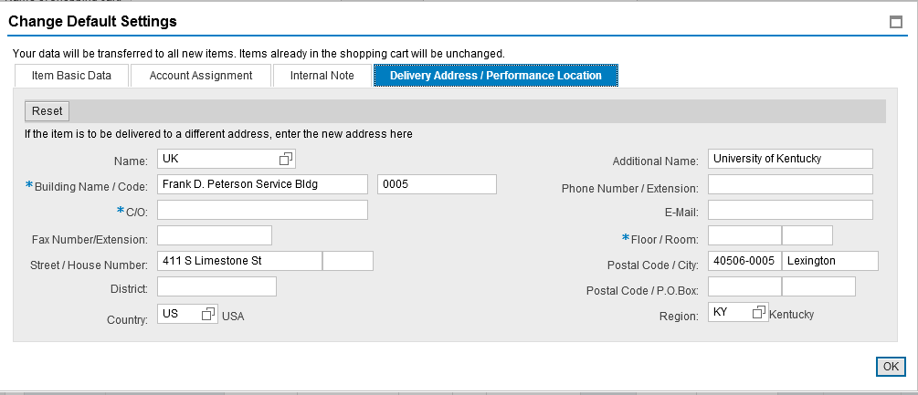
Appendix: Setting an Alternate Delivery Building
At the Shopper’s choosing, you can enter an alternate building for delivery on a cart-by-cart basis.
If an alternate delivery building is needed, click on the Possible Entries icon on the right side of Name box.
Important: Be sure to select an alternate building through the steps described. Do not enter building information or speed sort code via free hand.

Slide 49
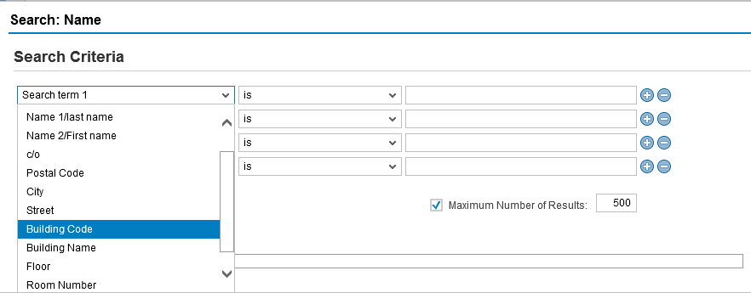
Appendix: Setting an Alternate Delivery Building
The most common method to find an alternate delivery building is a search using either Building Code (Speed Sort) or Building Name wildcard(*) search.
Example 1: Building Code – Select Building Code from the Search term 1 dropdown menu

Slide 50
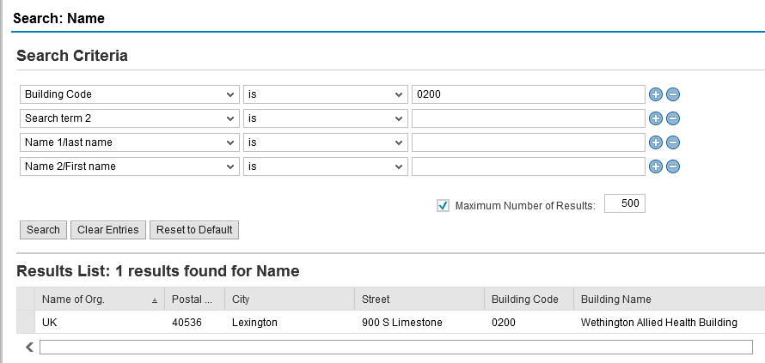
Appendix: Setting an Alternate Delivery Building
Enter the building/speed sort number and click Search. Click on the building from the results list to choose it for your Shopping Cart.

Slide 51
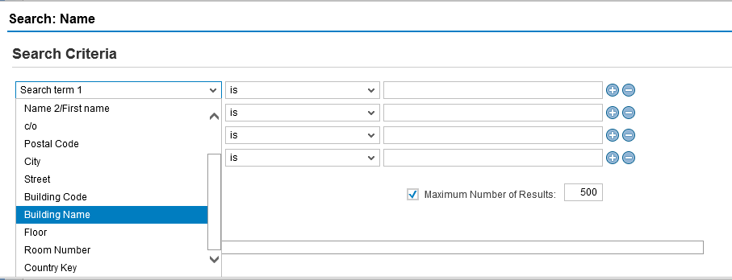
Appendix: Setting an Alternate Delivery Building
Example 2: Building Name – Select Building Name from the Search term 1 dropdown menu

Slide 52
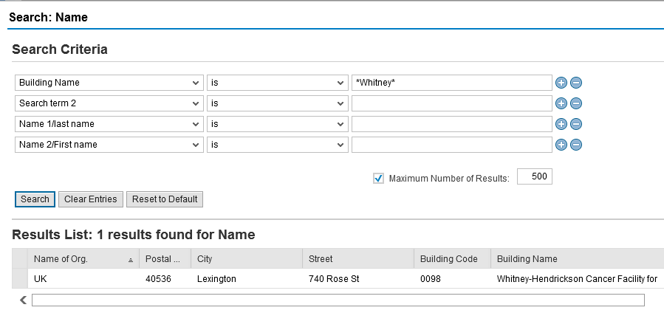
Appendix: Setting an Alternate Delivery Building
Enter building name key term with (*) on each end and click Search. Click on the building from the results list to choose it for your Shopping Cart.

Slide 53
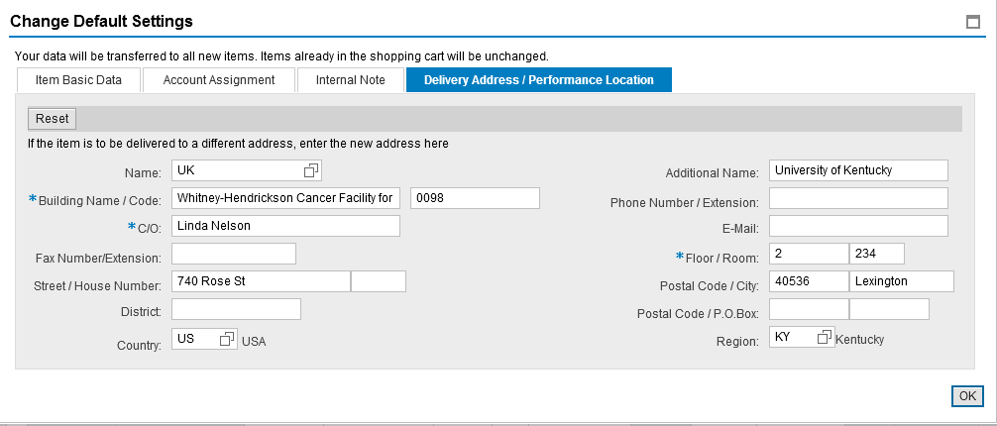
Appendix: Setting an Alternate Delivery Building
Regardless how you select an alternate building, once it populates into the Shopping Cart, complete with C/O name, floor, and room number as normal.
Complete delivery C/O name, floor and room numbers

