Slide 1
Using the SRM Steelcase Furniture e-Catalog

Slide 2
Introduction
These reference materials show specifically how to use the Steelcase
e-catalog to purchase furniture within the Supplier Relationship Management (SRM) system.
Departmental staff placing orders must first hold the SRM Shopper role and have the related tab within myUK. If needed, additional information is available on the Purchasing website at: http://www.uky.edu/Purchasing/SRM.htm
How-To Guide for Establishing Roles, including information on booking and taking the online curriculum to receive the Shopper tab in myUK.
Full SRM Shopper Training Guides
This Quick Reference Guide assumes the Shopper has already set their Personal Settings, including default delivery building. If assistance is needed with Personal Settings or other features beyond what is reflected here, you may find the larger Shopper training documents useful.

Slide 3
Overview
Steelcase Inc. is one of the primary contract suppliers of furniture to the University of Kentucky. The e-catalog contains standard and customized products available for ordering. Shoppers may select finishes, colors, caster types, etc. when applicable during the Shopping process.
More complex orders (e.g., cubicles, high volume projects) are processed via written quotes from the local dealer. Quotes can be retrieved by quote number and loaded directly into a Shopper’s cart from within the catalog.
All products are “delivered and installed”, meaning the local dealer will deliver items directly into the department’s space and unpackage, assemble, and install as needed.
Steelcase products are customized for each purchase and are non-returnable.
The local Steelcase dealer for the University is Office Resources Inc. (ORI), Lexington. Pricing is based on State of Kentucky government contract.

Slide 4
Who Uses The Steelcase e-Catalog
The Steelcase e-catalog is used solely with the Supplier Relationship Management (SRM) system. All areas of campus use SRM as their procurement system with the exception of Hospital areas.
All areas of the academic campus should utilize the e-catalog through SRM for purchases of Steelcase furniture regardless of order amount. This includes items previously purchased utilizing procurement card.
*See notes on following slide regarding College of Medicine purchases.

Slide 5
College of Medicine Furniture Standards
College of Medicine (COM) faculty and staff follow a furnishings standards policy as set forth by their Dean’s office. Furnishings are standardized on the Steelcase line of furniture and may not be purchased from other sources. Office Resources Inc. is the sole provider of furniture for COM and only select fabrics, finishes, etc. are permitted.
COM Shoppers are to use the Retrieve Quotes tool for all orders of Steelcase products. Due to furnishing standards policies, each quote must be individually prepared by the ORI sales representative and loaded onto the e-catalog for transfer. COM Shoppers may not purchase from the standard items loaded on the e-catalog landing page. Beginning with slide 32 are steps showing how to load a quote once Default Settings (Account Assignment and Delivery Address) are entered.
For questions or information, contact Ann Emmerson, Facilities Operations Director, email: ann.emmerson@uky.edu, phone: 323-0008.
Susan Durham is the ORI dedicated sales representative for College of Medicine quotes.

Slide 6
Furniture Restrictions
The following restrictions apply to furniture purchases:
Lounge Furniture
Any lounge furniture that will be placed in a public space (e.g., building lobby, auditorium, etc.) must be reviewed and approved by the University’s Interior Designer. For questions or purchase review, contact: Shareese Malone (samalo2@uky.edu) or Debi Miller (debi.miller@uky.edu).

Slide 7
Ordering Standard
e-Catalog Items

Slide 8
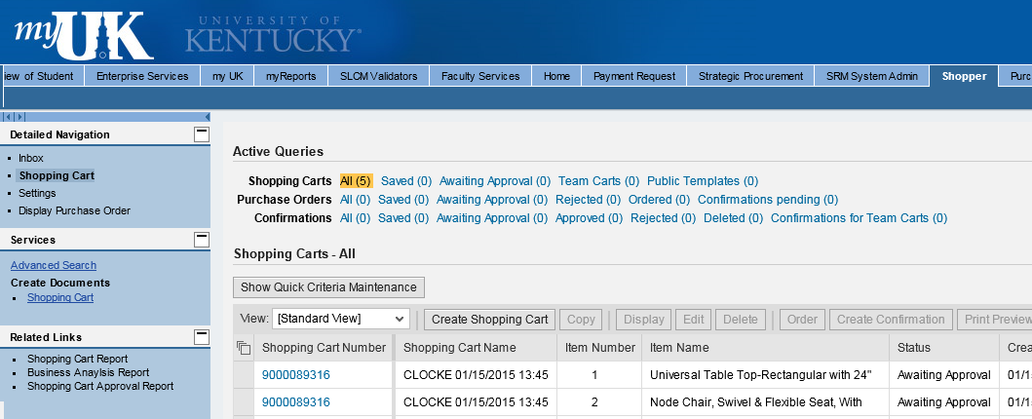
Begin Shopping Cart from POWL
1. Start from the Shopper tab within myUK
2. Select Shopping Cart from Site Navigation to display the POWL
3. Click Create Shopping Cart

Slide 9
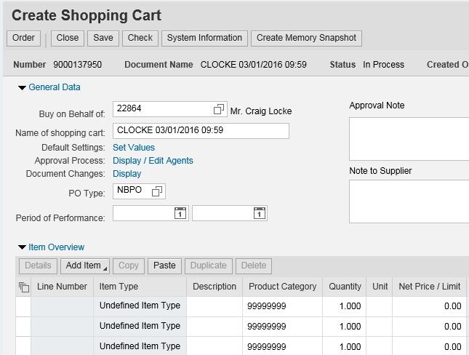
Default Settings: Set Values
Two default values – Account Assignment and Delivery Address – are set at the beginning of the ordering process. This will copy the data to all line items as they are placed into the Shopping Cart, thus bypassing tedious line item entries later.
4. Click Set Values within Default Settings

Slide 10
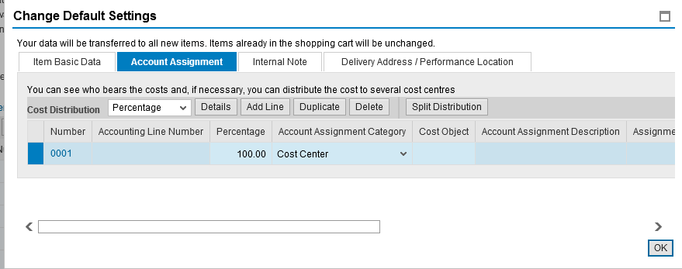
Set Account Assignment
5. Click Account Assignment

Slide 11
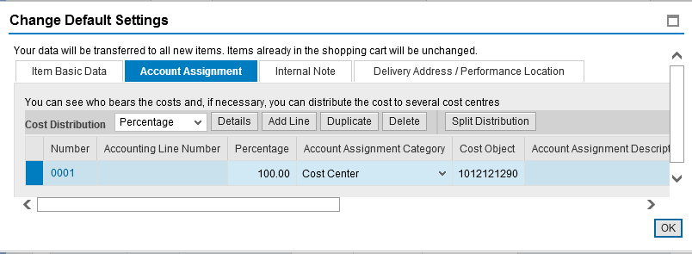
Set Account Assignment
Enter Cost Center or WBS Element information if the entire order will be charged to the same cost object structure. Alternatively, if you need to charge various line items to different cost objects, this can be entered later within the Line Item Details.
6. Default Account Assignment Category is Cost Center. You can also select WBS Element from the dropdown if needed.
7. Enter the Cost Center or WBS Element number as applicable
TIP: WBS Elements relate to grants.

Slide 12
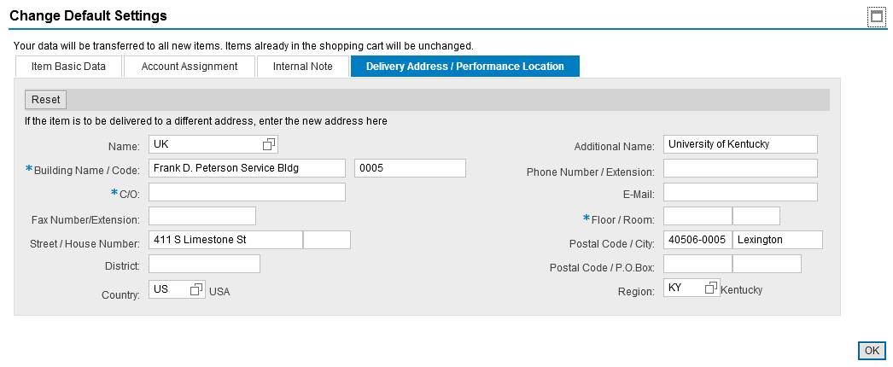
Complete Delivery Address
8. Select the Delivery Address / Performance Location tab

Slide 13
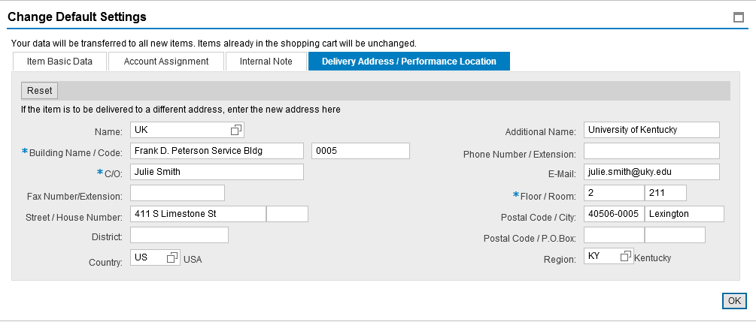
Complete Delivery Address
Delivery information flows in from Personal Settings and reflects your building address only. The Shopper must add the Contact Person, Floor, and Room Number, etc. This must be completed for each cart and will populate to all line items placed in the cart.
Important: Be sure to enter the delivery information at Set Values. Bypassing entry of the contact person, floor, and room number within Set Values will require the information to be entered for each line item in the bottom Details section.
9. Complete contact person, floor, room, etc.

Slide 14
Setting An Alternate Delivery Building
At the Shopper’s choosing, you can enter an alternate building for delivery on a cart-by-cart basis. After selecting the new building by number, complete the section with contact person’s name and room and floor numbers.
If desired, click the possible entries icon and select alternate building by speed sort number. Remember to add in the contact person, floor, and room number.
Important: Remember to select replacement delivery addresses through the menu search based on building code. Do not freehand building information other than C/O, floor, and room.

Slide 15
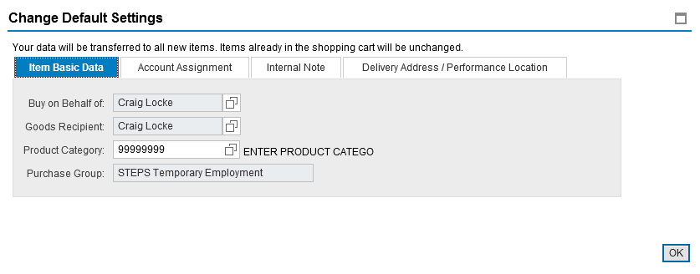
Finish Header Values
10. Click OK to finish Set Values

Slide 16
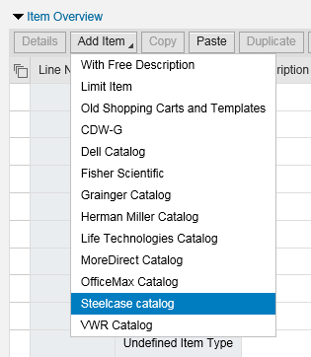
Select Steelcase Catalog from Add Item Menu
E-Catalog items are ordered through the Add Item dropdown menu.
11. Click Add Item and select Steelcase Catalog.
Shopper will be transferred
to the Steelcase e-catalog.

Slide 17
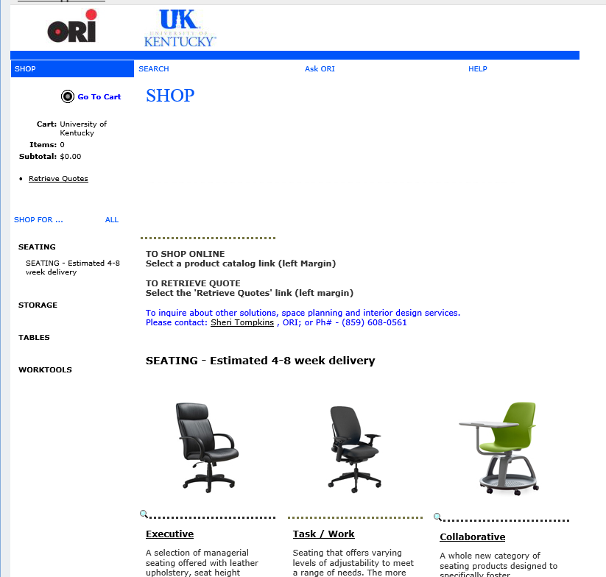
Select Standard Items To Order
Shoppers can also search for products by keyword
12. For standard products, utilize the category menu on the left for needed item(s).
Note: E-Catalog orders will time out after several minutes of inactivity. It is a good idea to move through the shopping process expeditiously and in one sitting.

Slide 18
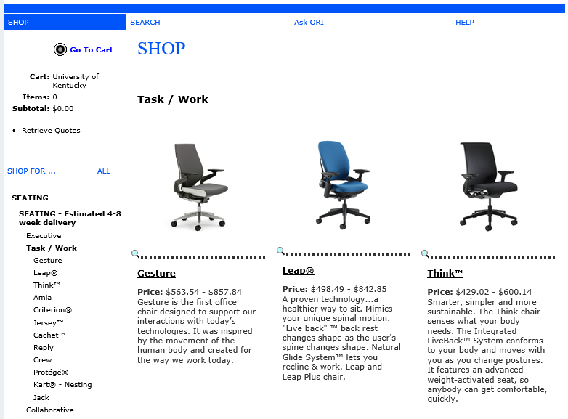
Select Standard Items To Order
13. Shoppers can view various models and products within each category. Navigate menu choices to locate item(s).

Slide 19
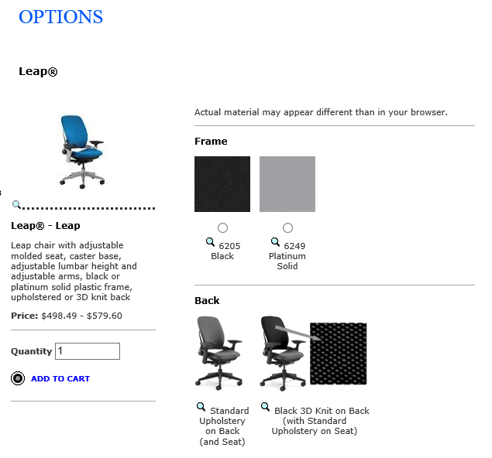
Select Standard Items To Order
Product summary reflects details, item price range, etc.
14. Many items, particularly seating, can be customized based on color, finish, fabric, etc. Check options when applicable.

Slide 20
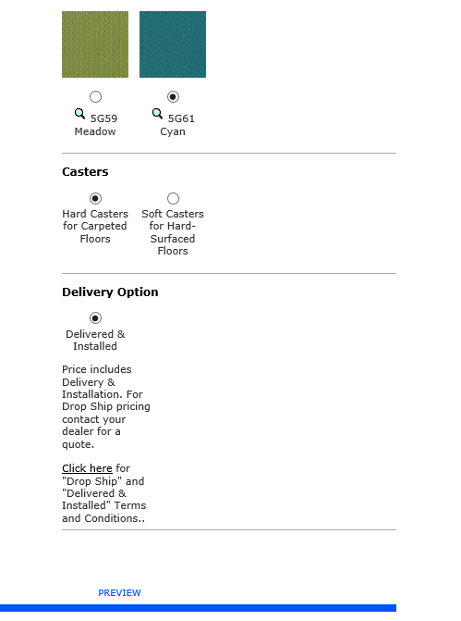
Select Standard Items To Order
15. Continue to select options navigating toward bottom of page
16. Select Delivered and Installed as delivery option
17. Click Preview to see item as customized

Slide 21
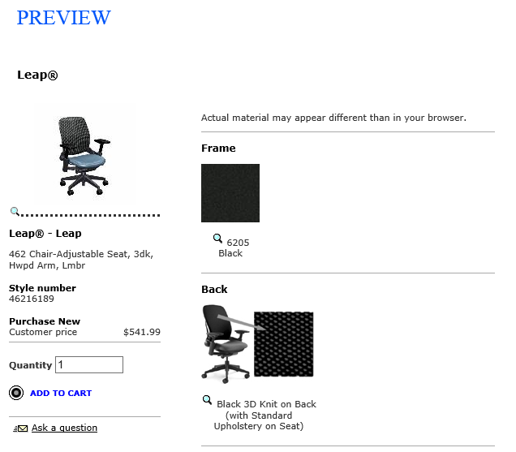
Select Standard Items To Order
Preview option shows product with Shopper-selected options. Use the zoom icon to enlarge preview.
Pricing will show with options (Note: Delivered/installed charge will show at check-out.)
18. Adjust quantity and click Add to Cart

Slide 22
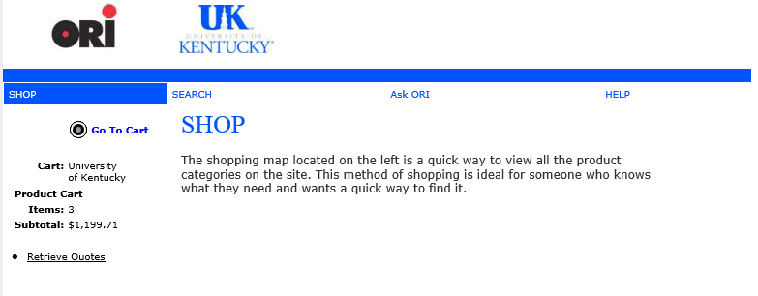
Select Standard Items To Order
19. Continue Shopping for items as needed. When ready for checkout, click Go To Cart.

Slide 23
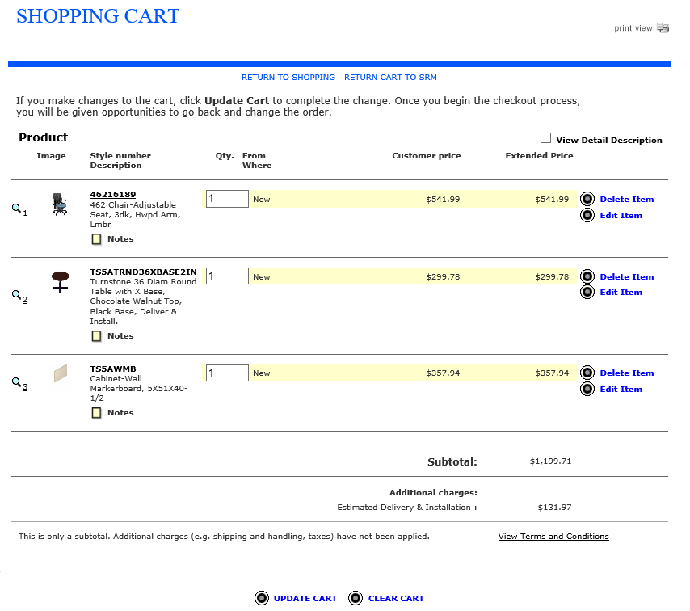
Select Standard Items To Order
From the Steelcase cart, Shopper can update quantities, delete items, edit options, etc.
Be sure to click Update Cart if you make changes. Shopper can also remove some or all items from the cart.

Slide 24
Select Standard Items To Order
20. When ready to check-out, click Return Cart to SRM

Slide 25
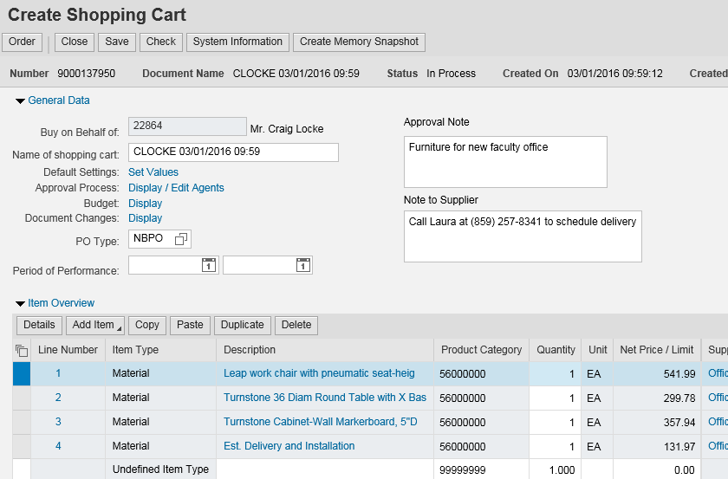
E-Catalog Items Return to SRM Shopping Cart
Optional: Shopper can add an Approval note (internal only; does not print on purchase order) or Note to Supplier (prints on purchase order).
The e-catalog order populates back to the SRM Shopping Cart.
21. Click to open Details (bottom) section of Shopping Cart

Slide 26
Review/Complete Account Assignment
If you need to assign cost object information to different line items, complete Account Assignment tasks here. If you completed this earlier within Set Values, you do not need to make changes to the cost object structure.
22. Select Cost Center or WBS Element from the dropdown menu
23. Enter the cost center or WBS Element number
Note: If you apply account assignment information at the line item level, it will need entered manually, or copied and pasted, for each line.

Slide 27
Complete Account Assignment – GL Account
24. GL Account 540300 will load by default. You can overwrite with a different GL Account if desired.
Reminder: If ordering a single item that is over $5000, a capital GL Account must be used. 550130 is the most common capital GL used with capitalized furniture.

Slide 28
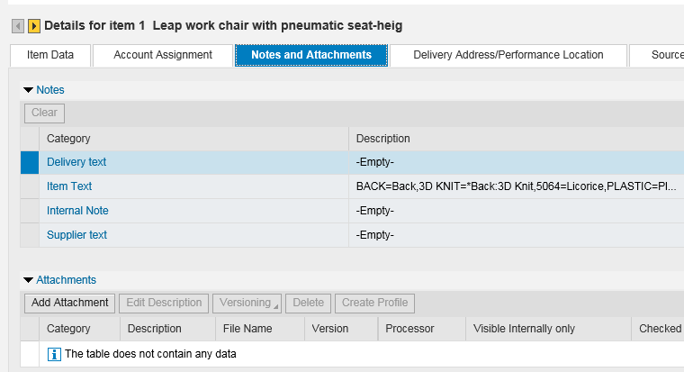
E-Catalog Order – Details Section
TIP: Delivery Address information was already set at header level under Default Settings/Set Values. Thus, nothing needs entered or modified in Details section.
25. Optional: Notes and file attachments can be added at the line item level. (Note: There is no quote attachment involved for a Steelcase e-catalog order.)

Slide 29
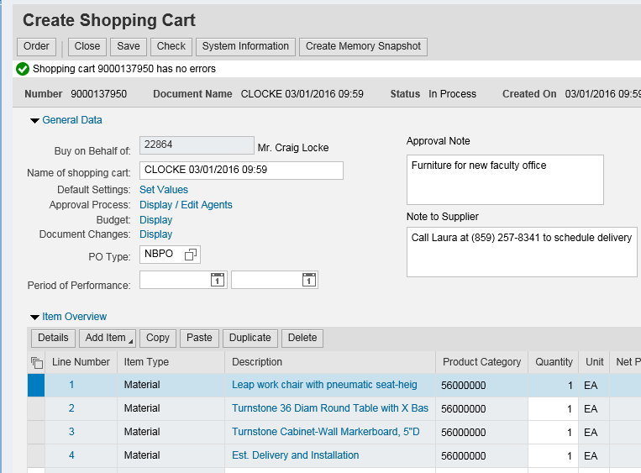
Check and Complete Order
26. Click Check to confirm whether errors exist
Remember: Only click the SAVE button if the order is to be placed on HOLD.
A Saved Shopping Cart is incomplete; it resides in the Shopper’s POWL and does not move forward.
27. Click Order to finish

Slide 30
Order Successful and Close Window
28. Click Close button
Order was successful

Slide 31
What Happens Next?
Orders < $5000 do not require approval. SRM automatically transmits a purchase order once a cart is created and ordered.
Orders > $5000 move to Approver’s workflow. Upon approval, the purchase order is generated and transmitted to Steelcase.
The Shopper receives email confirmation from Steelcase/ORI upon receipt of purchase order.
Office Resources Inc. (ORI) will arrange delivery and installation of furniture. Goods Confirmations are required for Steelcase e-catalog orders.
Steelcase/ORI generate an electronic invoice and submits to Accounts Payable for payment. The Shopper receives an email message confirming when the invoice posts.

Slide 32
Create Cart Utilizing
Quote Feature

Slide 33
Customized Quotes
Due to complexity of furniture purchases, not all items can be ordered as a standard product. Cubicle installations or larger volume purchases require a sales representative to come onsite and form a customized quote for departments’ needs.
Customized sales quotes are automatically loaded by Office Resources Inc. (ORI) onto the e-catalog with a notification emailed to the Shopper. Shoppers can locate quotes through the following steps, review, and transfer all items into their Steelcase cart.
COM Shoppers are to use the Retrieve Quotes tool for all orders of Steelcase products. Due to furnishing standards policies, each quote must be individually prepared by the ORI sales representative and loaded onto the e-catalog for transfer. COM Shoppers may not purchase from the standard items loaded on the e-catalog landing page. The following steps show how to load a quote once Default Settings (Account Assignment and Delivery Address) are entered in the header section of the Shopping Cart.

Slide 34
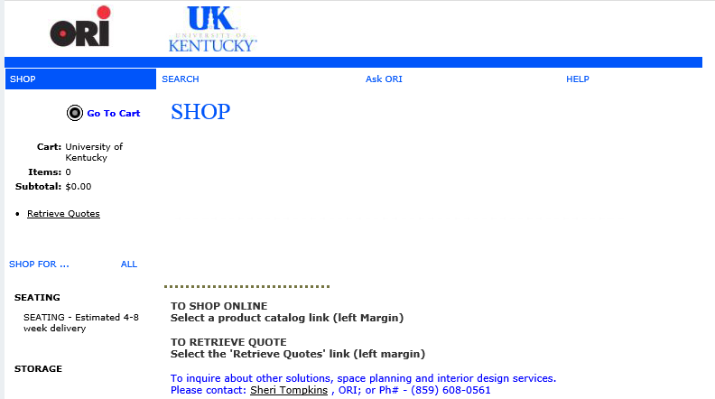
Retrieve Customized Quote
1. Within the e-catalog, click Retrieve Quotes

Slide 35
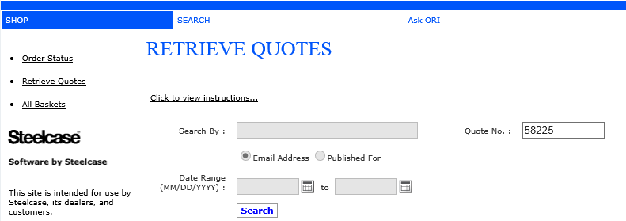
Retrieve Customized Quote
2. Enter the quote number from email
Note: If you have problems using the quote number search function, try searching wide open with all entries blank for the entire quote listing.
3. Click Search

Slide 36
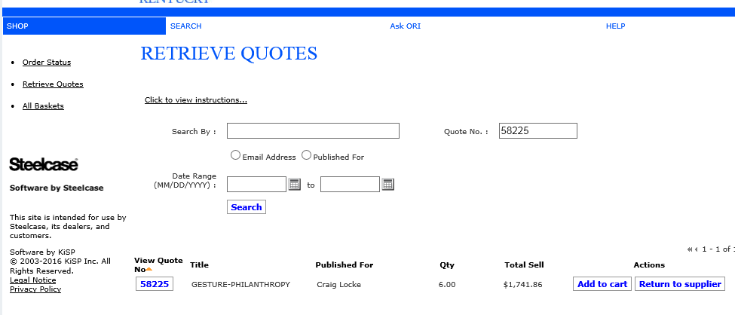
Retrieve Customized Quote
4. Click View Quote to access contents

Slide 37
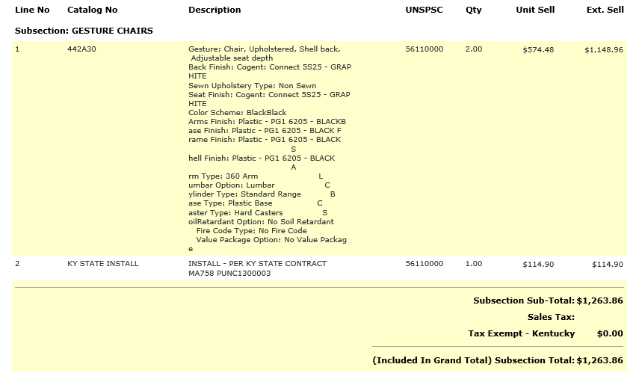
Retrieve Customized Quote
5. Review quote for line items, catalog numbers, quantities, and pricing

Slide 38
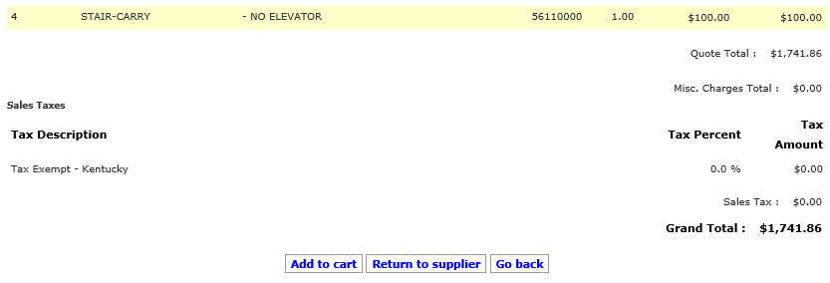
Retrieve Customized Quote
6. Click Add to Cart
7. Click Confirm

Slide 39
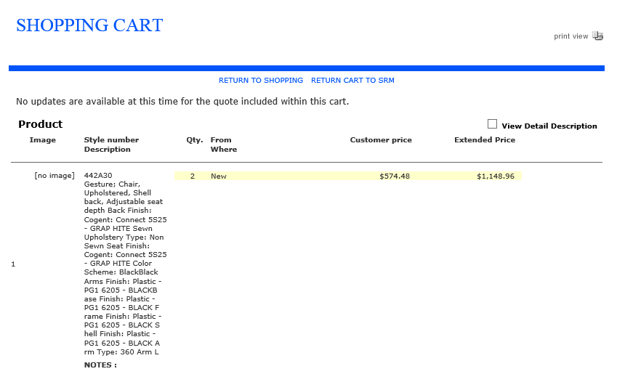
Retrieve Customized Quote
8. Quote items transfer into Steelcase cart. Click Return Cart to SRM and finish order as normal.
TIP: Double-check your Shopping Cart once items return to myUK/SRM to ensure all items transferred correctly.

Slide 40
Steelcase Product Support
Questions regarding Steelcase furniture, order inquiries, customized quotes, etc. should be directed to:
Education
Sherri Tompkins, Account Representative
Office Resources Inc. (ORI) - Lexington
Phone: (859) 241-2616
Email: stompkins@oriusa.com
Healthcare and College of Medicine
Susan Durham, Account Representative
Office Resources Inc. (ORI) - Lexington
Phone: (859) 241-2621
Email: sdurham@oriusa.com

Slide 41
Post-Order Changes and Purchasing Support
If changes are needed after a purchase order is placed, contact Purchasing with questions or for guidance.
The Purchasing contact for the Steelcase contract and related furniture purchases for the University is:
Craig Locke
Phone: 257-2964
Email: clocke@uky.edu
Alternatively, you can email SRMHelp@uky.edu at any time for system or ordering assistance.

Slide 42
SRM Help Resources
SRM Resource Page on Purchasing web site: http://www.uky.edu/Purchasing/srm.htm
Assistance email for any SRM-related inquiry: SRMHelp@uky.edu

