Slide 1

SRM Shoppers Introduction
SRM_SHO_301

Slide 2
What is SRM?
Supplier Relationship Management (SRM) is SAP’s e-procurement interface and serves as the University’s formal procurement system. It is web-based in nature and integrates with SAP functionality, e.g., invoicing, accounting, reporting, etc.
SRM enables departments to procure goods and services using a “Shopping Cart” environment within myUK. It generates savings and streamlines procurement for the University through use of electronic catalogs and related processes.
Contractual components of the system (e.g., e-catalogs) are managed by the Purchasing Division while the Enterprise Applications Group – Materials Management Team (EAG-MM) manages systems aspects.
2

Slide 3
Who Should Receive SRM Shopper Training?
Any persons authorized to perform procurement functions for their department or unit are eligible to complete training and receive the Shopper role. This includes administrative/other staff or faculty conducting purchases on behalf of their departments or units.
Departments can choose which individuals within their respective areas can be authorized to receive Shopper training. Some departments choose to empower end-users to shop on behalf of their own units. Other departments choose to operate on a centralized model for their procurement tasks. There are no restrictions on the number of Shoppers within a given department or unit.

Slide 4
Training Request Form Requirement
A Training Plan Request Form must be completed and approved to receive the Shopper role.
A How-To Guide to Establish Departmental Purchasing Roles can be found on the Purchasing website at: http://www.uky.edu/Purchasing/. The guide includes an overview of departmental roles, information on Role Combinations, and Steps to Request and Receive Training.
In addition to taking and passing this web-based curriculum, an approved Training Request Form must be provided to the Enterprise Applications Group (EAG) to receive the Shopper Role. If you have booked and are taking this course without having completed the Training Plan Request Form, please be sure to complete this to receive the Shopper role and myUK tab. The tab usually appears within 24 to 48 hours after completing both requirements.

Slide 5
When is SRM Used?
Being the formal procurement system for the University, SRM is used for the following purchases:
  Highest volume suppliers to the University and for which there are electronic catalogs loaded
  Purchases, regardless of amount, for which the procurement card is not the applicable method of purchase or the vendor does not accept the procurement card
  Any purchase, regardless of amount, that involves written agreements
  Commodities having special conditions or nature (e.g., personal service contracts, leases, licensed goods, etc.)
  Purchase of capital equipment (i.e., > $5000 cost per piece)

Slide 6
How SRM Differs from Other Purchase Methods
SRM differs from other purchase methods for which departments have delegated authority.
1. Procurement card – Generally used for purchase of:
  Most small-dollar operational goods and services other than those available from SRM e-catalogs
  Other orders with total cost < $5000
  Equipment with item cost < $5000 per piece
  General goods and services involving no special conditions or written agreements
2. Payment Request Document (PRD) – Used for processing payments for select goods and services that are usually of a discretionary nature or for which little or no Purchasing policy applies, e.g., speaker fees, government fees, awards, patient reimbursements, etc.
Accounts Payable holds responsibility for the PRD program.

Slide 7
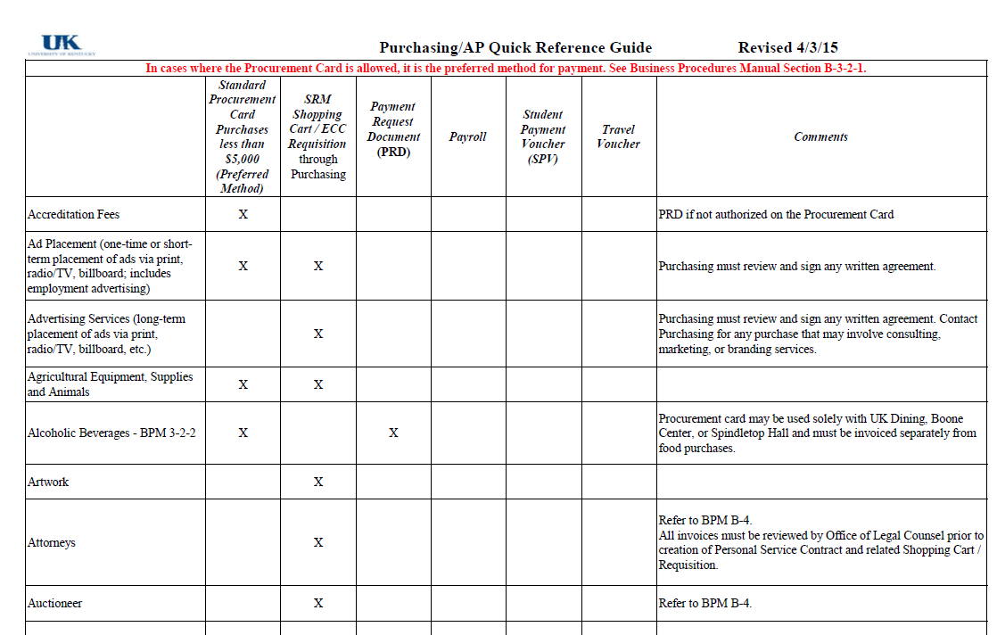
How Do I Know SRM is the Right Method?
The Purchasing / AP Quick Reference specifies the correct method by commodity type and can be found on the Purchasing website at:
http://www.uky.edu/Purchasing/
7

Slide 8
SRM Roles
Level | SRM Role | Role Description | Corresponding SRM document type
Department | Shopper | Responsible for creating a “Shopping Cart” to purchase goods and/or services from a particular supplier | Shopping Cart
Department / College / Unit | Approver | Approves Shopping Carts for their department or area | --
Purchasing | Buyer | Responsible for university-wide contracting processes for purchase of commodities | Purchase Order
Department | Confirmer | Confirms physical receipt of goods in satisfactory condition | Goods Confirmation
Accounts Payable | -- | Posts invoices against purchase orders | Invoice Receipt
8

Slide 9
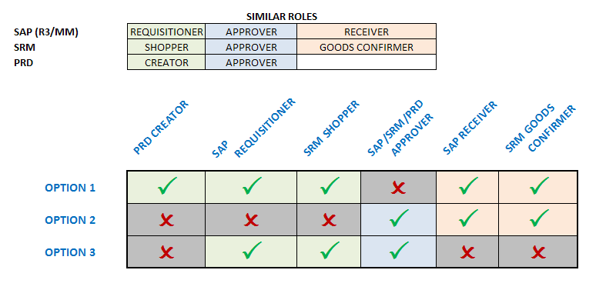
Role Combinations
In order to maintain checks and balances there is a limit on the number and structure of roles any one person may hold. The following matrix shows all permissible combinations for various procurement roles within myUK.
The same person is not required to hold all roles within any one option. The combinations reflect the maximum roles within each option any one person may hold.

Slide 10
Training Requirements for SRM Departmental Roles
Role | Training Requirements
Shopper | Shoppers are required to take and pass four course modules in successive order via myUK Training: SRM_SHO_301 SRM Shoppers Introduction (This course) SRM_SHO_302 SRM Punch-out Catalogs SRM_SHO_303 SRM Free Text Carts SRM_SHO_304 SRM Supplementary Information
Approver | Approvers are required to take and pass the MM_APP_300 Combined Approvers course via myUK Training .
Goods Confirmer | Goods Confirmers are required to take and pass the SRM_CON_300 SRM Goods Confirmations course via myUK Training.

Slide 11
SRM Terminology
Term | Definition
Shopping Cart | The tool utilized by Shoppers within myUK to purchase goods and/or services from suppliers
Attributes | End-user default settings which flow into every Shopping Cart
POWL (a.k.a., Dashboard) | Personalized Object Work List, serves as the Shopper’s home or starting point and holds queries, document history, etc.
Punch-out Catalog | Electronic catalogs located on external suppliers’ websites and accessed via myUK
Free Text Shopping Cart | Used when items are not available from electronic catalogs; entered via freehand from a supplier quote
Workflow | Process by which Shopping Carts or other documents route to inboxes of Approvers and other users
11

Slide 12
SRM General Process Flow (5 Steps)
1. Create Shopping Cart (Dept)
2. Approval (Dept / Unit / College)
4. Goods Confirmation (Dept)
3. Purchase Order Sent to Supplier (Purchasing)
5. Invoice Posting / Check Payment (Accounts Payable)
The Shopper creates carts for items/services via catalog selection or free text entry.
Shopping Carts move to Approver(s) via Workflow; some types of carts have automatic approvals.
After approval Purchasing processes and places the purchase order with the supplier. Purchase orders for punch-out catalogs are placed automatically by SRM.
Along with the purchase order, Goods Confirmations and invoice postings complete a 3-way match and check payment releases.
Encumbrance (i.e., funds reservation) occurs at point of Shopping Cart approval
12

Slide 13
Overview of SRM Shopping Types
There are two different types of Shopping within SRM:
Punchout Catalogs are used for the University’s highest volume suppliers within myUK. Shoppers “punch-out” to suppliers’ external websites to order items through e-catalogs. Shopping carts that are $5000 or greater require departmental approval through Workflow. After approval SRM creates and transmits a purchase order to the supplier for punch-out orders.
Free Text orders are used for any commodity listed in the Purchasing / AP Quick Reference Guide requiring Shopping Cart as the purchase method and for which there is not an electronic catalog loaded. After approval, Free Text carts arrive at Purchasing for manual processing.
Purchase orders are the transaction document issued for all SRM Shopping. SRM transactions do not utilize procurement card data in any way.

Slide 14
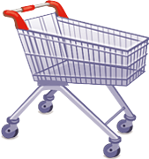
Personal Settings

Slide 15
Personal Settings Overview
Personal Settings relate to the user’s employee data and are established via Site Navigation.
    Default information populates into the Shopper’s settings based on data from the Human Resources organizational structure.
    Personal Settings must be confirmed and setup for a role during the first visit to SRM to ensure correct functioning and a successful Shopping experience.

Slide 16
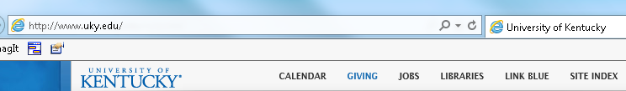
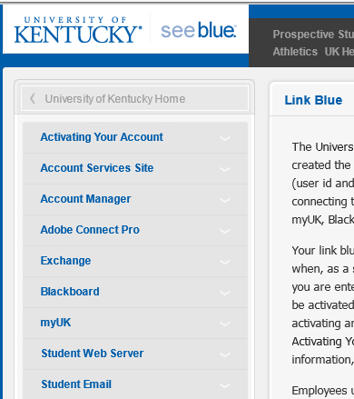
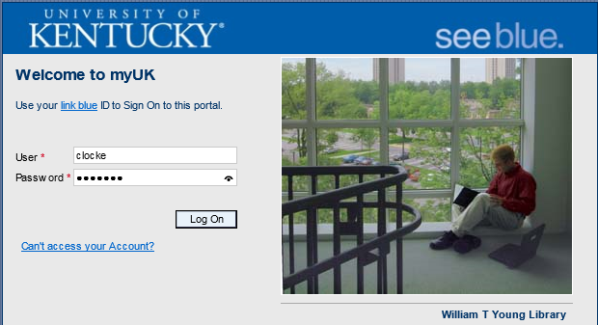
Login to myUK
1. Click Link Blue from the UK Home Page
3. Login to myUK using your AD account and password
2. Click myUK from the Link Blue site

Slide 17
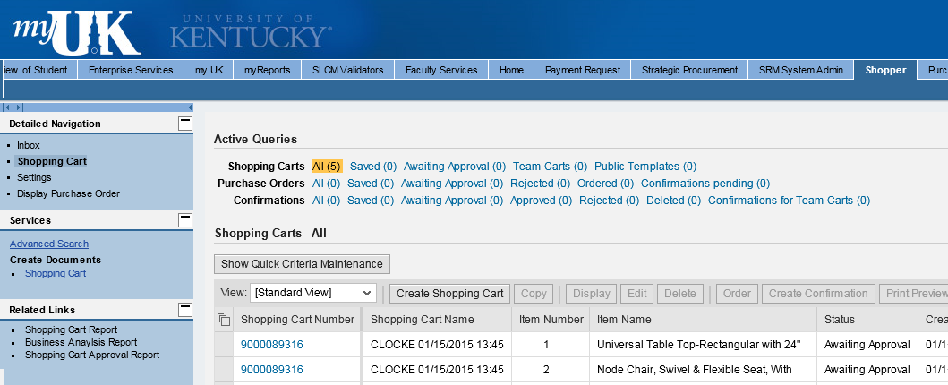
Shopper Tab and Site Navigation
4. Select the Shopper tab
Site Navigation
5. Click Settings

Slide 18
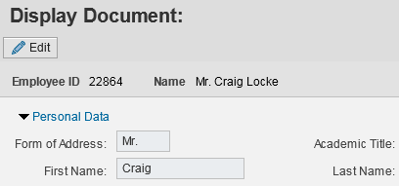
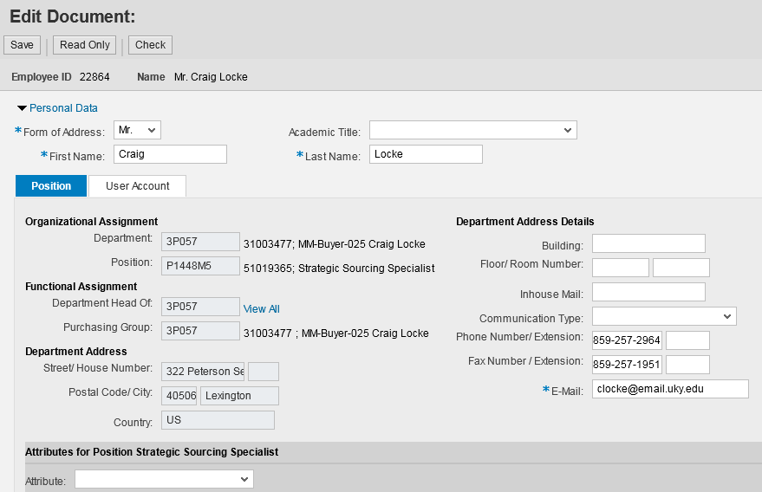
Personal Settings – Position Tab
6. Click Edit to begin changes
7. Form of address is required
8. Phone, fax, and email address are the only data on the Position tab to be edited

Slide 19

Personal Settings – Position Tab
Organizational and Functional Assignments populate automatically and relate to the employee’s position.
Department Address on the Position tab is organizational data only and will always be the 322 Peterson Building address. It does not require editing.
Note: None of these items are edited within Personal Settings. If any of your Organizational or Functional Assignment data appears to be incorrect or you have changed departments, please notify SRMHelp@uky.edu

Slide 20
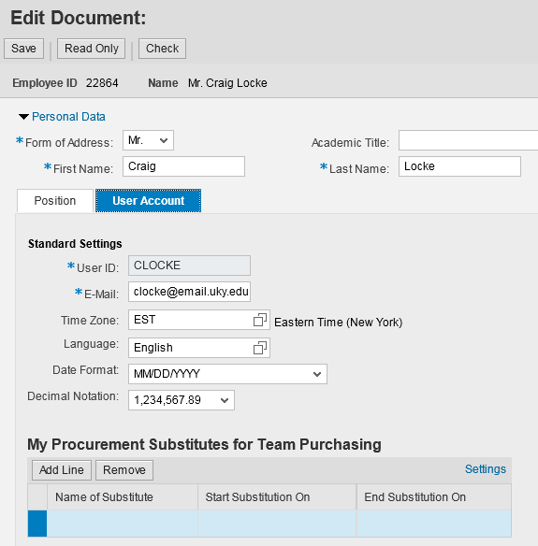
Personal Settings – User Account Tab
9. Click User Account Tab
10. Verify editable settings are correct

Slide 21
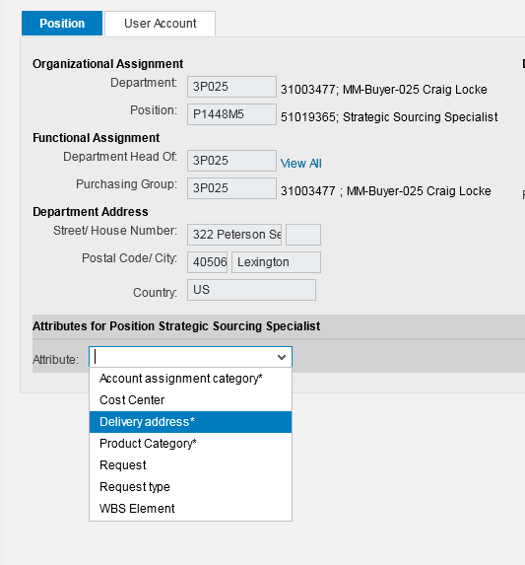
Set Building Delivery Address
The Building Delivery Address must also be set prior to using SRM. This designates the primary building to which purchased items will be delivered.
11. Return to the Position Tab
12. Select Delivery Address from Attributes drop down menu

Slide 22
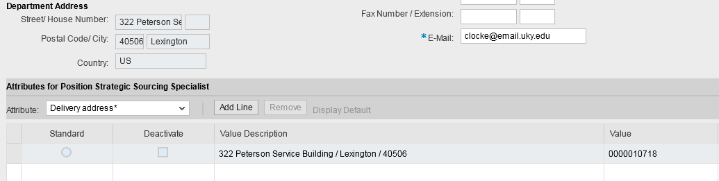
Set Building Delivery Address
The default building delivery address for all first-time Shoppers is 322 Peterson Service Building. It must be changed to your primary building address.
Important Note: If the building delivery address is not changed, any Shopping Cart orders you place will be delivered in error to the Peterson Service Building address.

Slide 23
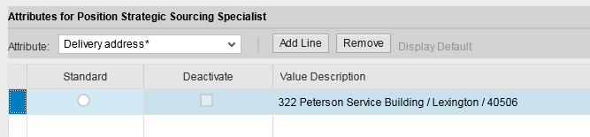
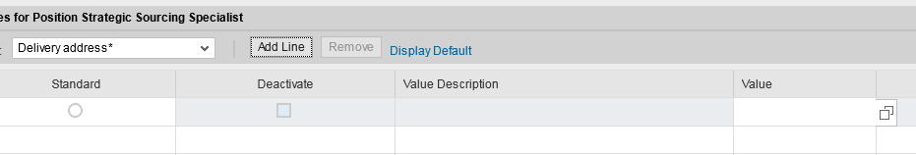
Set Building Delivery Address
13. Highlight default building line and click Remove
Note: If the building line does not delete using the Remove button, simply move onto Step 14. The Add Line command below will overwrite any pre-existing building information.
14. Click Add Line button. Next click the Possible Entries icon to search and choose your building delivery address.

Slide 24
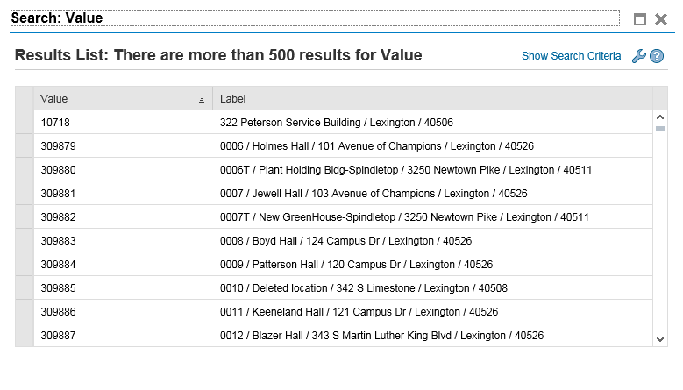
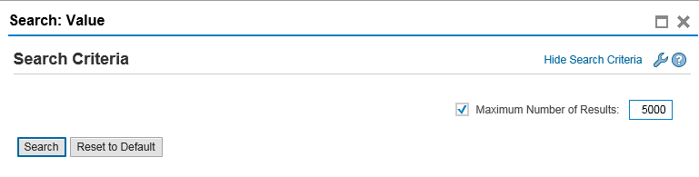
Set Building Delivery Address
15. Click Show Search Criteria
16. Change value to 5000
17. Click Search

Slide 25
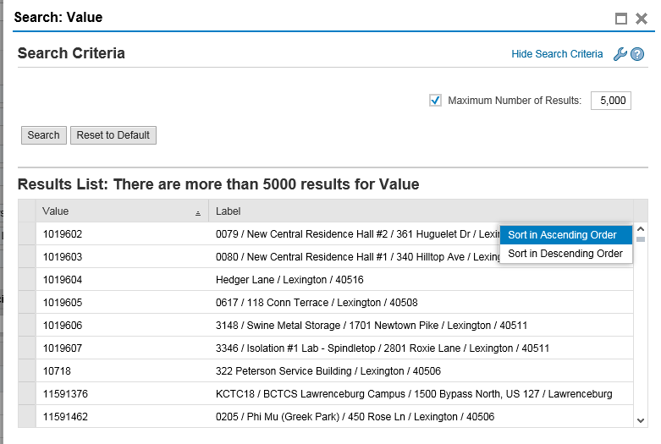
Set Building Delivery Address
18. Click the gray section of the Label header bar to expose sort menu
19. Select Sort in Ascending Order

Slide 26
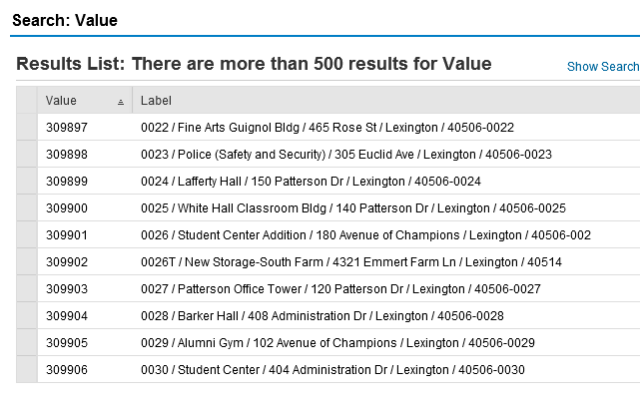
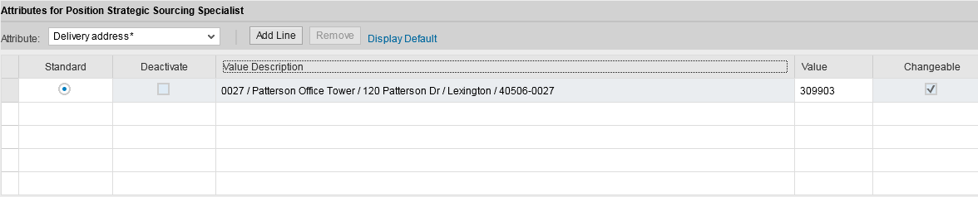
Finalize Building Delivery Address
20. The first four digits of the Label entries are Speed Sort codes. Locate your building based on postal speed-sort code. Highlight and click OK.
21. Click the Standard radio button

Slide 27
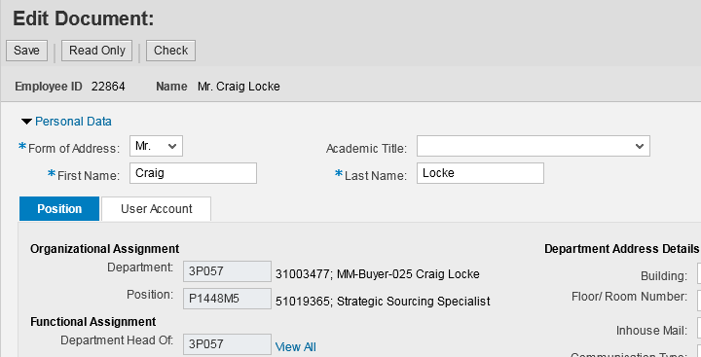
Save and Exit Personal Settings
22. Click Save when all settings are completed

Slide 28
Introduction to the POWL
SRM roles are tab-based within myUK with the Personalized Object Work List driving each user’s work tasks.
Personalized Object Work List
  a.k.a., the POWL or “dashboard”
  Serves as home base for each user
  Contains Active Queries of purchase documents, Quick Criteria Maintenance searches, and document history with active links.

Slide 29
Navigating to Personalized Object Work List
Note: You are still on the Shopper Tab
Click Shopping Cart within Site Navigation to activate the POWL
Site Navigation
POWL

Slide 30
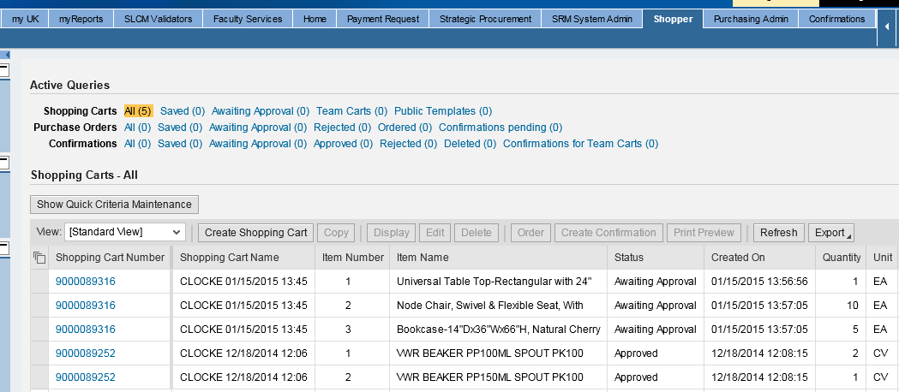
Personalized Object Work List Overview
The POWL is driven by pre-configured queries that display Shopping Carts you create and other documents that relate to your role(s).
Note: Shopping Carts are identified as a 10-digit number prefixed with 90.
Clicking any of the Active Queries at the top will display relevant documents in the bottom section. Clicking the number will display an existing Shopping Cart in new window or tab.
POWL also shows line item contents of each cart, date created, status, etc.

Slide 31
Shopping Cart Overview
1. Start from the Shopper tab
2. Select Shopping Cart from Site Navigation to display the POWL
3. Click Create Shopping Cart

Slide 32
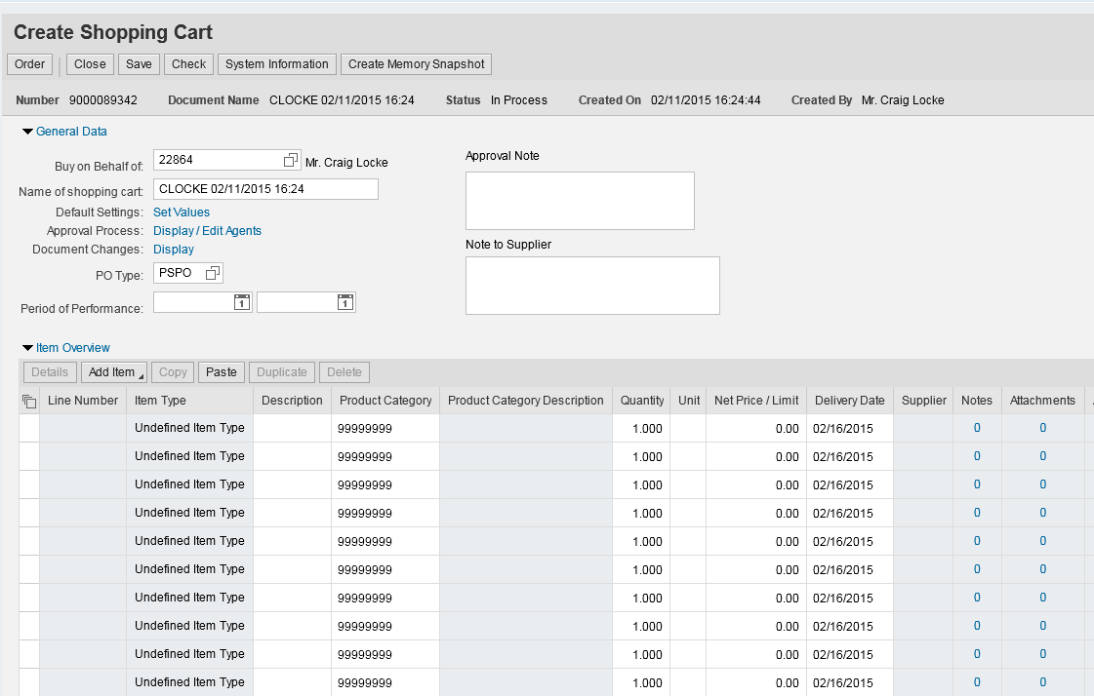
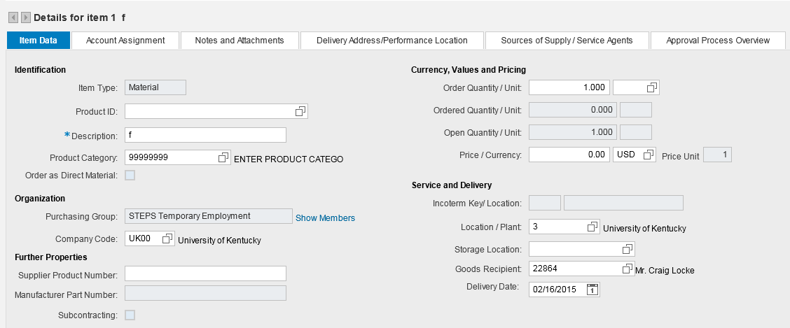
Shopping Cart Layout (Three sections)
General Data
(a.k.a. Header) Section (Top)
Item Overview Section (Middle)
Item Details Section (Bottom)

Slide 33
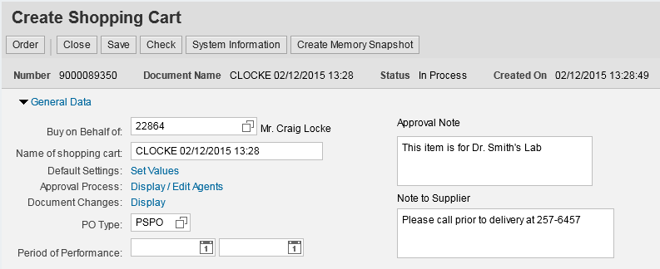
Shopping Cart Layout – General Data (Top)
Shopping Cart number automatically generates
Action Buttons
Naming convention populates automatically with your User ID and date/time stamp
Internal / Approval Note can be added (does not print on purchase order).
Note: “Header” notes are optional and apply to an entire Shopping Cart. Notes specific to individual line items can be entered in the Item Details section.
Note to Supplier prints on the purchase order

Slide 34
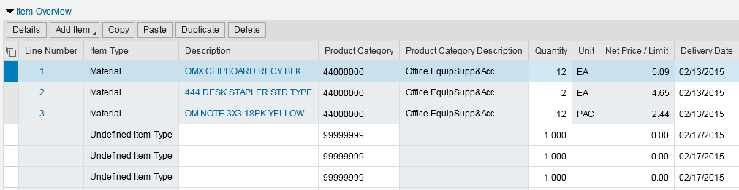
Shopping Cart Layout – Item Overview (Middle)
Ordered line items are reflected in the Item Overview Section
Action Buttons specific to Item Overview section
Section information includes line item description, quantity, UOM, price, and delivery date.
FYI: Line item information for punch-out orders pulls automatically from the e-catalogs. For Free Text orders, the Shopper forms the entries manually.

Slide 35

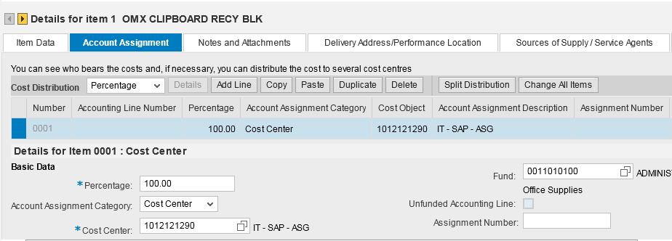
Shopping Cart Layout – Item Details (Bottom)
Item Details Section includes information specific to each line item. Click the arrows to move between multiple line items.
Information in this section includes Account Assignment, Notes and Attachments, Source of Supply, etc.

Slide 36
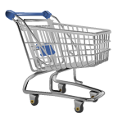
Shopping Cart Initial Settings
Initial Shopping Cart Settings must be set prior to completion of your first Shopping Cart. Because these settings relate to carts themselves, they are set within your Shopping Cart environment, not Personal Settings.
  Not configuring Shopping Cart settings may result in errors or incorrect processing of carts.
  This only needs completed once – on your first Shopping Cart.

Slide 37
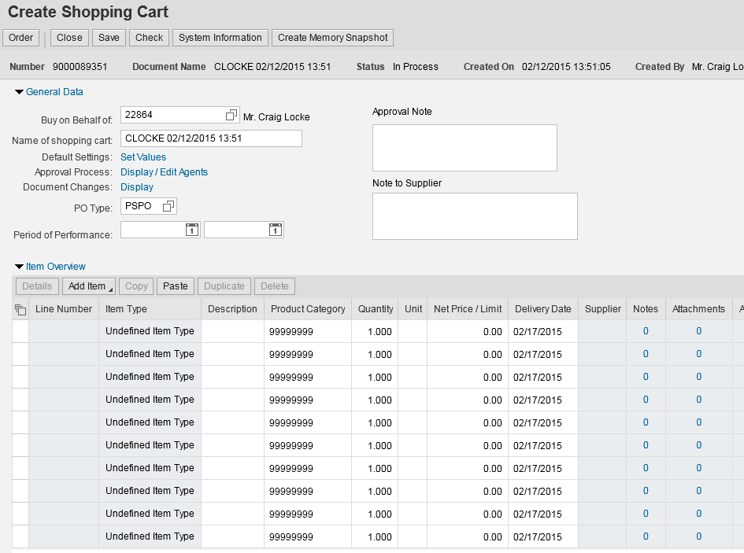

Shopping Cart Initial Settings
The Shopping Cart Settings button is located to the far right of the Item Overview (Middle) section. You may need to scroll to the right to locate it.
1. Once inside your first Shopping Cart, click Settings on far right side of screen of the Item Overview section.

Slide 38
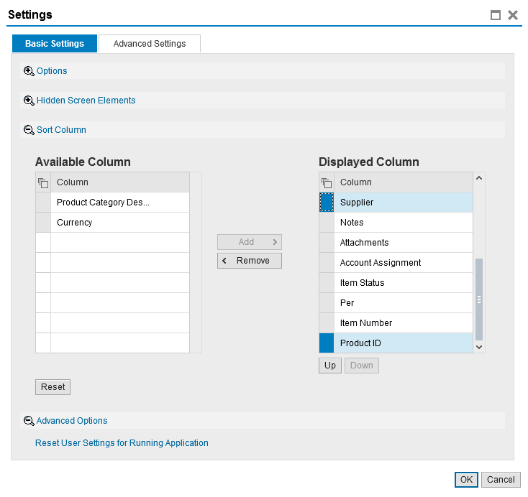
Shopping Cart Initial Settings – Remove from View
The Product ID and Supplier columns should be removed from view prior to creation of your first Shopping Cart. This only needs done once.
2. Under Basic Settings Tab, highlight Supplier and Product ID selections on the right and click Remove.
3. Click OK to finish cart settings

Slide 39
Completion of SRM Shoppers Introduction
This completes module SRM_SHO_301 Shoppers Introduction. After completing the Check for Understanding, you should book and complete the second module SRM_SHO_302 Punch-Out Catalogs.
Remember, all four modules must be completed and passed in succession to receive the SRM Shopper role:
SRM_SHO_301 SRM Shoppers Introduction
SRM_SHO_302 SRM Punch-out Catalogs
SRM_SHO_303 SRM Free Text Carts
SRM_SHO_304 SRM Supplementary Information

