Slide 1
SAP Requisitions
Requisitioner
MM_REQ_300

Slide 2
Table of Contents
Course topics are hyper-linked to respective slides. If desired click on topics to quick-jump to that section.
Note: Must be in Presentation mode to use hyper-link functionality (Press F5 to begin).
What is SAP Requisition? Slide 3
Who Should Receive Requisition Training? Slide 4
When are Requisitions Used? Slide 5
How Requisitions Differ from Other Methods Slide 6
How to Know Requisition is the Right Method? Slide 7
Note: Purchase of Healthcare Items Slide 8
SAP Roles Slide 9
Role Combinations Slide 10
Training Requirements for Departmental Roles Slide 11
SAP General Process Flow Slide 12
Understanding Transaction Codes Slide 13
Vendor Overview Slide 14
Begin Requisition Process Slide 15
Requisition Major Sections Slide 19
Personal Settings Slide 24
Create Requisition Slide 27
Select Account Assignment Category Slide 29
Select Vendor Slide 30
Complete Line Item Overview Slide 32
Details Section – Set Account Assignment Slide 33
Details Section – Text Notes Slide 34
Details Section – Delivery Address Slide 35
Create Attachment Slide 38
Check for Errors and Save Slide 40
Document Overview Slide 41
Display Requisition Slide 42
Edit Requisition Slide 43
Approval Slide 47
Inbox Overview Slide 49
How Handle Rejected Requisitions Slide 50
Delete Line Items or Requisition Slide 54
Display Requisition Slide 57
Display Purchase Order Slide 58
Vendor Lookup Using XK03 Slide 60
Reporting via T-codes ME2L and ME2K Slide 62
Additional Helpful Icons Slide 64
Working with “Reverse” Requisitions Slide 65
Obtaining Hard Copy of Requisition Slide 66
Split Account Assignment Slide 67
Naming Convention-Attachments Slide 69
Numbering Conventions for POs Slide 70
Status Tab and Related Documents Slide 71
How Determine Assigned Purchasing Buyer Slide 72
Diagnosing Process Problems Slide 73
Sign Off Slide 76
SAP Help Web Sites Slide 77

Slide 3
What is SAP Requisition?
SAP Requisition is the University’s formal procurement system for UK Hospital and Facilities areas using Plant Maintenance (PM).
Departmental staff enter requisitions into SAP for purchase of needed goods and services for their areas. Following approval requisitions are processed into purchase orders by the Purchasing Division and placed with vendors.
Return to Table of Contents

Slide 4
Who Should Receive SAP Requisition Training?
Any persons authorized to perform procurement functions within the following areas:
  UK Hospital
  Facilities areas using Plant Maintenance (PM)
This includes administrative/other staff or faculty conducting purchases on behalf of their departments or units.
Return to Table of Contents

Slide 5
When are SAP Requisitions Used?
Being the formal procurement system for UK Hospital and Facilities, the SAP Requisition is used for the following purchases:
  Purchases for which the dollar amount exceeds procurement card limits
  Purchases, regardless of amount, for which the vendor does not accept the procurement card
  Any purchase, regardless of amount, that involves written agreements
  Commodities having special conditions or nature (i.e., personal service contracts, leases, licensed goods, etc.)
  Purchase of capital equipment (i.e., > $5000 cost)
Return to Table of Contents

Slide 6
How SAP Requisitions Differ from other Purchase Methods
SAP Requisitions differs from other purchase methods for which departments have delegated authority.
1. Procurement card – Used for purchase of:
Most small dollar operational goods and services with total cost < $5000
Equipment with item cost < $5000
Items involving no special conditions or written agreements
2. Payment Request Document (PRD) – Used for processing payments for select goods and services that are usually of a discretionary nature or for which little or no Purchasing policy applies, e.g., speaker fees, government fees, awards, patient reimbursements, etc.
Accounts Payable holds responsibility for the PRD program.
Note: Some areas within Hospital and Facilities areas have restrictions on usage of the procurement card for many purchases and require the requisition as their purchase method of choice.
Return to Table of Contents

Slide 7
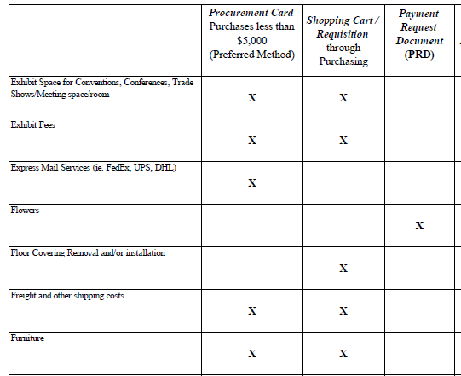
How Do I Know SAP Requisition is the Right Method?
The Purchasing / AP Quick Reference dictates the correct method by commodity type and can be found on the Purchasing website at:
http://www.uky.edu/Purchasing/docs/quickrefguide.pdf
Return to Table of Contents

Slide 8
Note: Purchase of Healthcare Items
Important note for hospital requisitioners that will order healthcare-related goods and services:
A different requisition type may be applicable when purchasing items for hospital areas. Some commodities (e.g., capital equipment, medical supplies, etc.) require a “ZB” requisition type when creating an order.
Additional information regarding this can be found at: http://www.uky.edu/Purchasing/docs/zbnbmatrix.pdf
The guide on the above link shows commodities for which the ZB requisition type is required. This course will show how to set the ZB requisition type at the appropriate step.
ZB requisitions are not applicable to Facilities.
Return to Table of Contents

Slide 9
SAP Roles
Level | SAP Role | Role Description | Corresponding SAP document type
Department | Requisitioner | Responsible for creating a “Requisition” to purchase goods and/or services from a particular supplier | Requisition
Department / College / Unit | Approver | Approves Requisitions for their department or area | --
Purchasing | Buyer | Responsible for university-wide contracting processes for various commodities | Purchase Order
Department | Goods Receiver | Confirms physical receipt of goods/services in satisfactory condition | Goods Receipt
Accounts Payable (or Hospital Accounting) | -- | Posts invoices against purchase orders | Invoice Receipt
Return to Table of Contents

Slide 10
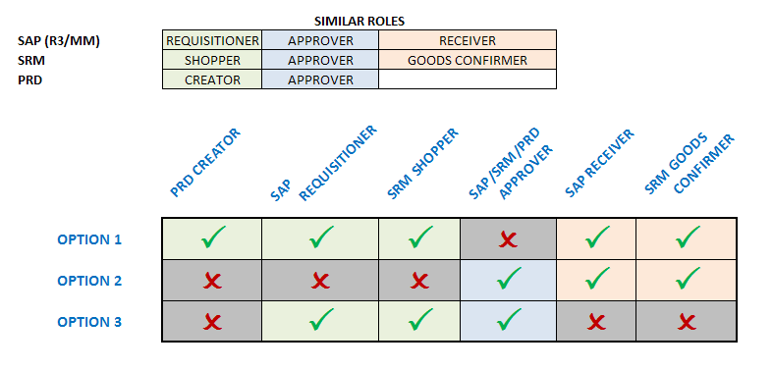
Role Combinations
In order to maintain checks and balances there is a limit on the number and structure of roles any one person may hold. The following matrix shows all permissible combinations for various procurement roles within myUK.
The same person is not required to hold all roles within any one option. The combinations reflect the maximum roles within each option any one person may hold.
Return to Table of Contents

Slide 11
Training Requirements for SAP Departmental Roles
Role | Training Requirements
Requisitioner | Requisitioners are required to take and pass web-based training course MM_REQ_300 – Requisitions via myUK Training System
Approver | Approvers are required to take and pass web-based training course MM_SRM_APP_300 – Combined Approvers via myUK Training System
Goods Receiver | Goods Receivers are required to take and pass web-based training course MM_REC_320 – Goods Receiving via myUK Training System
Return to Table of Contents

Slide 12
SAP General Process Flow (5 Steps)
1. Create Requisition (Dept)
2. Approval (Dept / Unit / College)
4. Goods Receipt (Dept)
3. Purchase Order Sent to Supplier (Purchasing)
5. Invoice Posting / Check Payment (Accounts Payable / Hospital Accounting)
The department creates requisitions for items/services, with approval(s) to follow.
Purchasing processes and places the purchase order with the supplier.
Along with the purchase order, goods receipts and invoice postings complete the 3-way match and payment releases.
A pre-encumbrance is established when the requisition is created; the actual encumbrance is created at point of purchase order processing.
Return to Table of Contents

Slide 13
Understanding Transaction Codes
Tasks within the SAP environment are executed via “Transaction Codes” a.k.a., T-codes. Each T-code is alphanumeric and executes a unique task.
The following T-codes are primarily used by requisitioners:
  ME51N – Create Requisition
  XK03 – Display Vendor
The following T-codes may also be used by requisitioners as needed, but the tasks listed can also be executed from within the ME51N screen for convenience purposes:
  ME52N – Change Requisition
  ME53N – Display Requisition
  ME23N – Display Purchase Order
Return to Table of Contents

Slide 14
Vendor Overview
The University’s Vendor Database is managed by the Purchasing Division. The database contains an entry for every vendor with whom the University conducts business via purchase orders and other purchase-related transactions.
Before a requisition can be entered, the Vendor Database must be checked to confirm the vendor entry is listed and with the correct address.
If the vendor cannot be found, they must complete a Vendor Application Form and submit for consideration. The form can be found at: http://www.uky.edu/eForms/forms/vendapp-sap.pdf.
Questions regarding the Vendor Database can be sent to: UKPurchasing@uky.edu
Return to Table of Contents

Slide 15
Begin Requisition Process
Return to Table of Contents

Slide 16
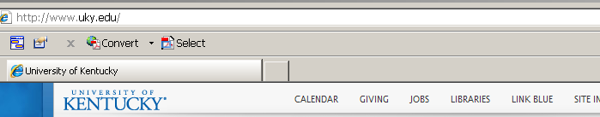
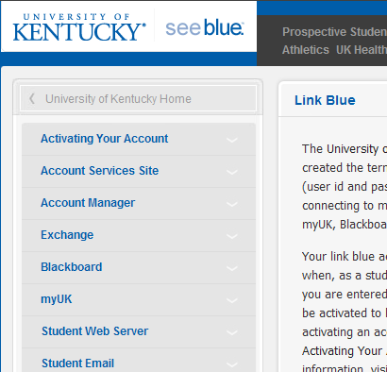
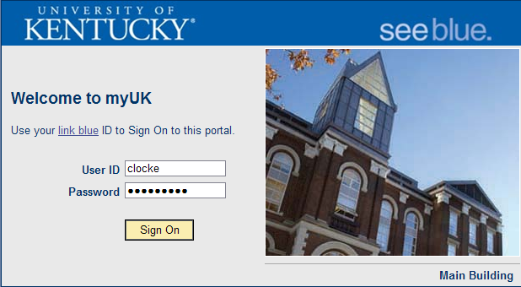
Login to myUK
1. Click Link Blue from the UK Home Page
2. Click myUK from the Link Blue site
3. Login to myUK using your AD and password
Return to Table of Contents

Slide 17
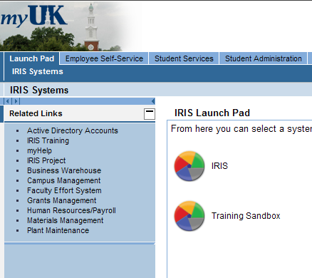
Launch Pad
4. Click the Launch Pad icon to enter SAP
Return to Table of Contents

Slide 18
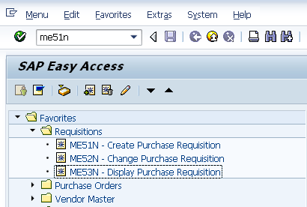
SAP Easy Access
5. The SAP Easy Access menu will appear. Enter T-code ME51N to open the requisition screen.
TIP: You can also create customized folders and list T-code Favorites that you may use repetitively
Return to Table of Contents

Slide 19
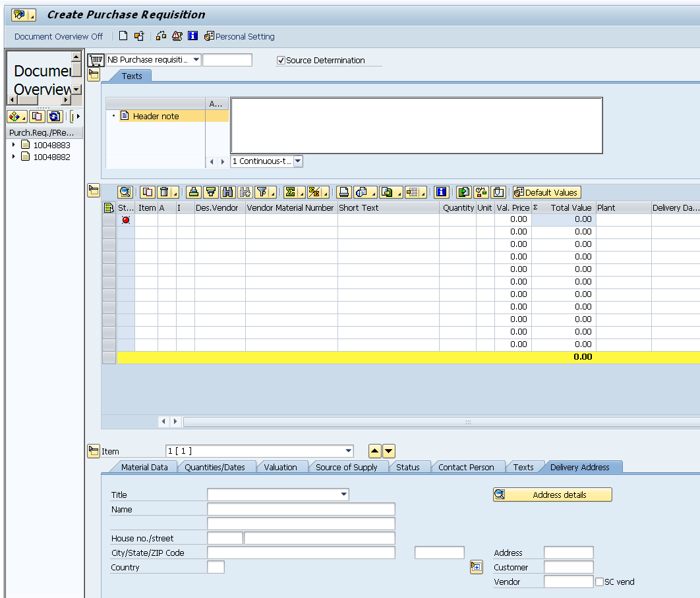
Requisition Major Sections
Header (Top)
Document Overview
Item Overview (Middle)
Item Details (Bottom)
Return to Table of Contents

Slide 20
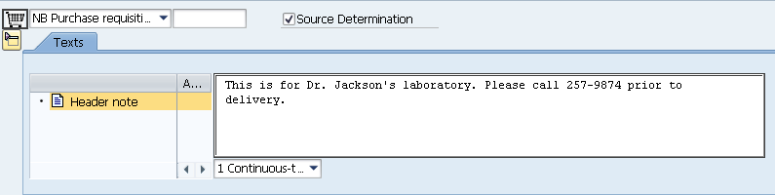

Requisition Layout – Header (Top)
Notes relevant to a requisition can be entered. Header notes are for internal use only.
Note: Header notes apply to an entire requisition. Notes specific to individual line items are entered in the Item Details (bottom) section.
Return to Table of Contents

Slide 21
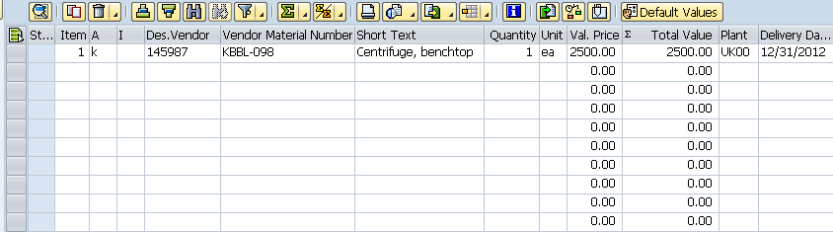
Requisition Layout – Item Overview (Middle)
Item Overview section shows ordered items in line item format
Data includes vendor, product number, description, quantity, price, etc.
Return to Table of Contents

Slide 22
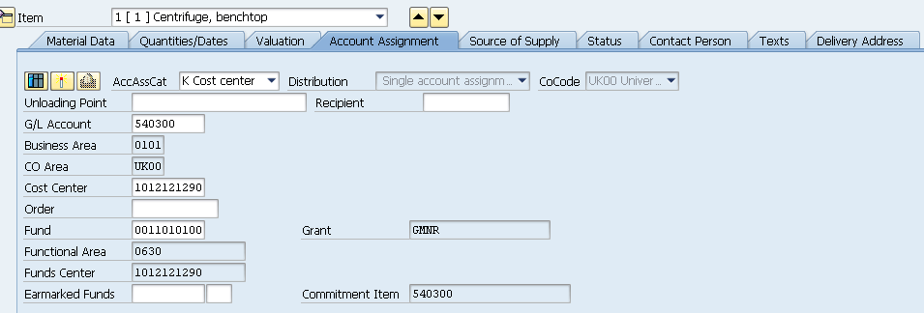
Requisition Layout – Item Details (Bottom)
Item Details section contains additional information such as Account Assignment, Delivery Address, etc.
Information can be entered/edited on a line item basis. Click the up/down buttons to move between multiple lines.
Return to Table of Contents

Slide 23
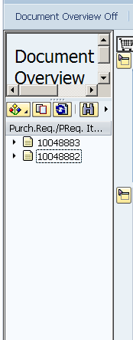
Requisition Layout – Document Overview
Document Overview is on the left side of the screen. It displays a record of requisitions as you create them.
Turning Document Overview off will collapse it for more requisition screen space
Return to Table of Contents

Slide 24
Personal Settings
Return to Table of Contents

Slide 25
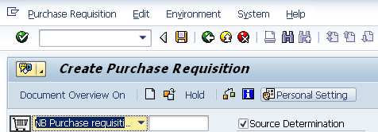
Personal Settings
Personal Settings must be confirmed and setup for your requisition role prior to entering your first requisition to ensure a successful experience.
1. From the ME51N requisition screen click Personal Setting
Return to Table of Contents

Slide 26
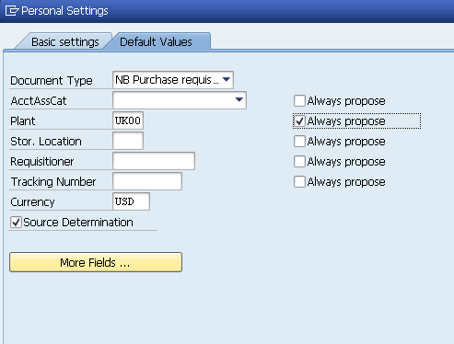

Personal Settings
2. Under the Default Values tab modify settings to match items notated in red boxes
If you are missing any Default Values, click More Fields button to access additional Values to move into view
3. Click Save icon when finished
Return to Table of Contents

Slide 27
Create Requisition
Return to Table of Contents

Slide 28
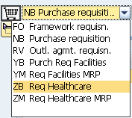
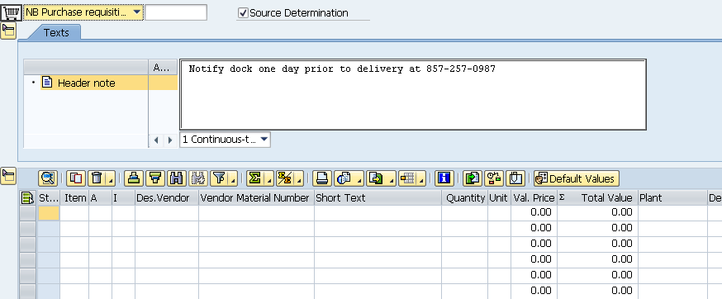
Requisition Type and Header Note
A vendor quote must be obtained prior to beginning a requisition. Much of the data entered into the requisition is mirror information from the quote.
1. NB is the standard purchase requisition type and populates by default. Hospital requisitioners entering type ZB requisitions will select ZB Req Healthcare from the drop down.
Remember: If you are buying certain commodities for the hospital, you may need to select ZB Req Healthcare as your requisition type. Visit http://www.uky.edu/Purchasing/docs/zbnbmatrix.pdf for more information.
2. If applicable enter any relevant notes. Requisition header notes are seen internally only; they will not print on the purchase order.
Return to Table of Contents

Slide 29
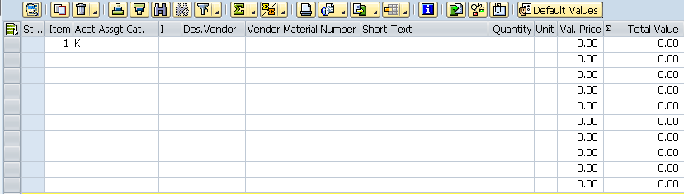
Select Account Assignment Category
4. Enter Account Assignment Category as follows:
K – if using Cost Center
P – if using WBS element (e.g., grant)
X – if split accounting across multiple cost objects
3. Enter line item number
Return to Table of Contents

Slide 30
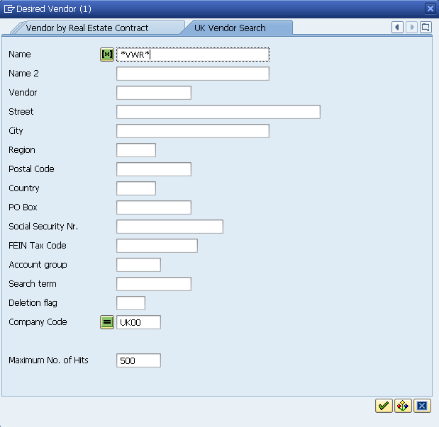
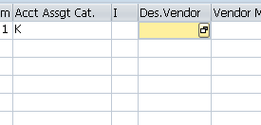
Select Vendor
6. Enter a portion of the vendor’s name into the Name box placing (*) on each end
5. To search for the Desired Vendor, click the possible entries icon to the right
TIP: If known the requisitioner can enter other search criteria (city, postal code, etc.) to refine searches and produce better results.
7. Click to conduct search
Return to Table of Contents

Slide 31
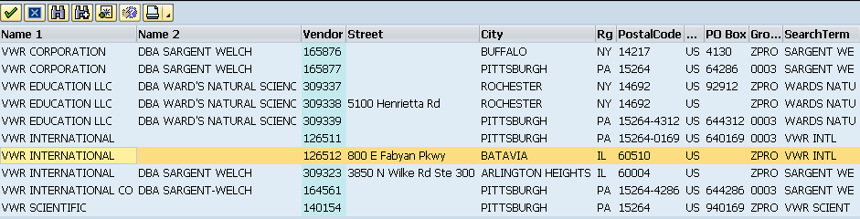
Select Vendor
8. Locate the correct vendor and double click on the entry
Note: Vendors for SAP requisitions must be identified with group ZPRO. If the vendor you need is listed with a different group, contact Purchasing for assistance.
Return to Table of Contents

Slide 32
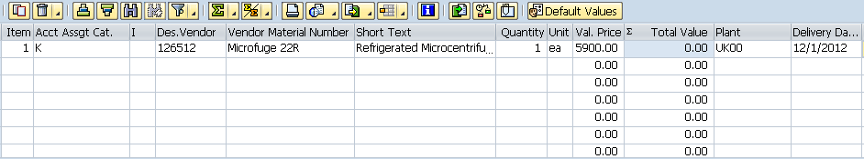
Complete Line Item Overview
9. Enter vendor catalog number from the quote
10. Enter short text description of item
11. Enter quantity, unit of measure, and price each
12. Enter the Required Delivery date.
Press Enter when complete.
Return to Table of Contents

Slide 33
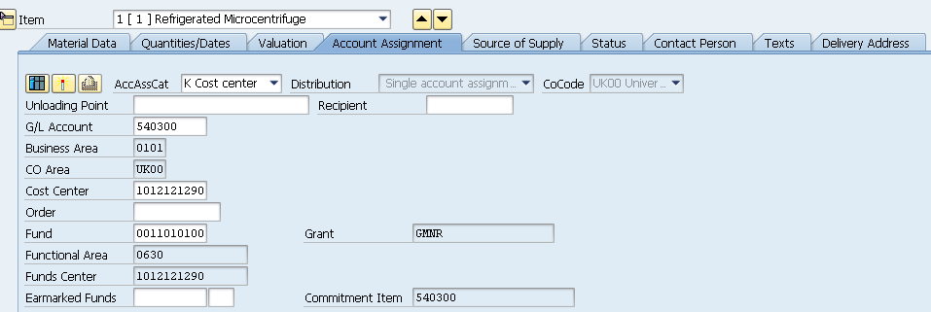
Details – Set Account Assignment
There are three tabs within the Item Details section to complete:
Account Assignment , Texts, and Delivery Address.
13. Complete Account Assignment tab. Enter the GL Account and Cost Center or WBS Element number and press Enter. The other fields will populate automatically.
TIP: The General Ledger (GL) Account is an accounting component that relates to the description of the goods or services purchased.
Optional: Some departments use a statistical internal order number for additional accounting controls. If applicable, it is entered in the Order blank.
Return to Table of Contents

Slide 34
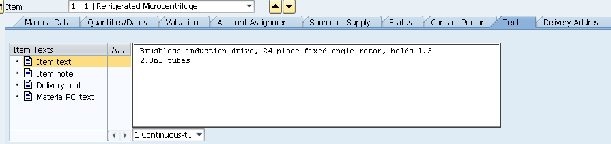
Details – Text Notes
14. If applicable enter text notes regarding the line item. This may include additional specs, etc. identified with the line item.
Note: While header notes will not print on the purchase order, text notes at the Line Item Details level will print on the purchase order.
Return to Table of Contents

Slide 35
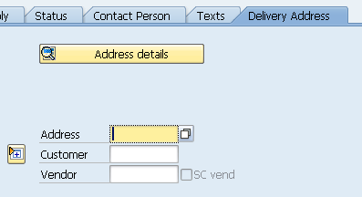
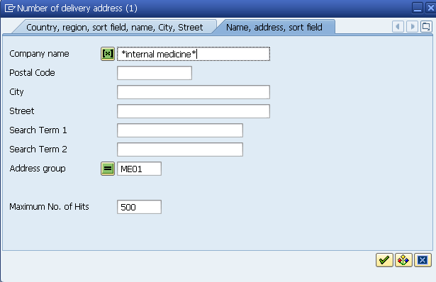
Details – Delivery Address
Delivery address is entered next. Many campus delivery addresses are
listed in a database.
15. Click the Possible Entries icon on the Delivery Address tab
16. Enter keyword related to delivery address name with (*) on each end
17. Click OK
Return to Table of Contents

Slide 36
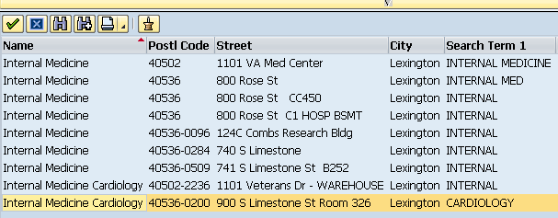
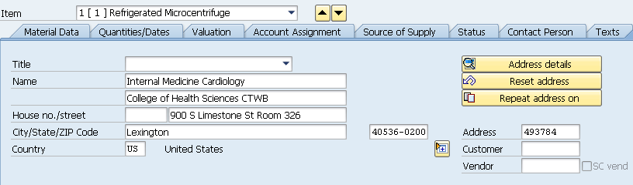
Details – Delivery Address
18. Locate and double click on the correct delivery address from within the search results
Note: If you have multiple lines, click the Repeat Address on button to copy to all lines
Delivery address populates automatically
Return to Table of Contents

Slide 37
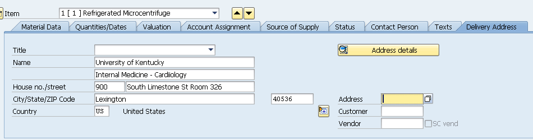
Details – Delivery Address
If your campus delivery address is not found in the database, you may enter it directly into the form via freehand.
Note: Only one delivery address is allowed per requisition
Return to Table of Contents

Slide 38
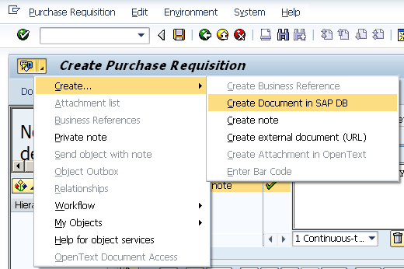
Create Attachment
The vendor quote should be electronically attached to the requisition.
19. Click black triangle on right side of Services for Object icon
20. Select Create Document in SAP DB
Return to Table of Contents

Slide 39
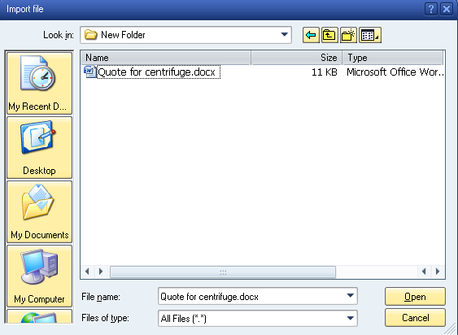
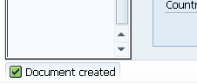
Create Attachment
21. Locate and highlight file within your drive(s)
22. Click Open to attach
Attachment successful message shows at bottom left of screen. Attachment will execute when document is Saved.
Return to Table of Contents

Slide 40
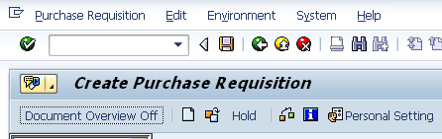
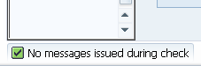
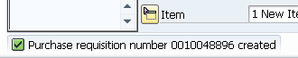
Check for Errors and Save
23. Click Check to check for errors.
TIP: The check button will expose any errors that may exist. An error with a red icon must be corrected before saving. A yellow icon error is only an advisory and does not require correction.
24. If no errors exist, click Save icon at top to finish.
Requisition number will show at bottom left of screen
Return to Table of Contents

Slide 41
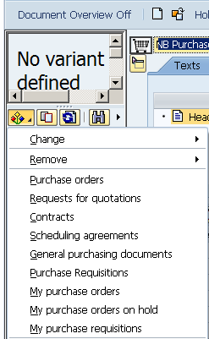
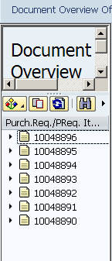
Document Overview
Document Overview holds a record of all requisitions you create
Click on the Selection Variant and select My purchase requisitions
Requisitions you create will appear within Document Overview
Return to Table of Contents

Slide 42
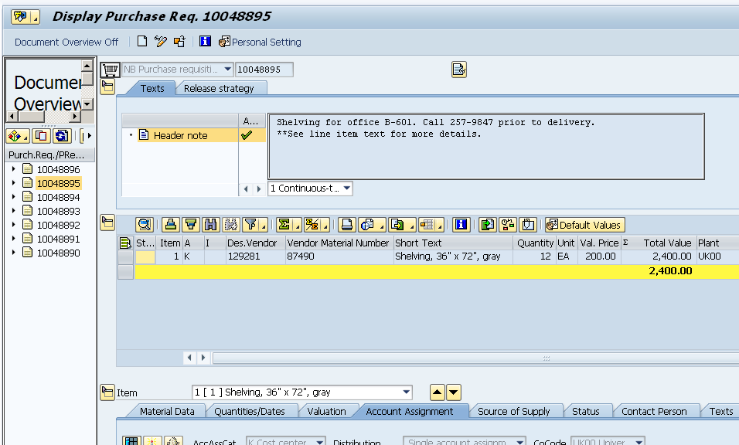
Display Requisition
You can display the contents of any requisition within Document Overview by double clicking on the requisition number. This is identical to using T-code ME53N.
Requisition enters display mode
Double-click any requisition number
Return to Table of Contents

Slide 43
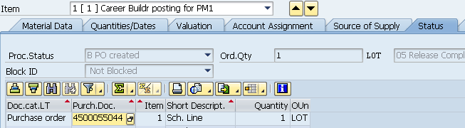
Edit Requisition
A requisition can be edited after creation. Common edits may include:
  Add, delete, or modify line items
  Modify Account Assignment
  Add Attachment
The requisitioner or approver can edit the document provided the purchase order has not been processed.
Important: The requisition should not be edited after the purchase order is created. If you have modifications to an order after the PO is processed, contact Purchasing for guidance.
If a purchase order has been processed, it will appear on the Status tab within the Details section.
Return to Table of Contents

Slide 44

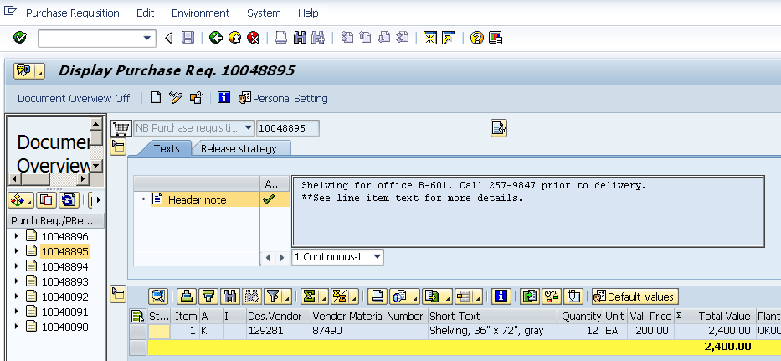
Edit Requisition
2. Click the pencil/glasses icon to move document into edit mode (screen will turn white)
1. Double-click the requisition number from within Document Overview
Return to Table of Contents

Slide 45
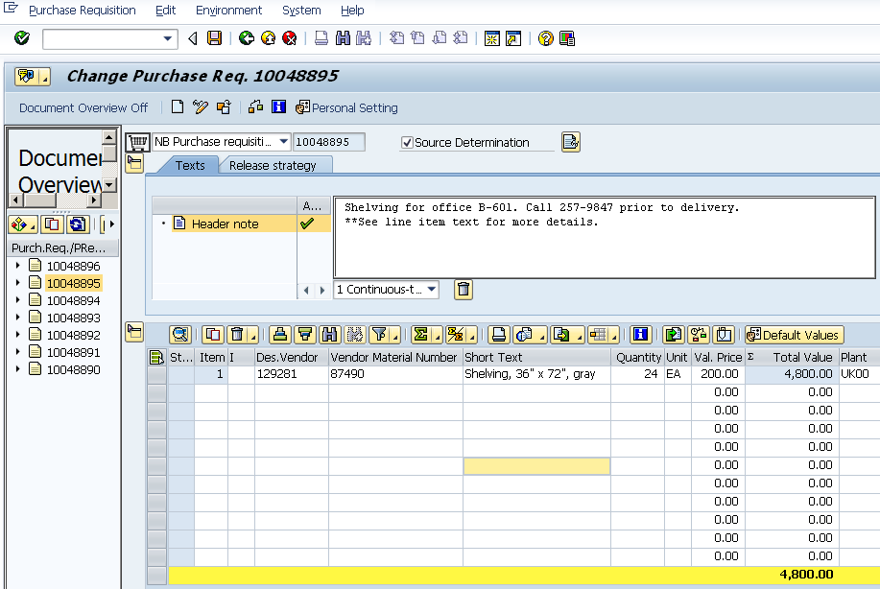
Edit Requisition
4. Click Save
when finished with edits
3. Make changes as needed to the requisition
Return to Table of Contents

Slide 46
Supplementary Tasks
Return to Table of Contents

Slide 47
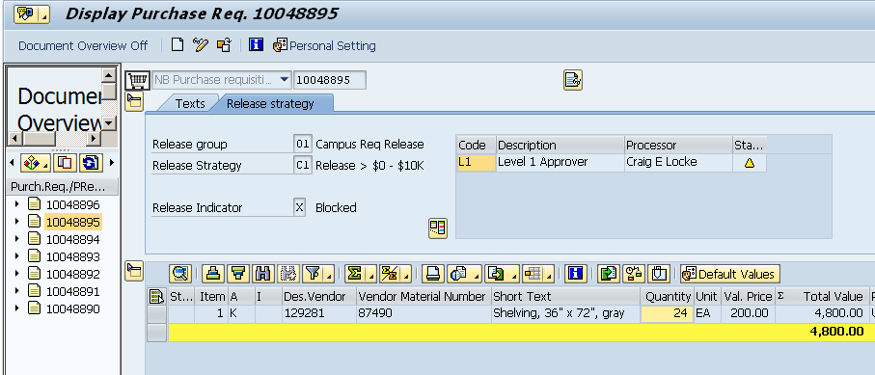
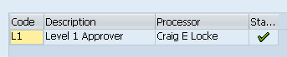
Approval
After the requisition is created, it next moves to the Approval process. Approval status can be viewed on the requisition.
1. Double-click requisition from within Document Overview to display
2. Release Strategy tab shows approver status. Yellow icon means document has not been approved.
Green check mark indicates approval completed and document has moved to Purchasing
Return to Table of Contents

Slide 48
Approver Levels
Multiple approvals may be required depending on the amount
of the requisition
Total value of document | Approval(s) Required
Less than $10,000 | Level 1 only
$10,000 or greater | Level 1 & Level 2
Note: Special additional approvals are required for purchases of vehicles and computer equipment. SAP Workflow automatically routes these to the appropriate special level approvers.
Return to Table of Contents

Slide 49
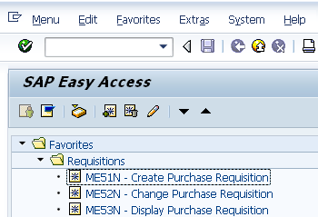
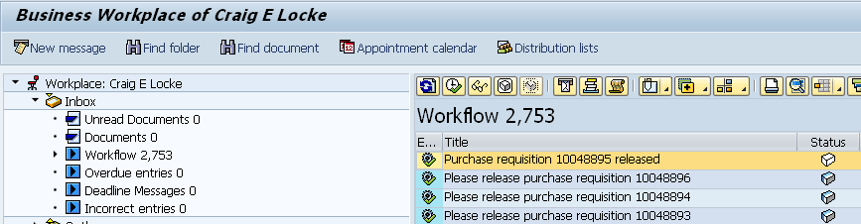
Inbox Overview
All requisitioners have Inboxes. Document-related messages and other communications move throughout SAP Workflow to users’ Inboxes.
1. Click the Inbox icon from the SAP Easy Access screen
Various communications regarding approvals, rejections, etc. will appear here. Requisitioners also receive Outlook notifications as requisitions are approved or rejected.
2. Click the Workflow folder within Inbox
Return to Table of Contents

Slide 50
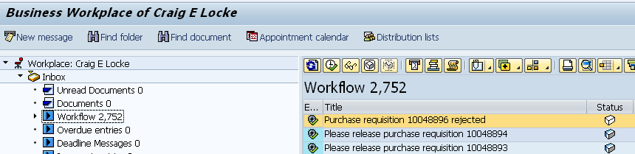
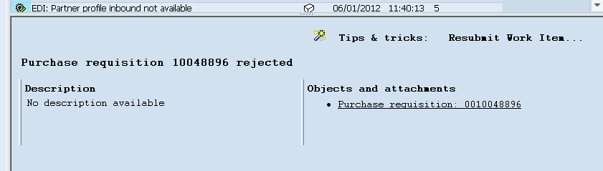
How Handle Rejected Requisitions
Requisitions rejected by an Approver will appear within the Inbox of the requisitioner. SAP also sends an Outlook notification when a requisition is rejected. A rejected requisition must be corrected and re-saved, or deleted as applicable.
1. A rejected requisition will appear in the Workflow folder of the Inbox. Highlight the document.
2. To edit the rejected document, click the requisition link showing at the bottom of the Workflow screen
Return to Table of Contents

Slide 51
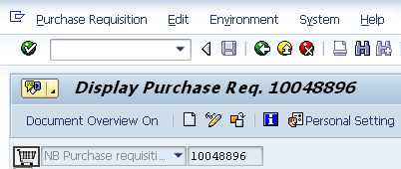
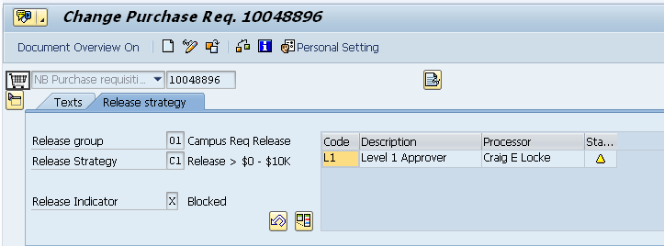
How Handle Rejected Requisitions
3. The requisition will appear in display mode. Click the glasses/pencil icon to edit.
4. Click the undo icon to clear the rejection. Screen will turn white allowing editing.
Return to Table of Contents

Slide 52
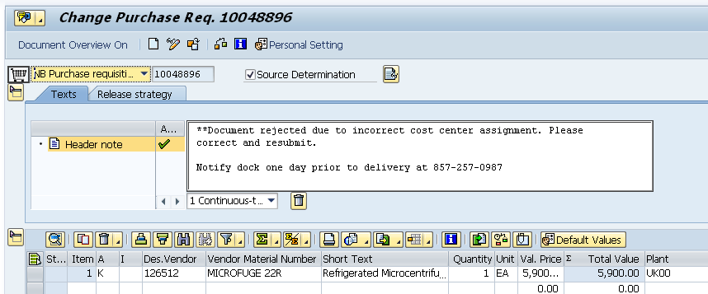
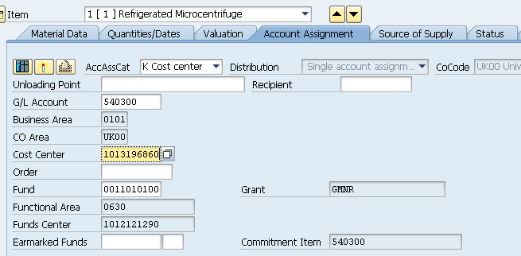
How Handle Rejected Requisitions
5. Check the header texts for note(s) from the Approver as to reason for rejection
6. Make corrections as necessary
Return to Table of Contents

Slide 53


How Handle Rejected Requisitions
7. Click the check icon to confirm whether errors exist
8. Click Save to finish edit
Edit successful and requisition returns to Approver’s inbox
Return to Table of Contents

Slide 54
Delete Line Items or Entire Requisition
Requisition line items can only be deleted if a purchase order has not been processed. Before deleting any requisition lines, be sure to check the Status tab to confirm whether a purchase order has been processed. If needed contact Purchasing for guidance.
If a purchase order has been processed, it will appear on the Status tab within the Details section.
Return to Table of Contents

Slide 55

Delete Line Items or Entire Requisition
Provided the status tab does not reflect a purchase order number, the requisitioner can delete some or all lines of the requisition.
2. Click the pencil/glasses icon to move the requisition to edit mode
1. Double-click the requisition number within document overview
Remember: Although T-code ME51N is for creating requisitions, it will also allow access to Document Overview to display or edit requisitions.
Return to Table of Contents

Slide 56


Delete Line Items or Entire Requisition
3. Highlight the line(s) to be deleted
4. Click trash can icon
Note: To delete an entire requisition: highlight all lines, click trash can icon, and click Save.
5. Click Save icon to finish
Line item shows deleted
Return to Table of Contents

Slide 57


Display Requisition via Select Other Document
Clicking the Other Purchase Requisition icon allows you to locate and display any requisition
Enter document number, set radio button, and click Other Document. The requisition will display on the screen.
Return to Table of Contents

Slide 58


Display Purchase Order via Requisition Status Tab
Users can display purchase orders through either the requisition status tab
(if PO is related to one of their requisitions) or using the Select Other Document feature (provided PO number is known).
To access through Status tab: Double-click on the purchase order number
Corresponding purchase order will display
Return to Table of Contents

Slide 59



Display Purchase Order via Select Other Document
1. To access through Select Other Document, click icon
2. Enter PO number, set radio button to PO, click Other Document
Corresponding purchase order will display
Return to Table of Contents

Slide 60


Vendor Lookup Using XK03
Requisitioners can verify whether a vendor is currently listed within the Vendor Database – without initiating a requisition – using T-Code XK03.
1. Enter T-code XK03 from SAP Easy Access Menu
2. Click the Possible Entries icon to start search
Return to Table of Contents

Slide 61


Vendor Lookup Using XK03
3. Enter search criteria as normal and click execute
Search results display in new window
Return to Table of Contents

Slide 62


Reporting via T-code ME2L – Vendor
Requisitioners have access to various T-codes for reporting needs.
2. Click to execute document searches and display results
1. Using T-code ME2L enter various criteria to search documents based on vendor data and/or other criteria
TIP: Range and multiple entry cells return extended results if needed
Return to Table of Contents

Slide 63


Reporting via T-code ME2K – Account Assignment
Using T-code ME2K enter various criteria to search documents based on Account Assignment data and/or other criteria. Click execute button to display results.
TIP: Range and multiple entry cells return extended results if needed
Return to Table of Contents

Slide 64
Additional Helpful Icons
The ME51 screen contains other icons useful to the requisition creator.
Blank sheet icon starts a new requisition
Pencil/glasses icon toggles requisition between edit/display mode (same as ME52N/ME53N)
Refresh icon will refresh Document Overview showing latest requisitions created
Return to Table of Contents

Slide 65

Working with “Reverse” Requisitions
Some types of orders perform better in “reverse” format. Reverse orders are entered as one line item with a lump sum dollar amount for the entire order, regardless whether the quote has multiple lines. Reverse format is usually used for complex orders such as furniture or printing. They may also be used for orders that span a length of time and require monthly payments, e.g., equipment rental.
Reverse requisitions are entered as one line for the entire order. Enter the total dollar amount in the quantity column, LOT as the unit of measure, and 1.00 in the Val. Price box.
Contact the responsible buyer in Purchasing if you are unsure whether a specific requisition you plan to enter might work best in a reverse format.
Return to Table of Contents

Slide 66

Obtaining Hard Copy of Requisition
There are two ways of printing requisitions if needed.
1. Click Customize Local Layout button and select Hard Copy for a print-screen version, or -
2. - Click print button in Item Overview section for line item format printout.
Return to Table of Contents

Slide 67


Split Account Assignment
Account Assignment for any line item can be distributed across multiple cost centers or WBS Elements.
1. For split accounting, select X as the Account Assignment Category
2. Within the Account Assignment tab in Details section, select the type of split desired. Costs can be split based on quantity or percentage basis.
Return to Table of Contents

Slide 68

Split Account Assignment
3. Enter the percentage (or quantity) allocated for each cost center or WBS element and GL combination. Up to 99 split account assignments can be entered.
Remember: Account information is assigned on a line item level in the Details section. The requisitioner may assign different accounting combinations to each line item being purchased.
Return to Table of Contents

Slide 69
Naming Convention for Attachments
When creating attachments, refrain from inserting special characters, such as @, #, $, *, \, ‘, +, etc. into the filename.
Filenames should also not include spaces between words nor underscores. They should be named with a purely alphanumeric format.
Examples of suitable filenames:
  Medtechquote1001.pdf
  Furniturelayout.doc
Examples of unsuitable filenames:
  API Printing Quote.pdf (filename includes spaces)
  Fisher+incubator $1000.doc (filename includes special characters)
Only the following file formats are acceptable as requisition attachments:
  PDF, XLS, XLSX, DOC, DOCX, TXT, TIF, BMP, GIF, HTML
Return to Table of Contents

Slide 70
Numbering Conventions for Purchase Orders
Purchase orders follow numbering conventions depending on the campus sector in which the requisition originates.
PO Number Format Area
43XXXXXXXX Facilities using Plant Maintenance (PM) system
45XXXXXXXX Hospital NB Requisitions
47XXXXXXXX Hospital ZB Requisitions
Return to Table of Contents

Slide 71

Status Tab and Related Documents
The Status Tab located within the Details section will show status and all related documents (Purchase Order, Goods Receipt, Invoice Posting) for the requisition.
Click Status tab in bottom Details Section of the requisition
Related documents are listed with drill-down capability. Double-click on documents if needed to access them.
Return to Table of Contents

Slide 72

How Determine Assigned Purchasing Buyer
A Purchasing Buyer is automatically assigned to each purchase order.
The assigned buyer can be found in the Details section on the Contact Person tab
Return to Table of Contents

Slide 73
Diagnosing Process Problems
2. Approval (Dept / Unit / College)
4. Goods Receipt (Dept)
3. Purchase Order Sent to Supplier (Purchasing)
5. Invoice Posting / Check Payment (Accounts Payable / Hospital Accounting)
1. Create Requisition (Dept)
As an order evolves through the process, the Status tab will reflect whether subsequent documents have been created.
Problems can be frequently diagnosed based on the order status in the process.
  Example: With the purchase order being in place, completion of the Goods Receipt and the Invoice Posting complete a “3-way match” allowing the check payment to release. Common problems relate to one or more of these tasks being uncompleted.
Return to Table of Contents

Slide 74
Diagnosing Process Problems
1. To check whether Goods Receipts and invoices are posted against the purchase order, click the PO number from the requisition Status tab
The purchase order will display
Return to Table of Contents

Slide 75

Diagnosing Process Problems
2. Go to the Item Details section and click on the Purchase Order History tab
3. Goods receipts and invoices are posted and match the PO quantity, allowing check payment. If either is missing, or there is a mismatch, the check will not process.
Return to Table of Contents

Slide 76


Sign Off
To close requisition screen, click icon in upper left corner and select Close
Click Sign Off to end myUK session
Return to Table of Contents

Slide 77
SAP Help Web Sites
Resource Page on Purchasing web site: http://www.uky.edu/Purchasing/srm.htm - Site includes this PowerPoint file available for reference
myHelp – MM & Purchasing Help web site: http://myHelp.uky.edu/rwd/HTML/MM.html
Both sites contain Quick Reference Cards, updated and printable course manuals, Reference Manual, etc.
Assistance Email: UKPurchasing@uky.edu
Return to Table of Contents

