Slide 1
SAP Goods Receiving Goods Receiver MM_REC_320

Slide 2
Table of Contents
Course topics are hyper-linked to respective slides. If desired click on topics to quick-jump to that section.
Note: Must be in Presentation mode to use hyper-link functionality (Press F5 to begin).
What is SAP Goods Receiving? Slide 3
Who Should Receive SAP Receiving Training Slide 4
SAP Roles Slide 5
Role Combinations Slide 6 Training Requirements for Departmental Roles Slide 7
SAP General Process Flow Slide 8
Understanding Transaction Codes Slide 9
Goods Receiving Overview Slide 10
How to Identify PO Number Slide 11
Begin Goods Receiving Slide 12
Goods Receipt Major Sections Slide 16
Create Goods Receipt Slide 21
Display Goods Receipt Slide 27
Create Partial Goods Receipt Slide 28
Cancel Goods Receipt Slide 32
Display Purchase Order from Goods Receipt Slide 37
How Determine Assigned Purchasing Buyer Slide 38
Numbering Conventions for Purchase Orders Slide 39
Setting Delivery Complete Indicator Slide 40
Create Goods Receipt Against ”Reverse” PO’s Slide 41
Create Attachment Slide 42
Naming Convention for Attachments Slide 43
Helpful Icons within MIGO Slide 44
Obtaining Hard Copy of Goods Receipt Slide 45
Changes to PO Quantities Slide 46
Change Posting Date – Cancellations Slide 47
Diagnosing Process Problems Slide 48
Sign Off Slide 51
SAP Help Web Sites Slide 52

Slide 3
What is SAP Goods Receiving?
SAP Goods Receiving is a confirmation showing physical receipt of goods or services within a department or unit. The person conducting Goods Receiving affirms that ordered items are correct, in good condition, and in accordance with requirements of the purchase order.
Return to Table of Contents

Slide 4
Who Should Receive SAP Goods Receiving Training?
Any persons authorized to receive goods and services on behalf of the following areas:
UK Hospital
Facilities areas using Plant Maintenance (PM)
Return to Table of Contents

Slide 5
SAP Roles
Level | SAP Role | Role Description | Corresponding SAP document type
Department | Requisitioner | Responsible for creating a “Requisition” to purchase goods and/or services from a particular supplier | Requisition
Department / College / Unit | Approver | Approves Requisitions for their department or area | --
Purchasing | Buyer | Responsible for university-wide contracting processes for various commodities | Purchase Order
Department | Goods Receiver | Confirms physical receipt of goods/services in satisfactory condition | Goods Receipt
Accounts Payable (or Hospital Accounting) | -- | Posts invoices against purchase orders | Invoice Receipt
Return to Table of Contents

Slide 6
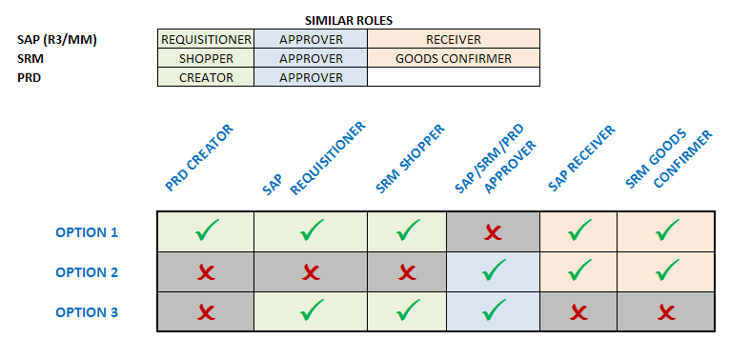
Role Combinations
In order to maintain checks and balances there is a limit on the number and structure of roles any one person may hold. The following matrix shows all permissible combinations for various procurement roles within myUK.
The same person is not required to hold all roles within any one option. The combinations reflect the maximum roles within each option any one person may hold.
Return to Table of Contents

Slide 7
Training Requirements for SAP Departmental Roles
Role | Training Requirements
Requisitioner | Requisitioners are required to take and pass web-based training course MM_REQ_300 – Requisitions via myUK Training System
Approver | Approvers are required to take and pass web-based training course MM_SRM_APP_300 – Combined Approvers via myUK Training System
Goods Receiver | Goods Receivers are required to take and pass web-based training course MM_REC_320 – Goods Receiving via myUK Training System
Return to Table of Contents

Slide 8
SAP General Process Flow (5 Steps)
1. Create Requisition (Dept)
2. Approval (Dept / Unit / College)
4. Goods Receipt (Dept)
3. Purchase Order Sent to Supplier (Purchasing)
5. Invoice Posting / Check Payment (Accounts Payable / Hospital Accounting)
The department creates requisitions for items/services, with approval(s) to follow.
Purchasing processes and places the purchase order with the supplier.
Along with the purchase order, goods receipts and invoice postings complete the 3-way match and payment releases.
Encumbrances occur along the way and are expensed at the creation of the goods receipt.
Return to Table of Contents

Slide 9
Understanding Transaction Codes
Tasks within the SAP environment are executed via “Transaction Codes” a.k.a., T-codes. Each T-code is alphanumeric and executes a unique task.
The following T-codes are used by those performing goods receiving:
MIGO – Create Goods Receipt
ME23N – Display Purchase Order
Return to Table of Contents

Slide 10
Goods Receiving Overview
Creation of the goods receipt:
Confirms ownership of goods/services by the University
Expenses purchase of the items against the appropriate cost object
Releases check payment to the vendor
Failure to create a goods receipt after items are delivered by the vendor will result in a payment block. The vendor cannot receive a check payment until the goods receipt is completed.
Goods receiving should not be completed if items are damaged or incorrect in any way.
If partial quantities of goods or services are received over time, partial goods receipts can be completed to allow vendor payments.
Contact the Contracting Officer in Purchasing responsible for the purchase order for questions or guidance.
Return to Table of Contents

Slide 11
How to Identify PO Number
The purchase order number must be known prior to creating the goods receipt. It can be found from any of the sources below:
Packing list accompanying the shipment
Many goods receivers also hold the SAP requisition role and thereby can identify the PO number from their requisition Status tab within the Line Item Details section.
Requisition approvers also have access to purchase order records from within their approval inbox.
Return to Table of Contents

Slide 12
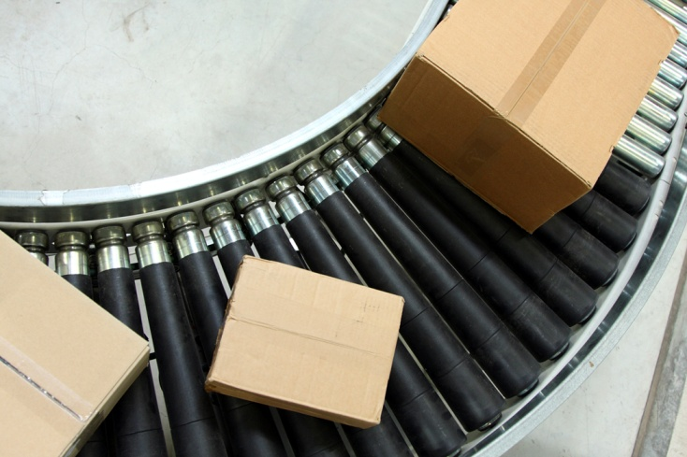
Begin Goods Receiving
Return to Table of Contents

Slide 13
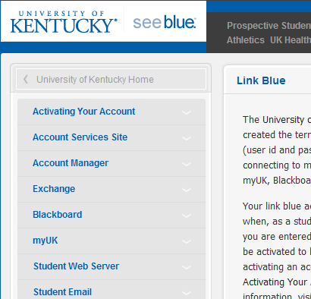
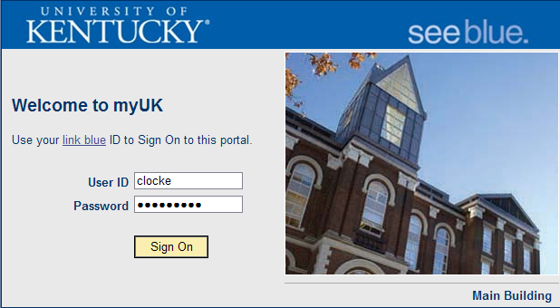
Login to myUK
1. Click Link Blue from the UK Home Page
2. Click myUK from the Link Blue site
3. Login to myUK using your AD and password
Return to Table of Contents

Slide 14
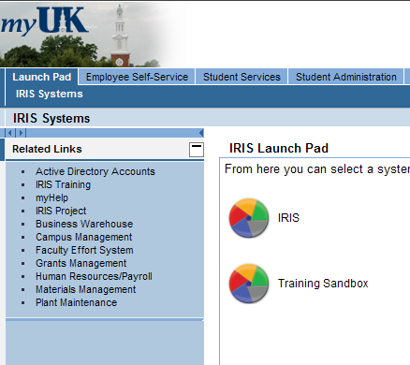
Launch Pad
4. Click the Launch Pad icon to enter SAP
Return to Table of Contents

Slide 15
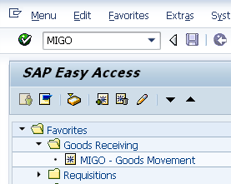
SAP Easy Access
5. The SAP Easy Access menu will appear. Enter T-code MIGO to open the Goods Receiving screen.
TIP: You can also create customized folders and list T-code Favorites that you may use repetitively
Return to Table of Contents

Slide 16
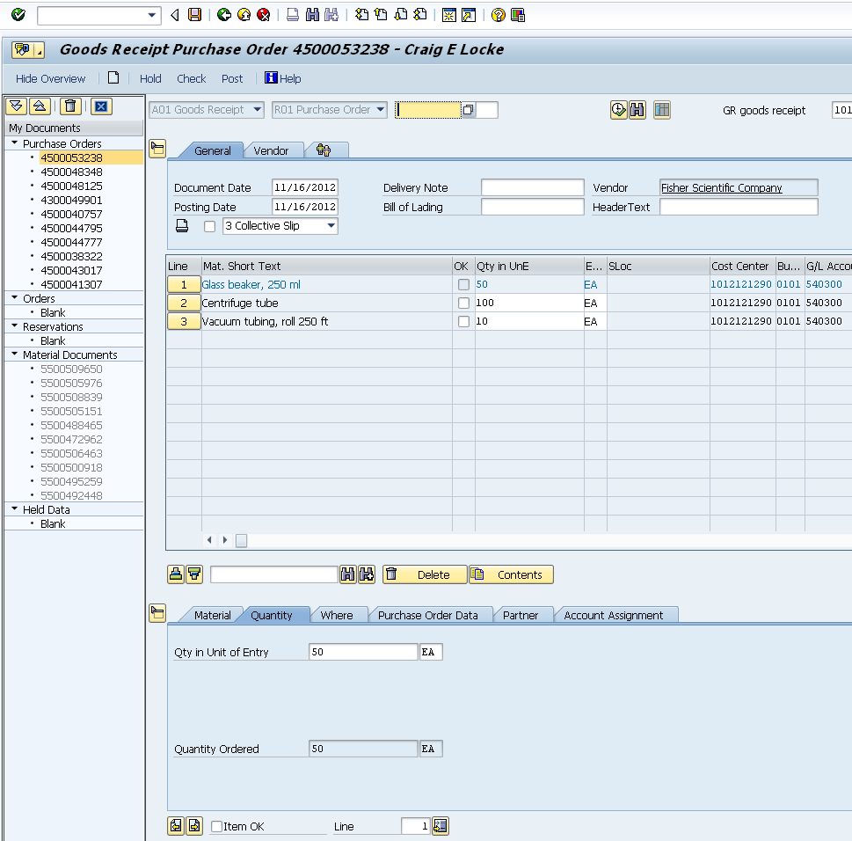
Goods Receipt Major Sections
Header (Top)
Item Overview (Middle)
Document Overview
Item Details (Bottom)
Return to Table of Contents

Slide 17
Goods Receipt Layout – Header (Top)
Contains header type information including document date, posting date, PO vendor, etc.
Return to Table of Contents

Slide 18
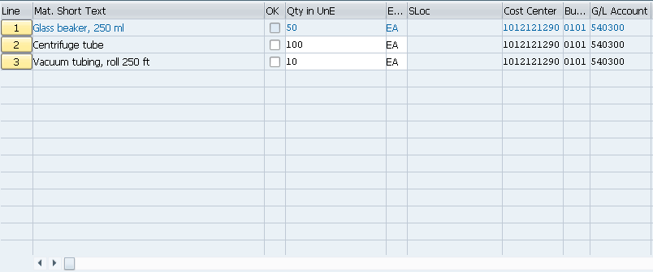
Goods Receipt Layout – Item Overview (Middle)
Item Overview section shows ordered items in line item format. The line item data draws directly from the purchase order record.
Data includes description, quantity remaining to receive, unit of measure, cost center, etc.
Return to Table of Contents

Slide 19
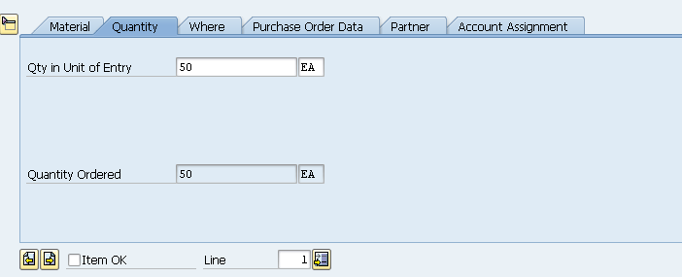
Goods Receipt Layout – Item Details (Bottom)
Item Details (bottom) section contains tabs and information relevant to each line item
Information can include quantity to receive, unloading point, direct link to purchase order, etc.
Move between line items using the < > buttons
Return to Table of Contents

Slide 20
Goods Receipt Layout – Document Overview
Turning Document Overview off will collapse it for more screen space
Document Overview is on the left side of the screen. It displays a record of goods receipts as you create them.
Return to Table of Contents

Slide 21
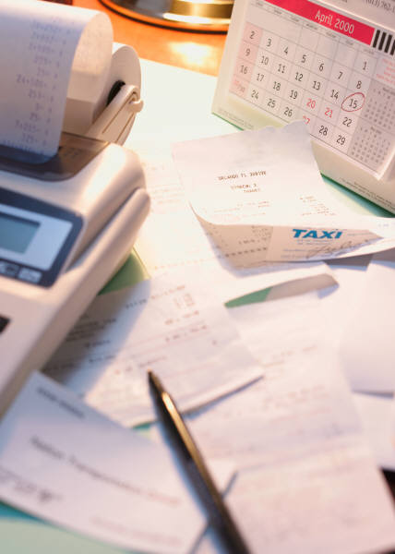
Create Goods Receipt
Return to Table of Contents

Slide 22
Create Goods Receipt - Begin
1. Select Goods Receipt from drop down menu
2. Enter purchase order number
3. Click execute icon
Return to Table of Contents

Slide 23
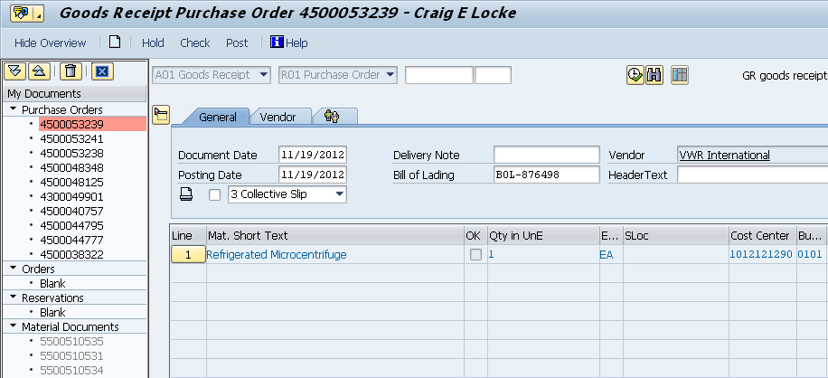
Create Goods Receipt
Document and posting dates populate automatically
4. Optional: Receiver may place header delivery note and/or Bill of Lading number
Line items flow in from purchase order with quantity and unit of measure
Return to Table of Contents

Slide 24
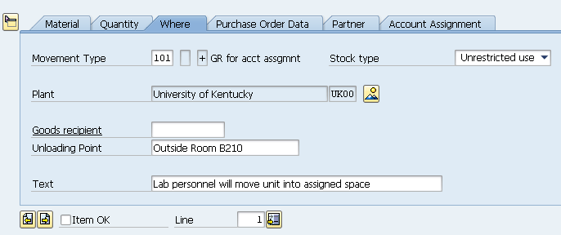
Create Goods Receipt
5. Click on the Where tab within the Item Details section. Enter notes regarding unloading point or other relevant text notes.
Return to Table of Contents

Slide 25
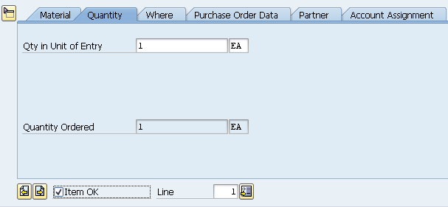
Create Goods Receipt – Confirm Line Item
6. Confirm quantity being received is correct
7. Check Item OK
Remember: If you are receiving an order with multiple lines, click the < > buttons to move between line items.
Return to Table of Contents

Slide 26
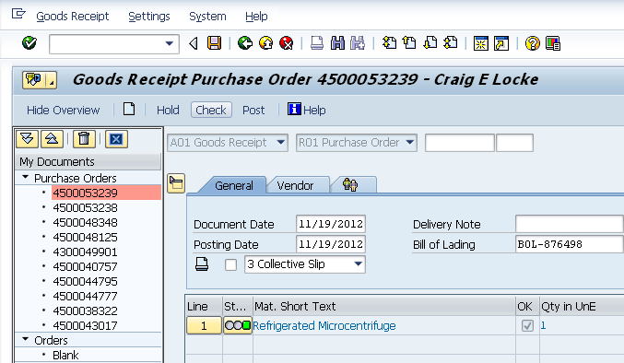
Create Goods Receipt - Finish
8. Click Check for errors
9. Click Save to finish
Material document number shows in bottom left corner
Return to Table of Contents

Slide 27
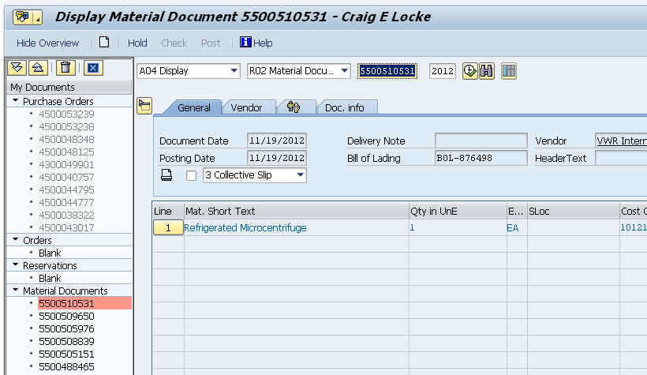
Display Goods Receipt
Document overview section keeps a record of all goods receipts you create.
1. Select Display from dropdown
TIP: You can also enter a Goods Receipt number in this cell and click execute
2. Locate and double-click the goods receipt number
3. Goods Receipt displays on screen
Return to Table of Contents

Slide 28
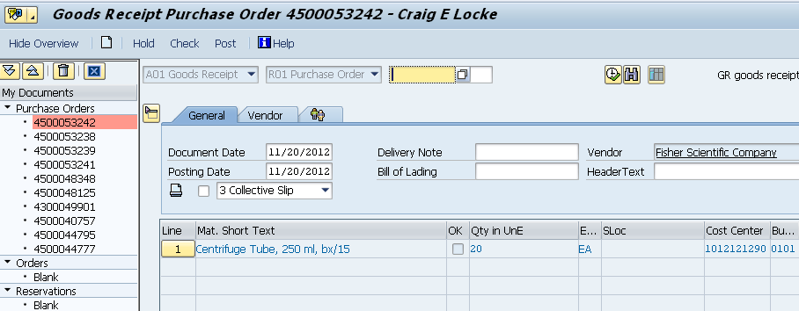
Partial Goods Receipts – Begin
A
Goods receivers can create partial receipts. The user can receive on select lines or partial quantities within a line.
1. Begin goods receipt as normal
Return to Table of Contents

Slide 29
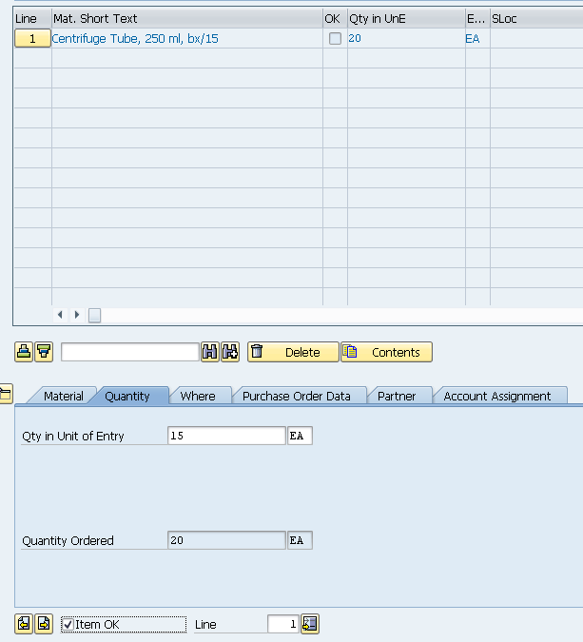
Receive Partial Quantities by Line Item
2. A total of 20 each were ordered. Goods receiver can modify Qty in Unit of entry to the actual number received (15).
3. Click Item OK
Return to Table of Contents

Slide 30
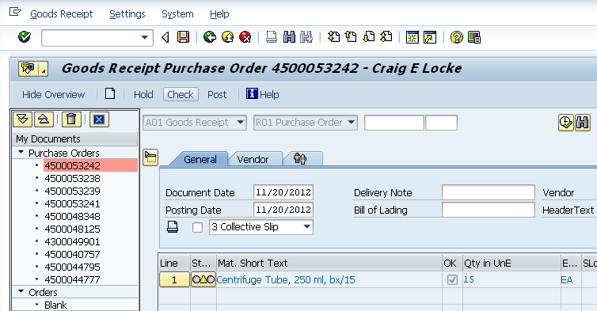
Receive Partial Order – Finish
4. Click Check for errors and Save to finish
Goods receipt shows partial quantities received in Item Overview section
Partial goods receipt completed successfully
Return to Table of Contents

Slide 31
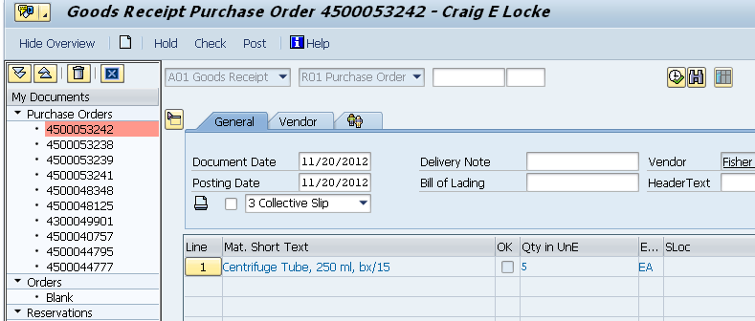
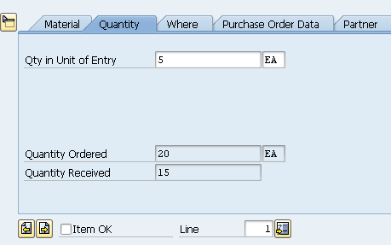
Receive Partial Order – PO Update
A
After a partial goods receipt is created, the purchase order updates quantities received. When additional goods receipts are created, the new document(s) will reflect only the remaining balance yet to receive.
Subsequent goods receipts against the purchase order show only remaining items and quantities
Return to Table of Contents

Slide 32
Cancel Goods Receipt – Overview
Occasionally it may be necessary to cancel a goods receipt. Reasons for cancellation could be:
Damaged goods discovered after unpacking
Incorrect quantity was entered
Goods receipt created against incorrect PO number
Goods receivers may cancel:
All items on a goods receipt
Only specific lines on a goods receipt
The quantity received for a given line item cannot be canceled. If a specific line item quantity is incorrect, the entire line must be canceled.
Canceled line items return to the purchase order record.
Return to Table of Contents

Slide 33
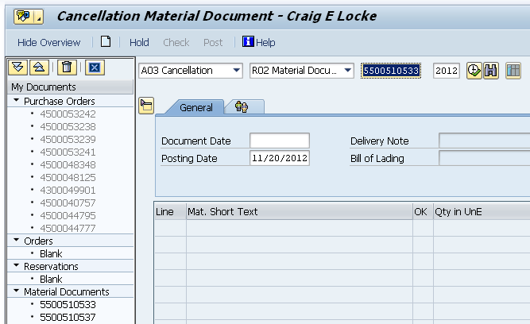
Cancel Goods Receipt
1. Select Cancellation from dropdown menu
2. Double click on Goods Receipt number from within Document Overview
Return to Table of Contents

Slide 34
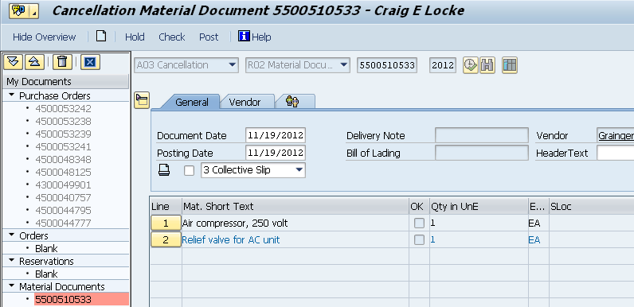
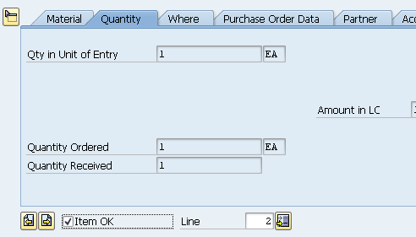
Cancel Goods Receipt
Cancellation initially shows all items on the original goods receipt
3. Within the Details section, click Item OK for lines to cancel. Click the < > buttons if moving between multiple lines.
Return to Table of Contents

Slide 35
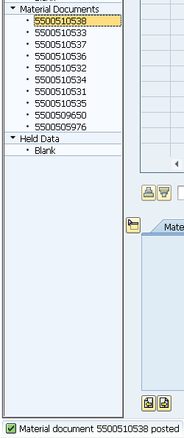
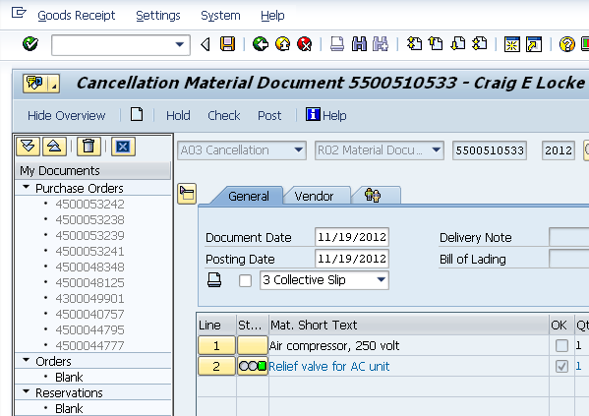
Cancel Goods Receipt – Finish
4. Cancellation shows line item 2 only is canceled. Click Check for errors. Click Save to finish.
Cancellation is assigned a unique document number. Document is accessible within document overview if needed.
Return to Table of Contents

Slide 36
Supplementary Tasks
Return to Table of Contents

Slide 37
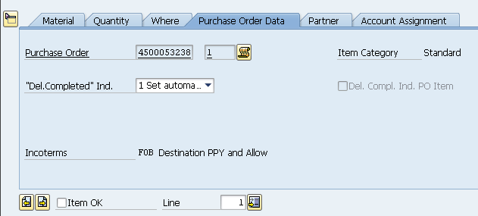
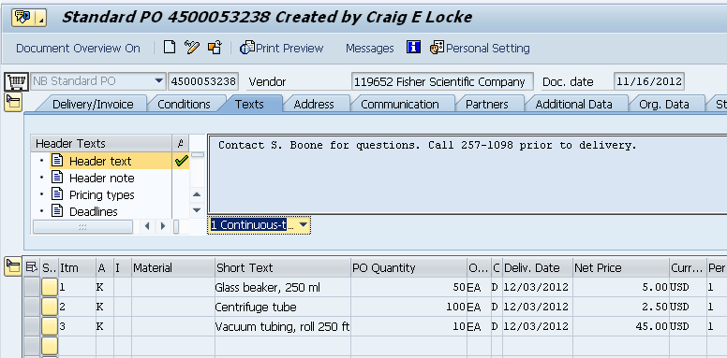
Display Purchase Order from Goods Receipt
If needed goods receivers can access and display the purchase order from within the Goods Receipt screen
Double-click the Purchase Order number on Purchase Order Data tab within Details section
Corresponding purchase order will display
Return to Table of Contents

Slide 38
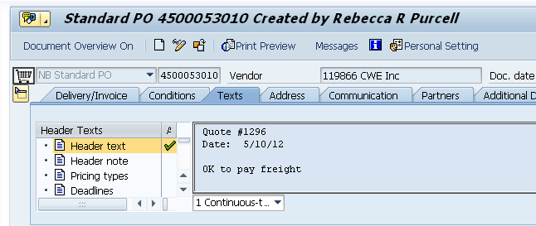
How Determine Assigned PO Purchasing Buyer
If needed for assistance the buyer responsible for the purchase order can be found at the top of the screen.
The assigned buyer can be found on the purchase order in the header section
Return to Table of Contents

Slide 39
Numbering Conventions for Purchase Orders
Purchase orders follow numbering conventions that correlate with the campus sector in which the requisition originated.
PO Number Format Area
43XXXXXXXX Facilities using Plant Maintenance (PM) system
45XXXXXXXX Hospital NB Requisitions
47XXXXXXXX Hospital ZB Requisitions
Return to Table of Contents

Slide 40
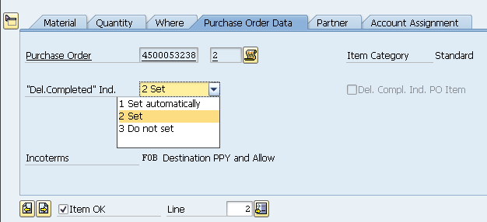
Setting Delivery Complete Indicator
If completing partial receiving and the remaining line item quantity is no longer needed, you can set the Delivery Completed Indicator to release the remaining encumbrance and close the line item.
From the Purchase Order Data tab within Details section, select “Set” from the Del. Completed Ind. dropdown
Note: If receiving on the full quantity of a line item, SAP automatically sets the Delivery Completed Indicator. It is only set manually if you are receiving less than a full quantity and do not plan to receive the remaining quantity.
Return to Table of Contents

Slide 41
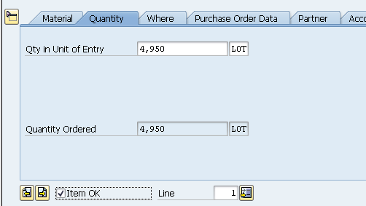
Create Goods Receipt against “Reverse” PO’s
Some types of purchase orders are setup in “reverse” format. Reverse orders are setup as one line item with a lump sum dollar amount for the entire order, regardless whether the quote has multiple lines. Reverse format is usually used for complex orders such as furniture or printing. When goods receipts are created against reverse purchase orders, the received quantity must be on the dollar amount of the order.
Reverse PO is setup on dollar amount of the order and using LOT as the unit of measure
Goods Receipt must be created against the dollar amount of the order rather than a physical quantity. Both complete and partial receipts are permissible against reverse purchase orders.
Return to Table of Contents

Slide 42
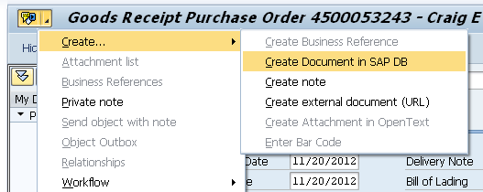
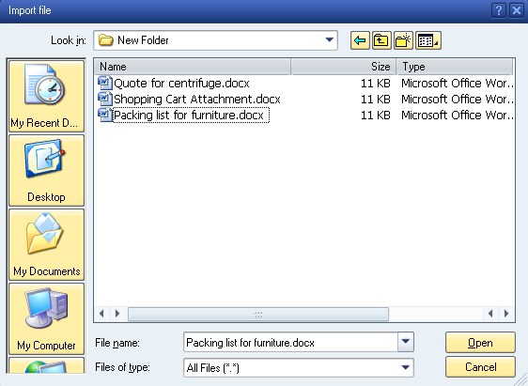
Create Attachment
Documents can be attached to the Goods Receipt if desired (optional).
2. Locate and highlight file
1. Click right side of Services for Object icon in top left corner of screen. Select Create Document in SAP DB.
3. Click Open to finish
Return to Table of Contents

Slide 43
Naming Convention for Attachments
When creating attachments, refrain from inserting special characters, such as @, #, $, *, \, ‘, +, etc. into the filename.
Filenames should also not include spaces between words nor underscores. They should be named with a purely alphanumeric format.
Examples of suitable filenames:
Medtechquote1001.pdf
Furniturelayout.doc
Examples of unsuitable filenames:
API Printing Quote.pdf (filename includes spaces)
Fisher+incubator $1000.doc (filename includes special characters)
Only the following file formats are acceptable as attachments:
PDF, XLS, XLSX, DOC, DOCX, TXT, TIF, BMP, GIF, HTML
Return to Table of Contents

Slide 44
Helpful Icons within MIGO
Hold – Click to place goods receipt on hold and to finish at a later time
New – Click to begin new goods receipt from within MIGO screen
Post – Same as clicking the Save icon to finish document
Return to Table of Contents

Slide 45
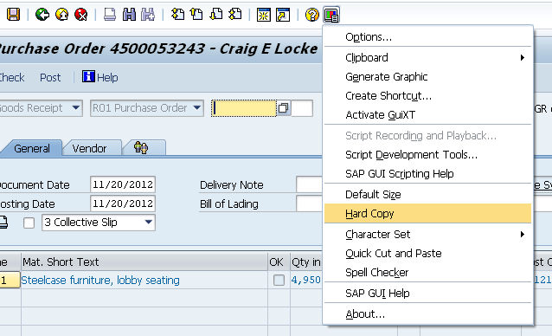
Obtaining Hard Copy of Goods Receipt
A hard copy of the Goods Receipt can be printed if desired
1. Click Customize Local Layout button
2. Select Hard Copy from the menu
Return to Table of Contents

Slide 46
Changes to PO Quantities
Changes may occasionally need made to a purchase order quantity. For instance, imprinted promotional goods frequently have over-runs due to the imprinting process.
Example: A department orders 1000 imprinted ink pens; the vendor ships and invoices 1025 pens as result of the manufacturing process
To facilitate the over-run, the purchase order must be increased to the new quantity before the goods receipt is completed. If the goods receipt is not created for the correct amount, the 3-way match will not complete and check payment will not process.
Contact the responsible Purchasing buyer for any orders which may include over-runs or need the quantity adjusted for other reasons.
Return to Table of Contents

Slide 47
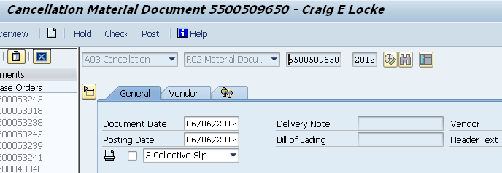
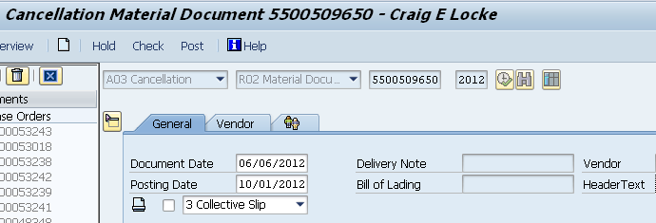
Change Posting Date – Cancellations
If canceling a goods receipt from a previous accounting period, the posting date must be overwritten to the current date.
Posting date on a cancellation automatically populates to date of the original goods receipt
Overwrite Posting Date to the current date
Return to Table of Contents

Slide 48
Diagnosing Process Problems
2. Approval (Dept / Unit / College)
4. Goods Receipt (Dept)
3. Purchase Order Sent to Supplier (Purchasing)
5. Invoice Posting / Check Payment (Accounts Payable / Hospital Accounting)
1. Create Requisition (Dept)
As an order evolves through the process, the Status tab will reflect whether subsequent documents have been created.
Problems can be frequently diagnosed based on the order status in the process.
Example: With the purchase order being in place, completion of the Goods Receipt and the Invoice Posting complete a “3-way match” allowing the check payment to release. Common problems relate to one or more of these tasks not being completed.
Return to Table of Contents

Slide 49
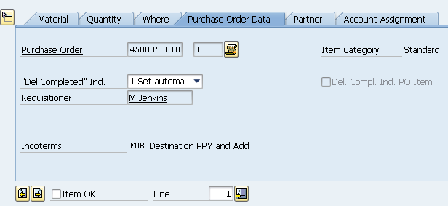
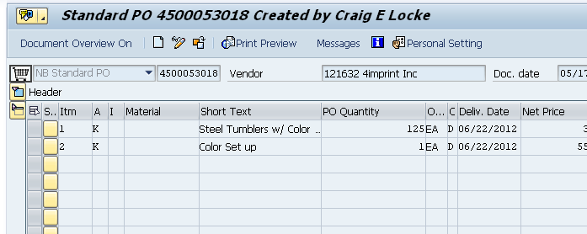
Diagnosing Process Problems
1. To check whether goods receipts and invoices are posted against the purchase order, click the PO number from the Purchase Order Data tab.
The purchase order will display
Return to Table of Contents

Slide 50
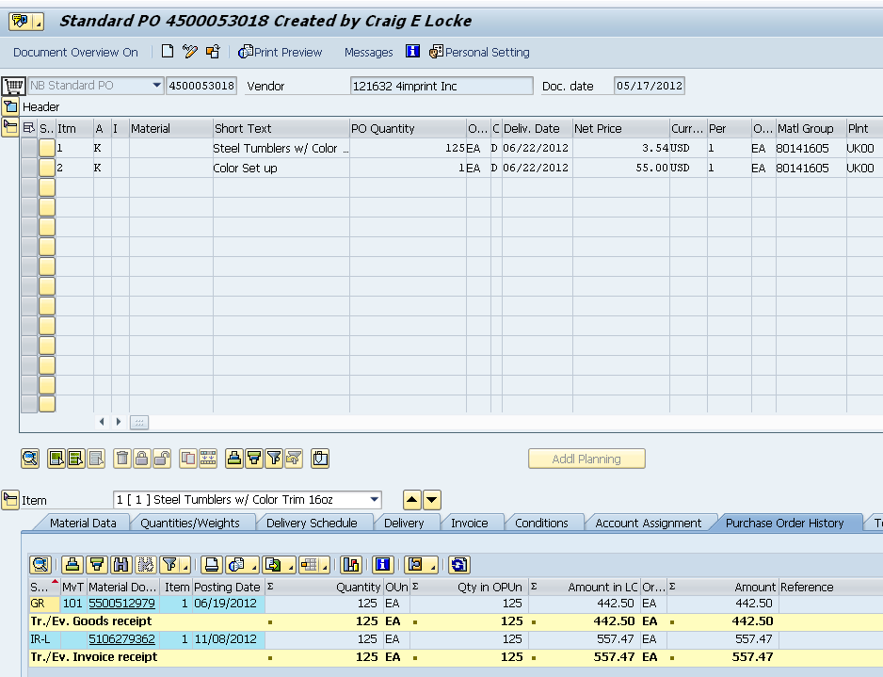
Diagnosing Process Problems
2. Go to the Item Details (bottom) section and click on the Purchase Order History tab
3. Goods receipts and invoices are posted and match the PO quantity, allowing check payment. If either is missing, or there is a mismatch, the check will not process.
Return to Table of Contents

Slide 51
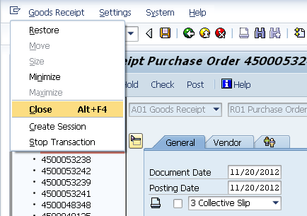
Sign Off
To close MIGO screen, click icon in upper left corner and select Close
Click Sign Off to end myUK session
Return to Table of Contents

Slide 52
SAP Help Web Sites
Resource Page on Purchasing web site: http://www.uky.edu/Purchasing/srm.htm - Site includes this PowerPoint file available for reference
myHelp – MM & Purchasing Help web site: http://myHelp.uky.edu/rwd/HTML/MM.html
Both sites contain Quick Reference Cards, updated and printable course manuals, Reference Manual, etc.
Assistance Email: UKPurchasing@uky.edu
Return to Table of Contents

