Slide 1
Using the Supplier Relationship Management (SRM) MoreDirect Punch-out Catalog

Slide 2
How to Use This Punch-out Training Guide
As desktop help references, the full SRM Shoppers Training documents are housed on the Purchasing Division website at: http://www.uky.edu/Purchasing/. The documents contains a broad perspective of the procurement system including Personal Settings, Shopping Cart tracking and Related Documents, approvals, etc.
In addition, Purchasing creates and publishes on its website smaller Quick Reference Guides customized for each punch-out catalog (i.e., this document). The punch-out guides are designed to reflect exact steps when ordering from each individual catalog.
This Quick Reference Guide material assumes the Shopper has already set their Personal Settings. If assistance is needed with Personal Settings or other features beyond what is reflected here, you may find the larger Shopper training documents to be useful.

Slide 3
What is MoreDirect?
Along with Dell and CDW-G, MoreDirect is a University contract holder for computing accessories and peripherals.
If you have a need for a computer from MoreDirect, contact Purchasing at SRMHelp@uky.edu.

Slide 4
Who Uses the MoreDirect Punch-Out Catalog
The MoreDirect punch-out catalog is used solely with the Supplier Relationship Management (SRM) system. Currently, all areas of campus use SRM as their procurement system with the exception of Hospital areas. Departments within these areas will continue to use the e-Buy site for MoreDirect purchases.
All other areas of campus should utilize the punch-out catalog through SRM for purchases of MoreDirect products regardless of price. This includes items previously purchased through the e-Buy site utilizing procurement card.

Slide 5
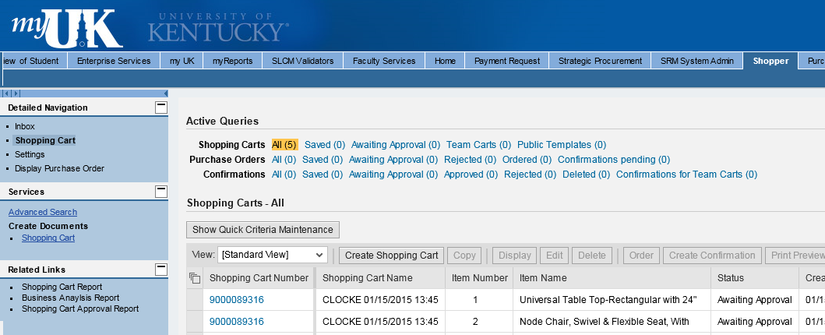
Begin Shopping Cart from POWL
1. Start from the Shopper tab within myUK
2. Select Shopping Cart from Site Navigation to display the POWL
3. Click Create Shopping Cart

Slide 6
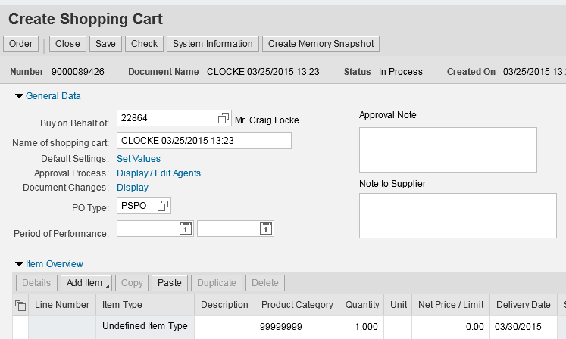
Default Settings: Set Values
Two default values – Account Assignment and Delivery Address – can be set at the beginning of the ordering process. This will copy the data to all line items as they are placed into the Shopping Cart, thus bypassing tedious line item entries later.
4. Click Set Values within Default Settings

Slide 7
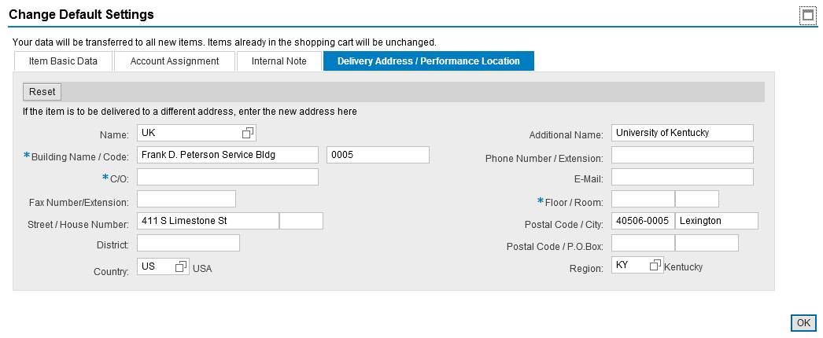
Complete Delivery Address (Required)
5. Select the Delivery Address / Performance Location tab

Slide 8
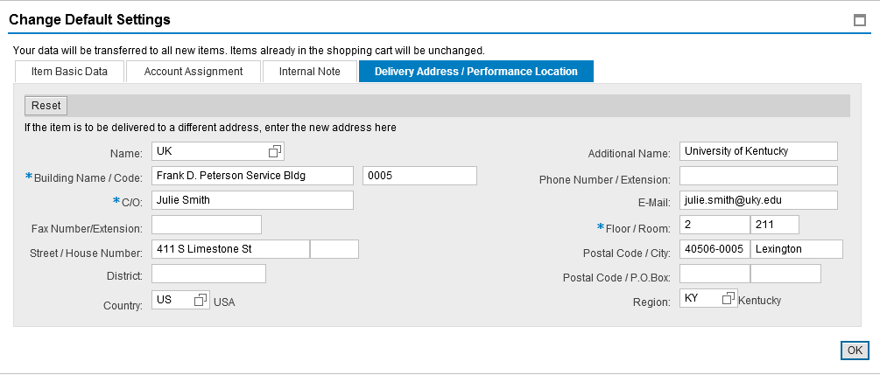
Complete Delivery Address (Required)
Delivery information flows in from Personal Settings and reflects your building address only. The Shopper must add the Contact Person, Floor, and Room Number, etc. This must be completed for each cart and will populate to all line items placed in the cart.
Important: Be sure to enter the delivery information at the header level. Bypassing entry of the contact person, floor, and room number within Set Values will require the information to be entered for each line item in the bottom Details section.
6. Complete contact person, floor, room, etc.

Slide 9
Setting an Alternate Delivery Building
At the Shopper’s choosing, you can enter an alternate building for delivery on a cart-by-cart basis. After selecting the new building by speed sort number, complete the section with contact person’s name and room and floor numbers.
If desired, click the possible entries icon and select alternate building by speed sort number. Remember to add in the contact person, floor, and room number.

Slide 10
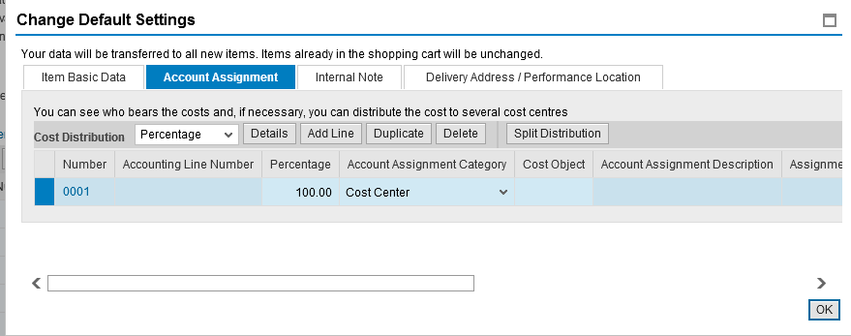
Set Account Assignment (Optional)
7. Click Account Assignment

Slide 11
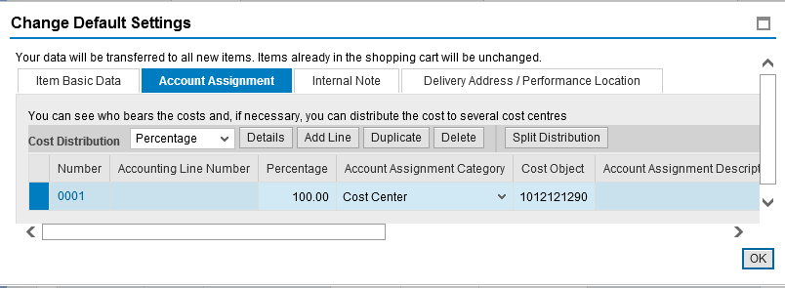
Set Account Assignment (Optional)
Enter Cost Center or WBS Element information if the entire order will be charged to the same cost object structure. Alternatively, if you need to charge various line items to different cost objects, this can be entered later within the Line Item Details.
8. Default Account Assignment Category is Cost Center. You can also select WBS Element from the dropdown if needed.
9. Enter the Cost Center or WBS Element number as applicable
TIP: WBS Elements relate to grants.

Slide 12
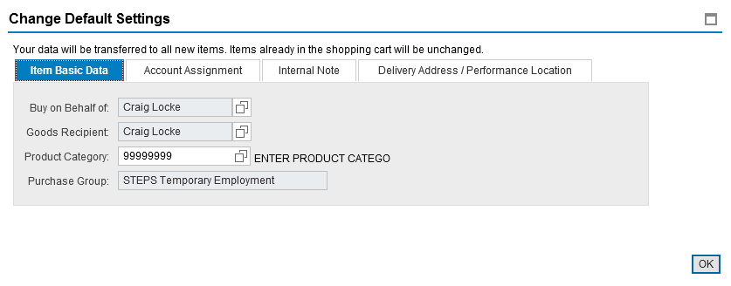
Finish Header Values
No entries are required on other tabs within Default Settings.
10. Click OK to finish Set Values

Slide 13
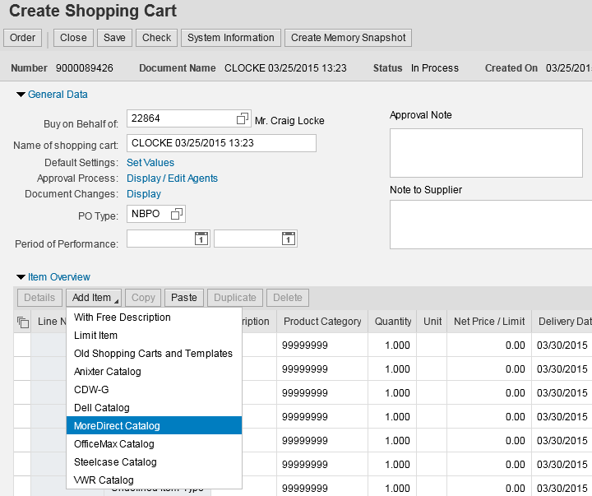
Punch-out Catalog Order – Create
Punch-out catalog items are ordered through the Add Item dropdown button. As new catalogs are added to the system, they will appear in the Add Item menu.
11. Click Add Item menu and MoreDirect catalog.
Shopper will transfer from SRM to MoreDirect’s website.

Slide 14
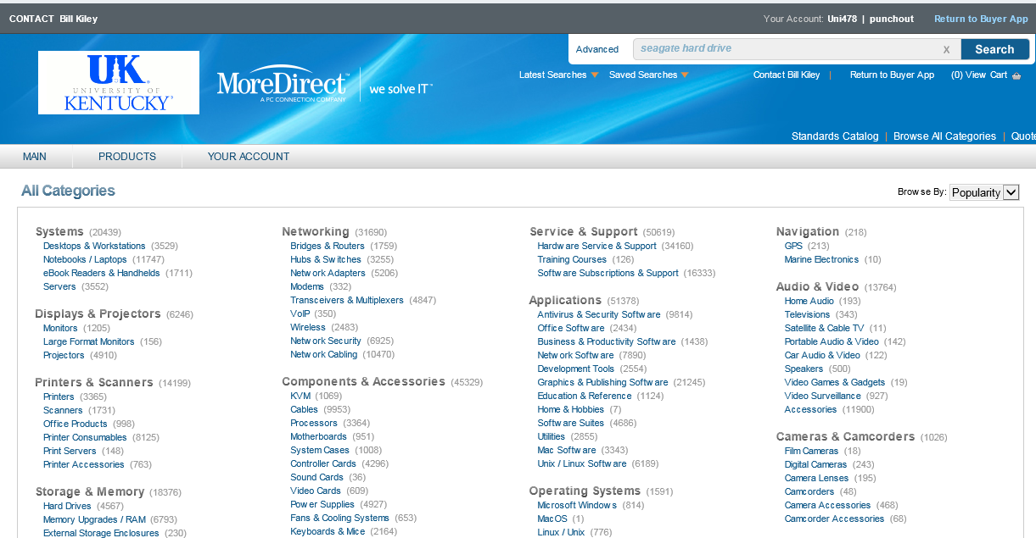
Arrive at Punch-out Landing Page
12. Shoppers can locate items by either browsing the Shop category menu…
….or using the Search feature along with relevant keyword(s).

Slide 15
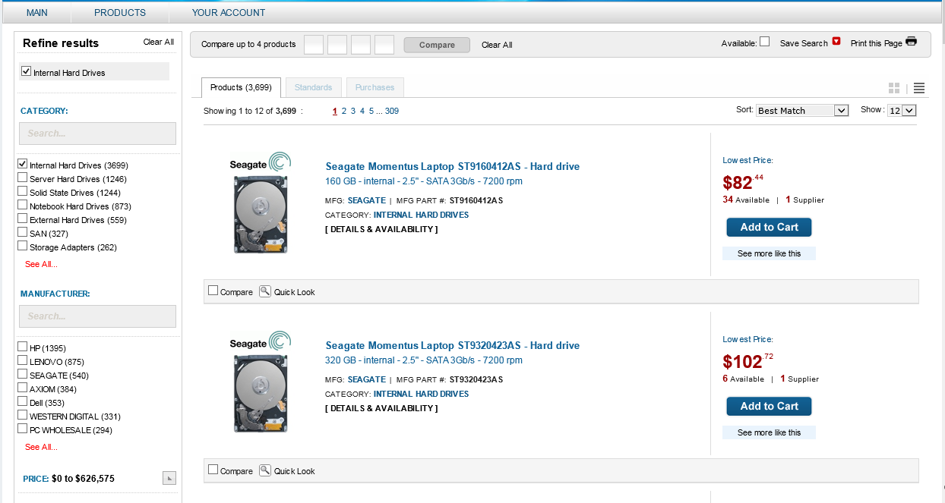
Product Search Results
If desired Shopper can select filter criteria from the left menu to narrow search results.
Other Shopping tools include: Quick Look for detailed product information, Compare Items, Sorting, See More Like This,
Sort, etc.

Slide 16
Add Desired Item to Cart
13. Click Add to Cart for item(s) you would like to purchase

Slide 17
Confirm Quantity to Add
14. From the pop-up window, enter the quantity needed and click Add.

Slide 18
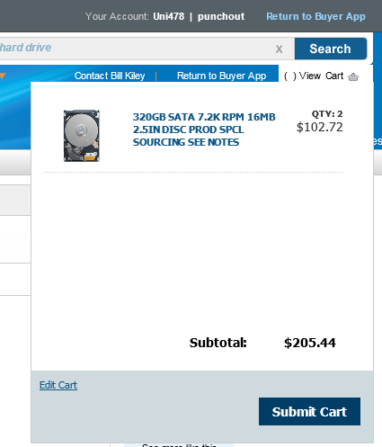
Item Adds to Cart
15. The pop-up window shows item is added to cart. Continue Shopping or if you are ready to check-out, click Submit Cart.
Note: You can also edit cart items, quantities, etc. if desired.

Slide 19
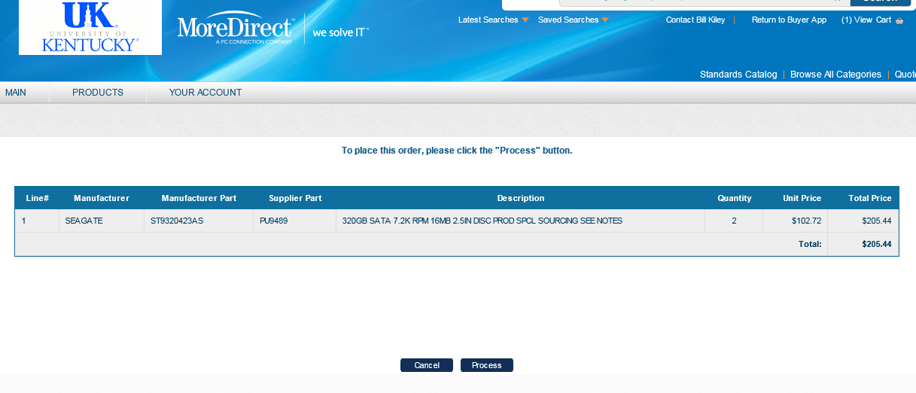
Final Review of Cart
16. Review items in cart. Ensure quantity entries are correct.
17. Click Process to check-out

Slide 20
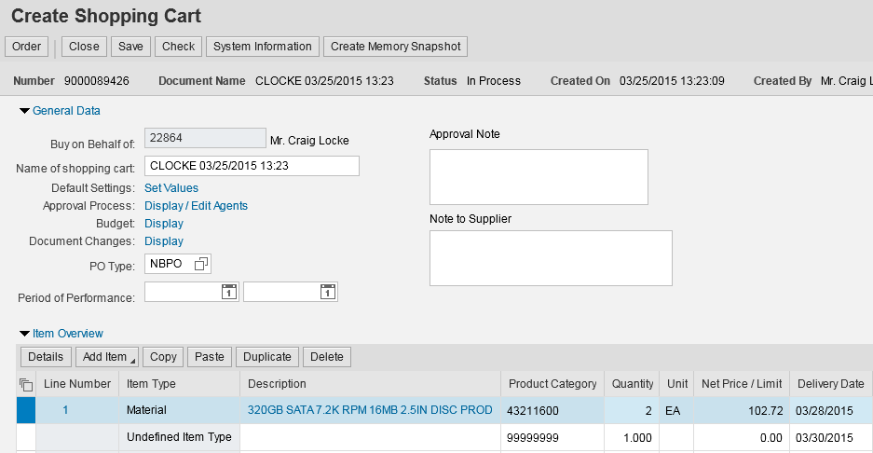
Punch-out Items Return to SRM Shopping Cart
Note: All product info transfers to SRM Shopping Cart including description, quantity, price, UOM, and supplier name.
Selected items from punch-out site transfer to the SRM Shopping Cart

Slide 21
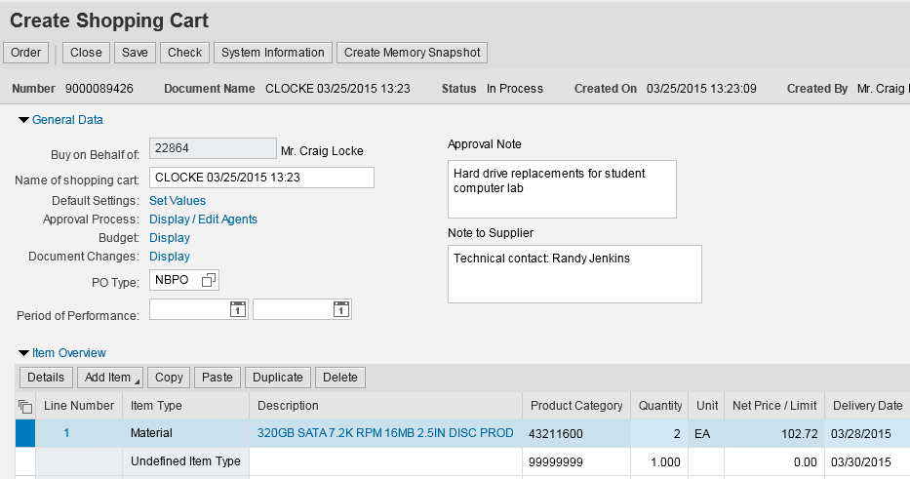
Complete Header and Item Overview
18. Add Header Notes if desired (Optional). Approval Note is internal and does not print on purchase order. Note to Supplier will print on purchase order.
19. Shopper can overwrite Delivery Date if desired
20. Click Details to open bottom section.

Slide 22
Punch-out Catalog Order – Details Section
The bottom section of the Shopping Cart is termed “Item Details”. It contains additional information relating to the purchase such as Account Assignment, Notes and Attachments, etc. and is edited on a line item basis, i.e., each line item can be assigned different notes, etc. if desired.

Slide 23
Punch-out Catalog Order – Account Assignment
Account Assignment entries can be formed at the line item level within the bottom Item Details section.
Remember: If you already set the Account Assignment Information within Default Values: Set Values at the header level, you can bypass this section.
21. Select the Account Assignment Category (either cost center or WBS element).
22. Enter the cost center or WBS element number

Slide 24
Punch-out Catalog Order – GL Account
TIP: The General Ledger (GL) Account is an accounting component that relates to the description of the goods or services purchased.
23. A suggested GL will populate automatically on many carts or can be entered/overwritten as needed. The Shopper should check the GL to ensure it is correct based on the nature of the particular purchase.
Note: If ordering a single item that is over $5000, a capital equipment GL must be assigned to that line item. A capital GL is prefixed with 55XXXX and can be selected from within the search function.
If needed, you can click on the right side of the GL box to access a Possible Entries icon and search function.

Slide 25
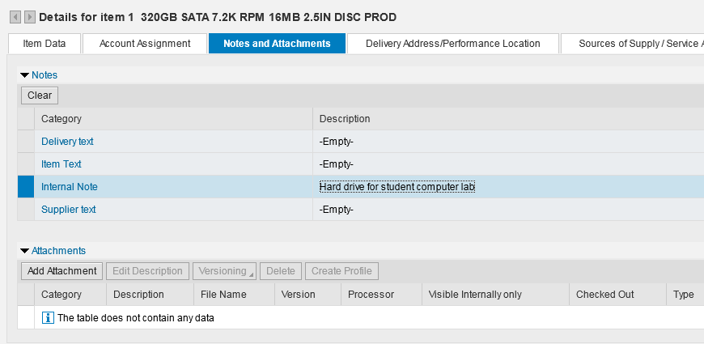
Punch-out Catalog Order – Line Item Notes
24. If desired, you can enter Notes and Attachments for individual line items. Internal Note does not print on the purchase order. All other notes will print on the purchase order to supplier.
TIP: Quotes are not required for punch-out orders. Thus, quote attachments here are not applicable.

Slide 26
Punch-out Catalog Order – Line Item Delivery Address
Provided you entered the Delivery Address information within the Default Values: Set Values section at the header level, nothing needs entered here.
Remember: If you already set the Delivery Address Information within Default Values: Set Values at the header level, you can bypass this section. If you omitted that step, the contact person, floor and room number will need entered manually for each line.

Slide 27
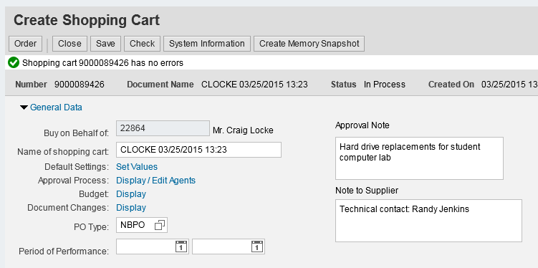
Punch-out Catalog Shopping Cart – Check & Order
Note: Only click the SAVE button if the order is to be placed on HOLD and finished later.
A Saved Shopping Cart resides in the Shopper’s POWL and does not move forward to the Approver.
25. Click Check to confirm whether errors exist
26. Click Order to finish

Slide 28
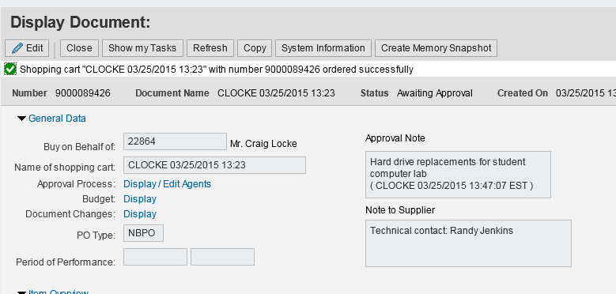
Punch-out Catalog Shopping Cart – Complete Order
27. Click Close button to close window

Slide 29
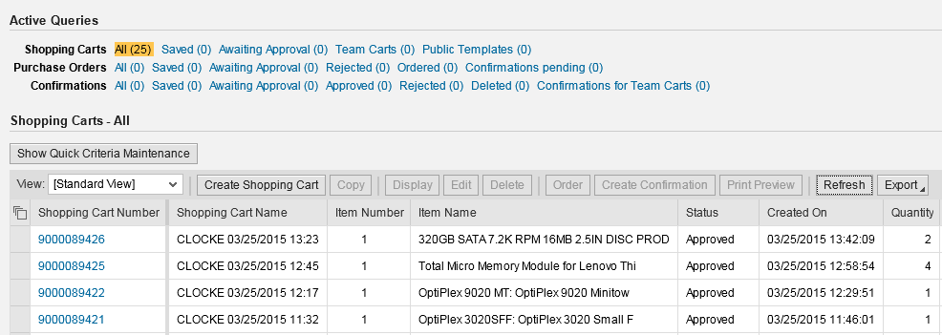
Punch-out Catalog Shopping Cart-Status from POWL
Click Refresh to see current Shopping Cart Status
Shopping Cart will be listed in the POWL and can be accessed by clicking on the cart number.

Slide 30
Special Notes on MoreDirect Punch-out Shopping Carts
Special features are added to SRM for MoreDirect punch-out catalog orders:
Orders totaling less than $5000 from the MoreDirect punch-out catalog do not require approval. SRM automatically transmits a purchase order once a cart is created and ordered.
For orders over $5000, SRM automatically transmits the purchase order after the appropriate approvals have taken place.
Goods Confirmations are required for all MoreDirect punch-out catalog orders.
MoreDirect generates an electronic invoice and submits to Accounts Payable for payment.
The Shopper receives an email message confirming when the invoice posts. To maintain a system of checks and balances, the Shopper’s supervisor is copied on the email notification.

Slide 31
SRM Help Web Sites
SRM Resource Page on Purchasing web site: http://www.uky.edu/Purchasing/srm.htm
myHelp – MM & Purchasing Help web site: http://myHelp.uky.edu/rwd/HTML/MM.html
Both sites contain Quick Reference Cards, updated and printable course manuals, Reference Manual, etc.
SRM Assistance Email: SRMHelp@uky.edu

